Slide 1
St Helens NHS Place Director’s Report ICB Board 4th August 2022

Slide 2
Contents
 | Item
1 | History of St Helens
2 | Introduction and Context
3 | Our Integration Journey
4 | People’s Plan 2022-27 (St Helen’s Place Plan)
5 | Place Priorities
 | Item
6 | Inequalities Agenda
7 | Engaging with People and Communities
8 | Place Delivery and Governance
9 | Big Ticket Items for 2022/23

Slide 3
1. History of St Helens

Slide 4
1. History of St Helens
The development of the town was spurred on by the rapid population growth in the region during the Industrial Revolution. Between 1629 and 1839 St Helens grew from a small collection of houses surrounding an old chapel, to a village before becoming the significant urban centre of the four primary manors and surrounding townships that make up the modern town.
Glass producer Pilkington is the town's only remaining large industrial employer; previously, it was home to Beechams the Gamble Alkali Works, Ravenhead United Glass Bottles, Triplex, Daglish Foundry and Greenall’s brewery.
1881 - Horse drawn trams begin running in St Helens
1884 - The Providence Hospital opens
1885 - St Helens sends its first MP to parliament
1893 - Samuel Taylor gives Taylor Park to the town
1899 - The first electric trams run in St Helens
1911 - The first cinema in St Helens opens
1946 - The last trams run in St Helens
1974 - St Helens is made a metropolitan borough
1991 - Sutton Manor Colliery Closes
2009 - The Dream unveiled
2009 - St Helens becomes part of the Liverpool City Region
2021 - St Helens RFC won the Super League Championship for the 9th time
Timeline
1552 - A chapel dedicated to St Helen is mentioned for the first time. The town takes its name from the chapel.
1746 - A turnpike road is built to Liverpool
1762 - A canal is cut. Coal mining in the St Helens area booms.
1773 - The British Cast Plate Glass Manufacturers opens. Glass making in St Helens booms.
1826 - William Pilkington founds a glassworks in St Helens
1828 - Josias Gamble sets up a chemical works in St Helens
1833 - The railway comes to St Helens
1839 - St Helens Town Hall is built
1868 - St Helens is given a corporation and mayor
1876 - A new Town Hall is built
St Helens RFC 'Saints’ is the most successful teams of the modern Super League era

Slide 5
2. Introduction and Context

Slide 6
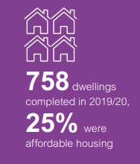
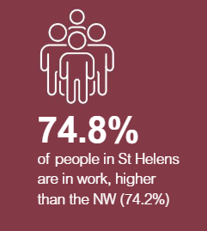
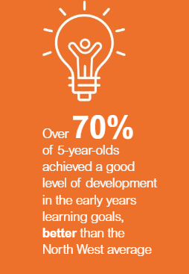
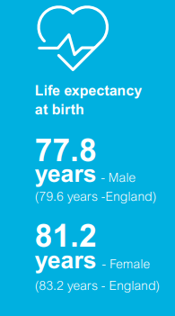
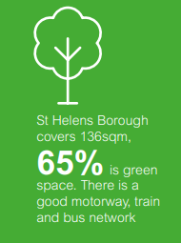
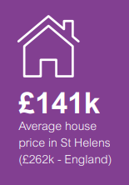
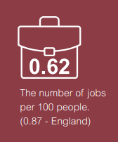
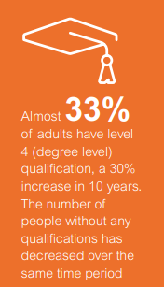
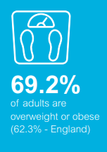
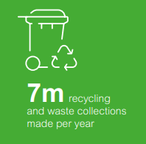
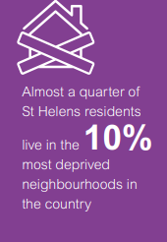
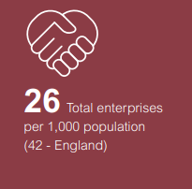
Key Statistics
£146m
Council Budget

Slide 7
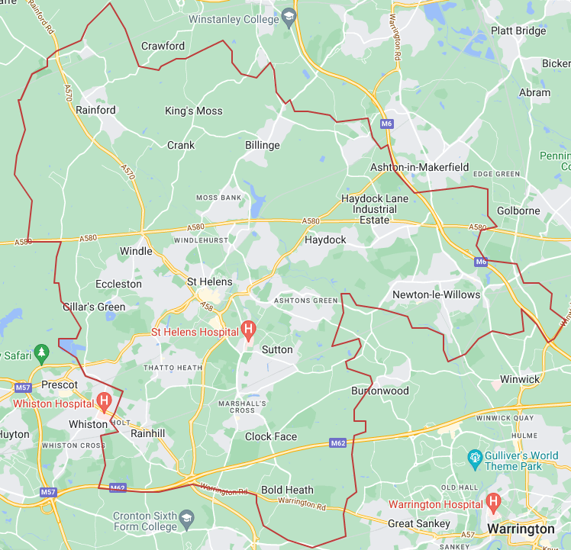
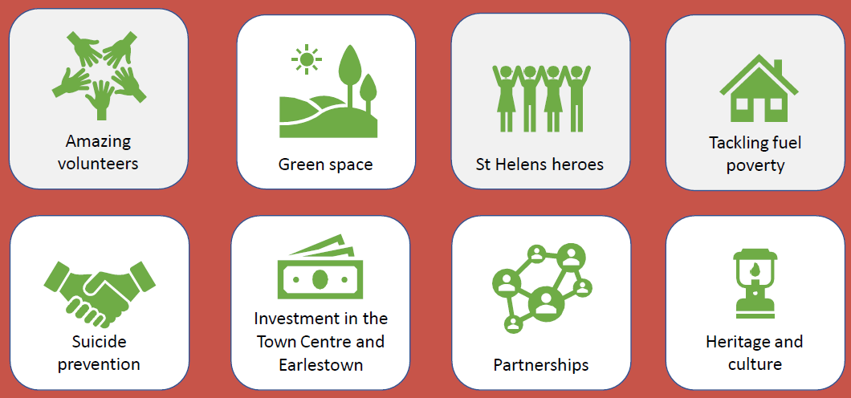
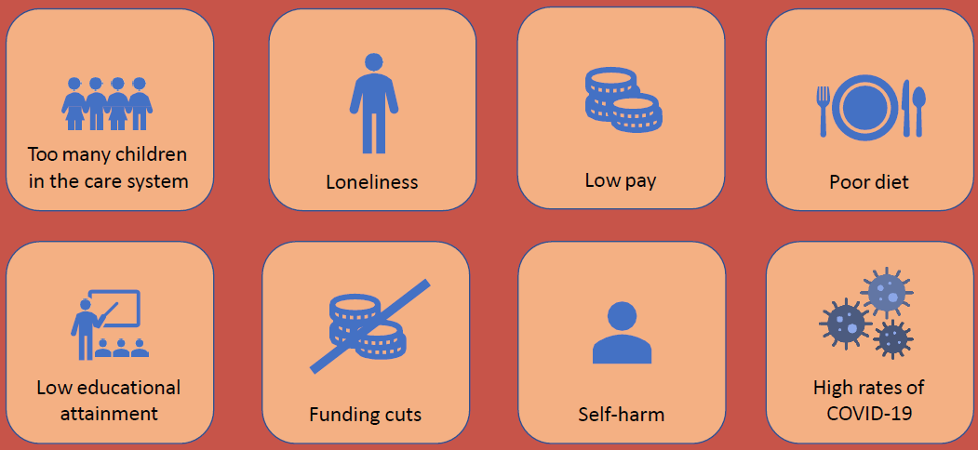
1. Introduction to St Helens
Assets
St Helens is one of 6 local authorities in the Liverpool City Region
Challenges
Area covers a total of 135 square kilometres, of which approximately half is rural and half is urban
Home to 180,049 people with 198,041 registered patients in 34 GP practice

Slide 8
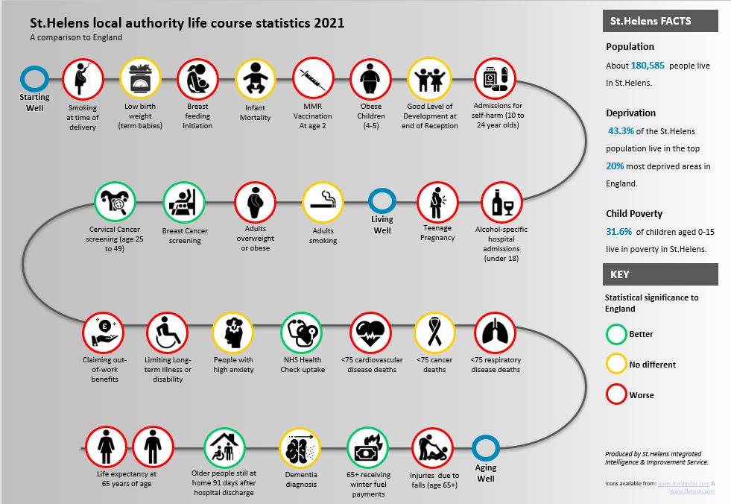
Context –
Borough

Slide 9
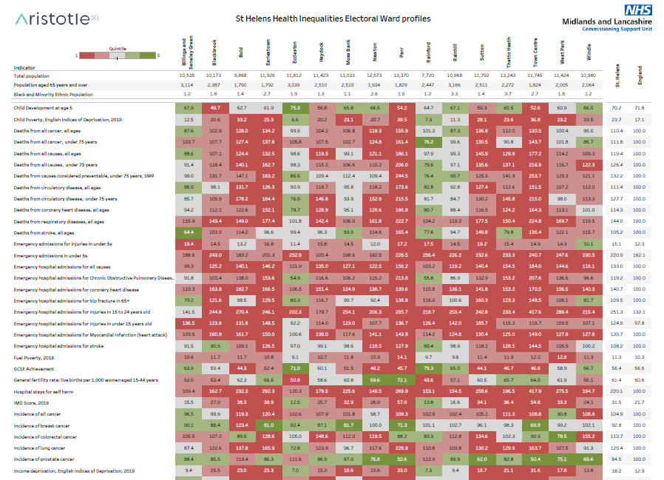
Our Tartan Rug
Indicators at ward level

Slide 10
3. Our Integration Journey

Slide 11
2. St Helens Cares Integration Journey
2018
2019
2020
2021
2022
Initial Integration
Embedding Integration
Responding to the Pandemic
Designing future Place Working
Delivering at Place & System
Joint AO and LA Exec Director Post
Joint Exec Leadership Team
Contact Cares Established
Shared Care Records
Integrated BI Team (LA/Trust/CCG)
PCNs Established
S.75, MOU & governance set up & Stakeholder forum
Launch of Contact Cares with SPOC
Rapid response enabled by Integration & partnership
CIPHA Pilot established at Place
First MVC in C&M delivering more than 500,000 jabs
Cancer line in place
New AO appointed
New place plan launched with focused priorities
Vax Bus roaming serving borough’s underserved
Children and Families Hub in place
C&M ICB and Place Launch
Deliverables this year:
Care Communities
Health Innovation Hub
Food Pantries Expansion
Hope Pathway
Life Rooms

Slide 12
3. People’s Plan 2022 – 2027 (St Helens Place)

Slide 13
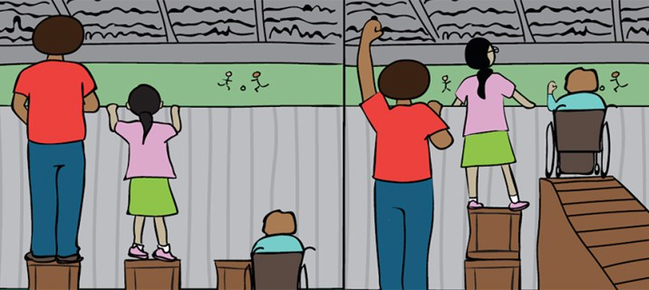
3 St Helens Place Based Partnership Plan
Our Vision
Our Priorities
One Place, One System, One Ambition
Improving people’s lives in St Helens together
1. Mental Wellbeing
By 2026, we will
A. Support people who are at risk of self-harm
B. Reduce Alcohol dependency in the Borough
C. Improve personal wellbeing in the Borough
By 2027, we will
A. Prevention and reduction of self-harm and suicide
B. Expand VCS capacity to support mental health and wellbeing
C. Improve the wellbeing of children and young people
Our Mission
2. Healthy Weight
Bringing people closer together, by tackling health inequalities in St Helens
By 2027, we will:
A. Support healthy eating choices in the Borough
B. Encourage residents to lead a more active lifestyle
C. Reduce diabetes
3. Resilient Communities
By 2026, we will:
A. Supporting people to live independently
B. Reduce social isolation and loneliness
C. Embed multi-sector/disciplinary team working in our four localities/networks
By 2027, we will:
A. Supporting people to live independently​
B. Reduce social isolation and loneliness​
C. Care Communities in our four localities/networks
D. Develop a Health & Care Skills Innovation Hub

Slide 14
St Helens Council Borough Strategy 2021 - 2030
LOCALITY WORKING
WORKPLACE WELLBEING
TACKLING INEQUALITIES
CLIMATE CHANGE
STRATEGIC DEFICIT
COMMISSIONING
DIGITAL TRANSFORMATION
PERFORMANCE MANAGEMENT

Slide 15
5. Place Priorities

Slide 16
Complex Lives
Training for all St Helens employers
Rapid referrals for self-harm patients
Improving the mental wellbeing of children and young people
Under 5s – Best Start in Life/ Family Hubs
Whole School Approach- BMH 0-19, Link programme, Youth Engagement Workers (Youth Provision)
Crisis Management
VCS- Community Resilience
Complex Families

Slide 17
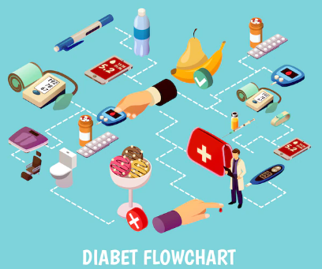
Food Pantries
Expanding our current provision of 3 Food Pantries to 10 + a mobile unit
Diabetes reduction
Stratifying and case finding citizens at risk from diabetes and putting in place preventative measures
Active Lives strategy launch – August 2022
Getting St Helens moving more

Slide 18
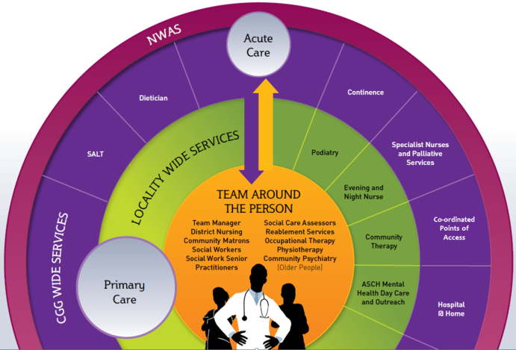
Care Communities
Care Communities pilot October 2022:
Multi-disciplinary teams centred around the PCNs
Health and Social Care Academy & Innovation Hub
Business case – Nov 2022
Pilot schemes from April 2023
Digital Developments
LTC mgt (COPD, diabetes
ED Streaming and redirection to PC & UTC
Telehealth self mgt
Falls prevention & alerts
Social Care

Slide 19
6. Inequalities Agenda

Slide 20
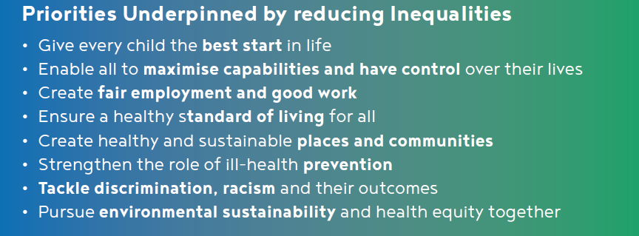
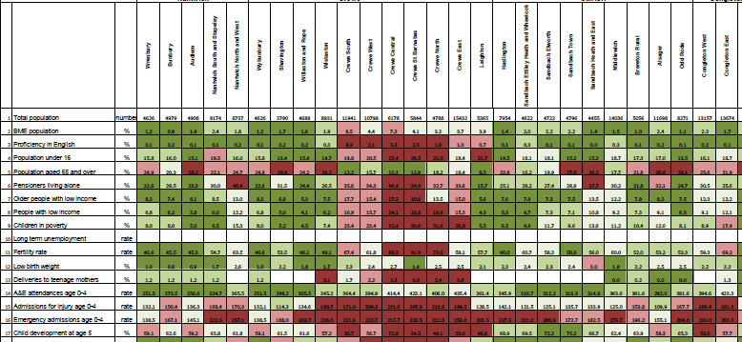
MARMOT
PHM Tools
Inequalities Commission Established 2021
Chair – CEO YMCA
Purpose:
Identify areas for local action and interventions to increase equality and opportunity
Becoming a ‘Marmot Community’
Link in with the localities approach, engage with local people and communities
Listen to local people and hear local testimony, as well as use quantitative evidence………….
Immediate Priority
Fuel and Food Crisis:
Rapid expansion of food pantry operationalised through Healthy Weight Group
Cold Homes programme - Torus
First Priority
Healthy start in life:
early years hubs
Digital exclusion
school readiness

Slide 21
7. Engaging and Co-Producing with our Communities

Slide 22
6. Engaging with People &Communities
St Helens Cares Stakeholder Forum Instrumental in providing a forum for debate on key pieces of work, for example, the St Helens People’s Plan, and understanding health inequalities in St Helens.
Healthwatch
We continued to hold listening events in partnership with Healthwatch St Helens to support the community in a number of different topics relating to health and social care. We also provide information on how to look after yourself and promote local community heath and care services and when to use them.
A bespoke online survey was designed in collaboration with St Helens council using questions on key aspects of well-being developed through the Good Childhood research programme. More than 3,200 children took part.
Talkfest
Our Talkfest events will continue going forward and will be offered in a number of ways (face to face, Virtually and via a freephone number) to make sessions accessible to all. Talkfest is our way of engaging with as many different people, communities, partners and providers in St Helens as possible including schools, workplaces, community, partners and third sector and voluntary organisations.
Children’s and Young People’s Engagement and Experience Group Made up of organisations who work directly with children and young people. The aim is to bring together all relevant organisations to ensure the voice of the child is heard and with regard to health and social care services, it ensures children and young people have the opportunity to get involved and have their say.
Working with our deaf community
During 2021/22 we worked closely with the Deafness Resource Centre to ensure our deaf community had the same access to information as the general population. Two face to face engagement sessions took place with support from BSL interpreters. The information leaflet developed was shared at the sessions and translated into a BSL video
Learning Disabilities Mortality Review (LeDeR) Programme The aim of the group is to engage and involve service users alongside parent and carers when developing material and engagement activities for our learning disabilities community.
St Helens Cares Festival
A week of sharing best practice and learning across the Place including an Awards Celebration
Residents Survey
An online survey to gain insight regarding our Place Priorities

Slide 23
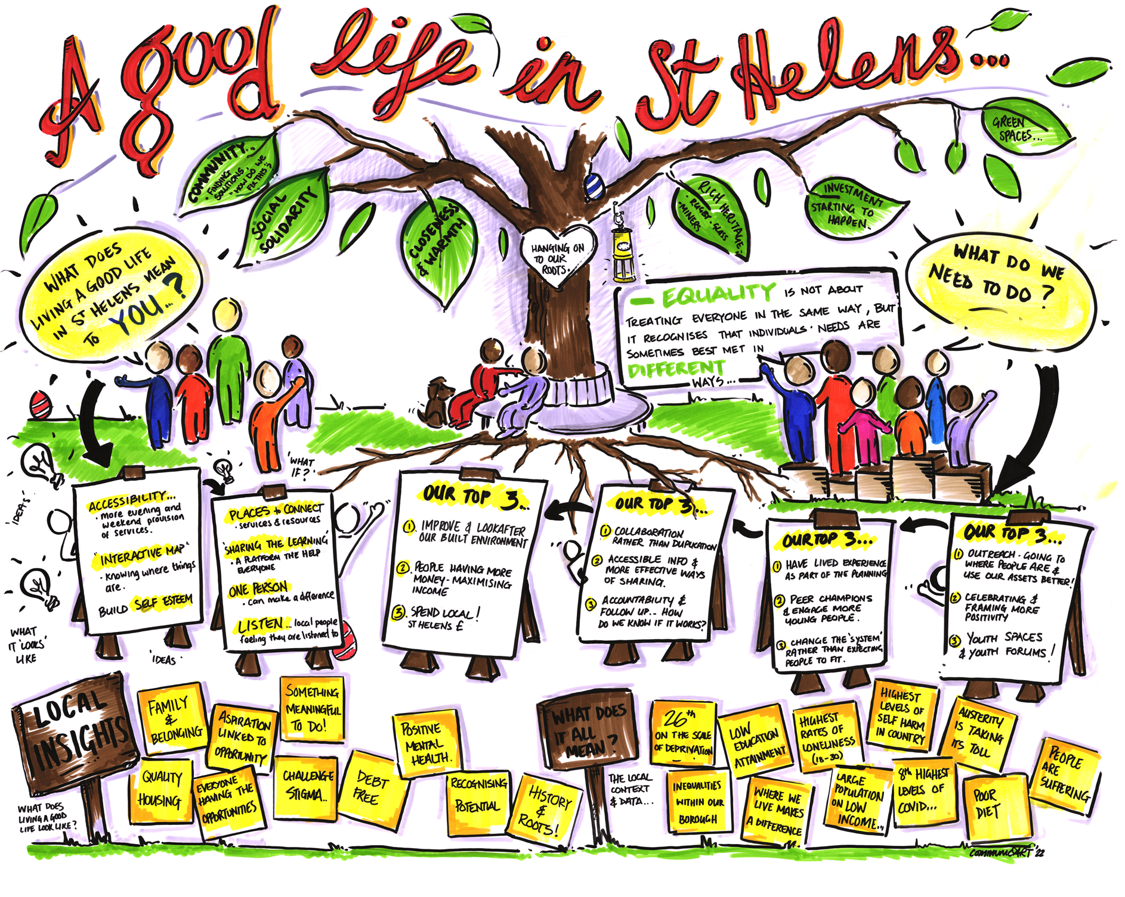
Notes:
Despite the challenges, St Helens has many assets, its people, communities, partnerships and relationships. We have set up an equalities commission and we last month we held our first community F2F in quite a while.
The theme was living ‘A good life in St Helens’ , this piece of art work demonstrates the pride, passion and love for the place that was in the room.
The leaves on the trees spell out what is great about the place
Green spaces
Investment starting the happen
Rich Heritage
Closeness and warmth
Community finding solutions
Each table came up with their top 3s. A flavour
Outreach to where people are (Care communities)
Youth spaces (project in Towns Fund)
Lived experiences as part of planning (stakeholder forum)
Maximising Income (1st priority of the Equality Commission due to recent fuel crisis). Developing a health and social care Skills & Innovation Hub
Spend Local, St Helens £ - key theme of Anchor Institution role of Trust, LA, Torus etc

Slide 24
8. Place Delivery and Governance

Slide 25
Fully Integrated Place Senior Leadership Structure across NHS and Council
NHS Place Director/Exec Director People’s Services – Joint with the LA
Director of Children's Services (LA)
Director of Adult Social Care (LA)
Director of Public Health (LA)
Associate Director of Quality & Safety Improvement
Associate Director of Finance & Performance
Associate Director Transformation and Partnerships
Director of Integration
Joint with Trust

Slide 26
St Helens Cares Place Governance
C&M Integrated Care Board (ICB)
C&M Integrated Care Partnership
Provider Organisation/Board
Provider Organisation/Board
Provider Organisation/Board
St Helens Council Cabinet
St Helens Place Partnership Board
St Helens People’s Board
C&M Provider Collaboratives
CMAST & MHLDC
NHS Place Director
Place PLT
Integrated Finance and Resources
Committee
(Section 75)
Primary Care Commissioning Committee
St Helens Health and Care Provider Alliance
Quality & Performance Group
Stakeholder Forum
Programme Delivery Group
System Resources Group
Legend
Clinical & Care Professionals Group
Mental Wellbeing
Healthy Weight
Resilient Communities
Population Health
Digital
Workforce
Estates
Finance
C&M Partnerships
Primary Care Leadership Group
Local Organisations
Delivery of Priorities
Enabling Groups
Place partnership Committee/fora
PCN & Care Community
PCN & Care Community
PCN & Care Community
PCN & Care Community
Delivery Groups
Localities

Slide 27
9. Big Ticket Items for 2022/23

Slide 28
9. Our Big Ticket Items for St Helens
Achieve the agreed shared outcomes
Significant Improvement in our Children Services
Implementation of a ‘Care Communities’ approach in our localities
Support providers to reduce system pressures in U&EC
Tackle the root causes of inequalities and promote inclusive growth
Effectively implement the significant Adult Social Care funding changes and be Inspection ready
Further integration of workforce, systems, processes and intelligence
Support the Cheshire and Merseyside ICB and the other 8 Places to improve the life chances and health and wellbeing of the population.

Slide 29
Thank you Any Questions

