Slide 1
The Kindness Collaborative creating the conditions for improvement

Slide 2
Let’s Talk About Kindness…
Notes:
Talk a lot about kindness and linked to that civility – but this is not just warm fuzzy words or inspirational quotes or pictures of cupcakes, unicorns and kittens.

Slide 3
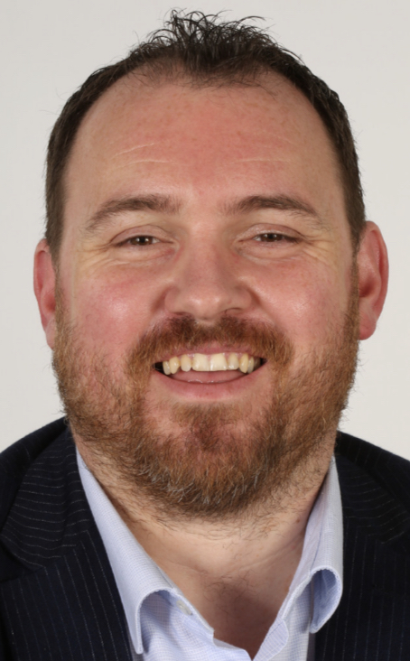
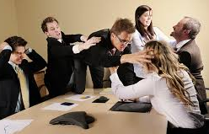
But first a story….
MY KINDNESS JOURNEY
BY
DAN GRIMES
NHS MANAGER

Slide 4
But we were not alone
The 2023 NHS Staff Survey shows that more than 1 in 4 NHS employees feel that they do not deserve the respect they deserve at work and nearly 1 in every 5 has experienced bullying, harassment or abuse from colleagues in the last 12 months.
Dr Jia Wang an academic studying incivility at work describes a silent epidemic with studies showing many tens of thousands of people worldwide report being exposed to uncivil or disrespectful behaviour at work at least once a month and that these numbers are increasing year on year.

Slide 5
So if it’s happening everywhere why does it matter?

Slide 6
THIS STUFF MATTERS
Dr Christine Porath, an expert in this field of incivility and workplace cultures and author of the book Mastering Civility: A Manifesto for the Workplace writes…
“For those who think consistent civility is an extravagance: just one habitually offensive employee critically positioned in your organisation can cost you dearly in lost employees, lost customers, and lost productivity”.

Slide 7
Some quick sums…
Nationally 1 in 4 NHS staff say they feel disrespected at work
Studies show that 48% of those exposed to uncivil behaviour reduce their time in work
1.4 million people work for the NHS in England.
So chances are ~168,000 people could be reducing their time spent in work due to workplace incivility.
What could reconnecting with those people do for your
Staffing levels and care quality?
Agency and bank spend?
Productivity and waiting times?
Staff wellbeing and morale?
Not just kittens, cupcakes and unicorns!

Slide 8
What causes incivility?
Dr Wang and Dr Porath describe a range of social phenomena that are driving increased incivility in the workplace including;
Emergence of less formal workplace cultures
Technology advances especially use of social media platforms that enable anonymous incivility on-line.
Stress
Perceptions that people in positions of authority abuse their status to act disrespectfully toward others and ‘get away with it’
Lack of self awareness coupled with people feeling inhibited providing direct real time feedback to each other or challenging uncivil behaviour – especially toward those in authority

Slide 9
What causes incivility?

Slide 10
What causes incivility?
We are the FUEL and we take ourselves with us wherever we go.
Stressors provide the HEAT source and can be highly subjective.
Focus on taking away the OXYGEN.

Slide 11
What causes incivility?
LEADERSHIP
BEHAVIOURS
Dr Wang and Dr Christine Porath describe a range of social phenomena that are driving increased incivility in the workplace including;
Emergence of less formal workplace cultures
Technology advances especially use of social media platforms that enable anonymous incivility on-line.
Stress
Perceptions that people in positions of authority abuse their status to act disrespectfully toward others and ‘get away with it’
Lack of self awareness coupled with people feeling inhibited providing direct real time feedback to each other or challenging uncivil behaviour – especially toward those in authority

Slide 12
HOW TO TACKLE THE PROBLEM?

Slide 13
HOW TO TACKLE THE PROBLEM?
Notes:
Variations on this theme – the standard you walk past is the standard you accept…nothing will kill a great employee faster than watching you tolerate a band one.

Slide 14
The kindness collaborative

Slide 15
self
The way you behave

Slide 16
Kindness is Never about being accepting of poor standards. It is about treating each other with respect in the pursuit of high standards.
*it’s about treating each other with respect FOR the pursuit of high standards…how else do you expect to achieve high standards?

Slide 17
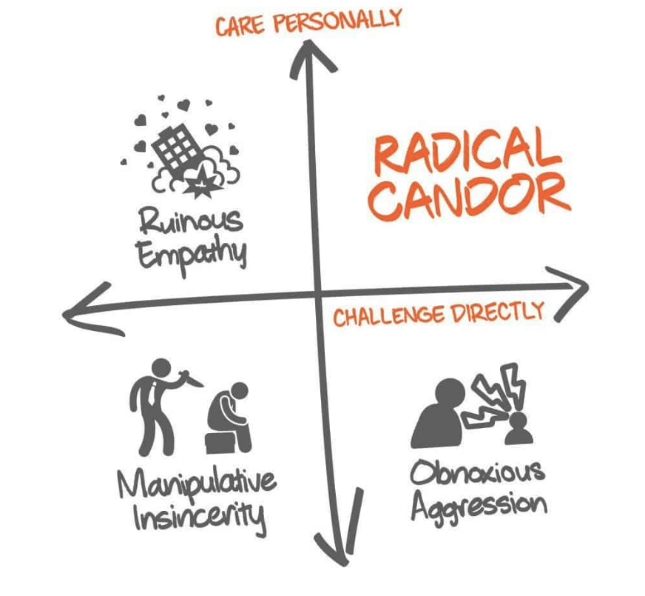
Challenging with kindness
RADICAL CANDOUR - KIM SCOTT
A framework for challenging incivility or unkindness.
Care Personally: the ‘give a damn’ axis requires genuineness and to bring your true self to work.
Challenge Directly: the ‘willingness to piss people off’ axis requires a willingness to tackle issues directly
GET IT – encourage feedback on yourself
GIVE IT – tell people you are going to do it and do it
GAUGE IT – respond to the emotions you get back
ENCOURAGE IT – don’t engage in ‘tittle tattle’
Notes:
Obnoxious aggression = the ‘asshole’ quadrant
Manipulative insincerity = the ‘passive aggressive’ quadrant
Ruinous empathy = the ‘nice’ quadrant

Slide 18
A word about emails…

Slide 19
Intra-TEAM
The way THE TEAM BEHAVES

Slide 20
Healthcare is a team sport
What makes teams perform better?
In 2015 Riskin & Eres published the first of their landmark papers. In it they took teams who were matched for expertise and put them into a patient simulator and they measured the outcomes.
Half of those teams were exposed to mild rudeness.
What did they find?
Relative performance can be plotted on a curve from the truly fantastic to the catastrophic and ONE factor was responsible for 40-60% of that variance - INCIVILITY.
The single most important factor determining outcomes for teams is how we treat each other.
Notes:
The conditions that we create within teams is important – it has life or death consequences.

Slide 21
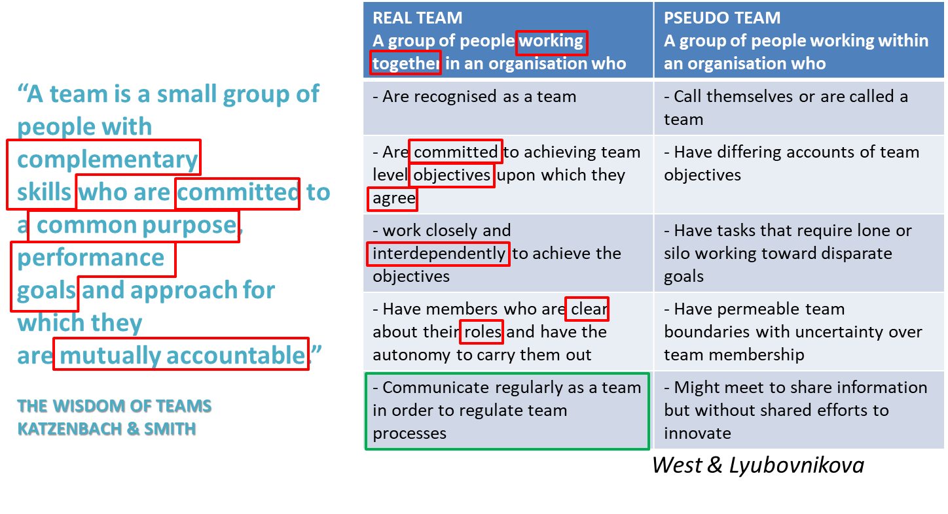
What even is a team?

Slide 22
Why be a real team?

Slide 23
The 5 dysfunctions of a team

Slide 24
THE 5 DYSFUNCTIONS OF A TEAM

Slide 25
Inter-TEAM
The way WE behave to each other

Slide 26
Super-chickens: compete or collaborate?

Slide 27
COLLUSION
The antithesis of collaboration.
Collusion is a type of conflict we experience in our lives where we engage in the behaviours that cause our problem to exist because we think the other person deserves it.
And the even weirder thing is that we get satisfaction from it!

Slide 28
A problem…
You are the CEO of a car company and you are losing money fast.
You call a board meeting and tell all of your teams they need to improve their performance otherwise you will go out of business!
SALES DIRECTOR:
“Not a problem. We can sell our way out of trouble. I’ll give my teams more stretching targets and offer to pay bigger bonuses for those who can bring in the most business. We’ll save this company!”
FINANCE DIRECTOR:
“Our biggest problem is bad debt. Too many of our customers can’t pay their car repayments. We’re going to reduce the number of people who default on their payments by introducing more rigorous credit checks. We’ll save this company!”

Slide 29
Collusion means…
3
Sales Director
(He Does)
- Sell more!
- Get creative with workarounds
- Lie?
Finance Director (She Sees)
- Mavericks
- No controls
- They are the problem!
4
2
Sales Director
(He Sees)
- Blockers
- Bureaucracy gone mad
- They are the problem!
Finance Director
(She Does)
- Reduce risk threshold
- Credit checks at point of sale
- Don’t process without paperwork!
1

Slide 30
Developing an outward mindset
Increase Sales
Reduce Bad Debt
Increase “Safe” Sales
The best route out of collusion is;
To see that you’re in it.
To try to see things from the other perspective.
Move away from siloed objectives to shared objectives. Look for win / win.
To make the first move unconditionally.
The route out requires someone to take the first step
START WITH SELF

Slide 31
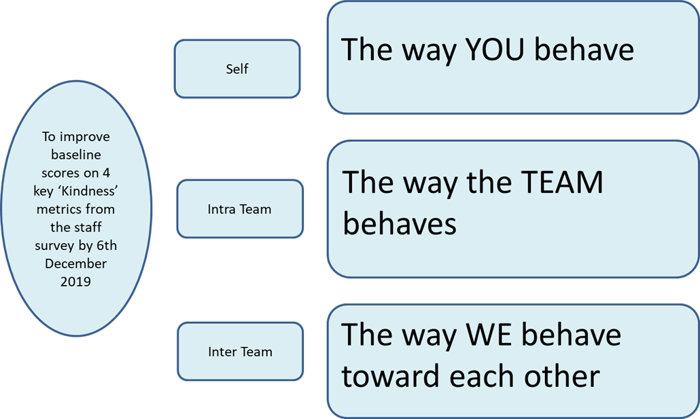
The way YOU behave
The way the TEAM behaves
The way WE behave toward each other

Slide 32
Our kindness collaborative
What we learned at oldham

Slide 33
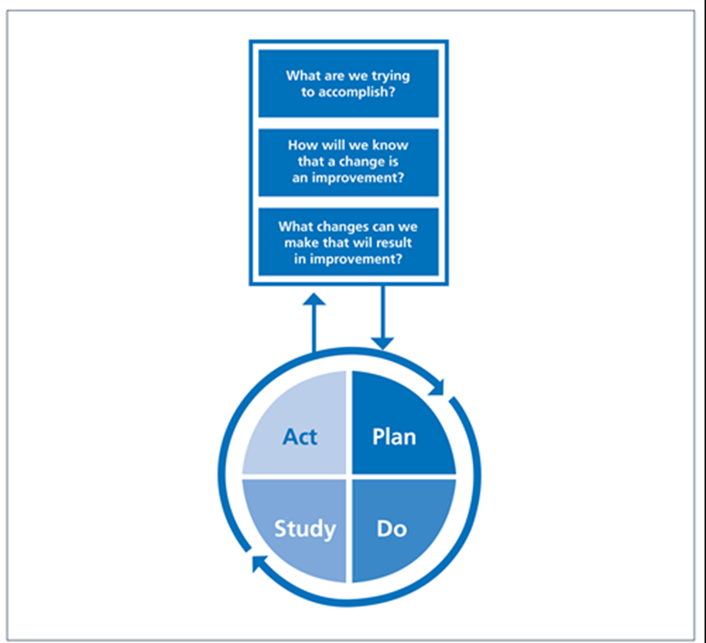
Our kindness collaborative

Slide 34
Measuring kindness
Focus on 4 key questions from NHS Staff Survey to establish a baseline for kindness
I receive the respect I deserve from colleagues
Work relationships are strained
In the last 12 months I have experienced bullying & harassment from colleagues
In the last 12 months I have experienced bullying & harassment from my line manager
Take a working baseline at the first learning session and then keep measuring until the summit.
Use your eyes and ears…does it feel better? What are people saying?

Slide 35
The impact
Question | LS1 Baseline Score | Summit Score | Change
I receive the respect I deserve from colleagues | 80% agree / strongly agree | 87% agree / strongly agree | 7% better
Work relationships are strained | 60% agree / strongly agree | 41% agree / strongly agree | 19% better
<12m bullying & harassment (colleagues) | 20% agree / strongly agree | 7% agree / strongly agree | 13% better
<12m bullying & harassment (line manager) | 26% agree / strongly agree | 3.5% agree / strongly agree | 22.5% better

Slide 36
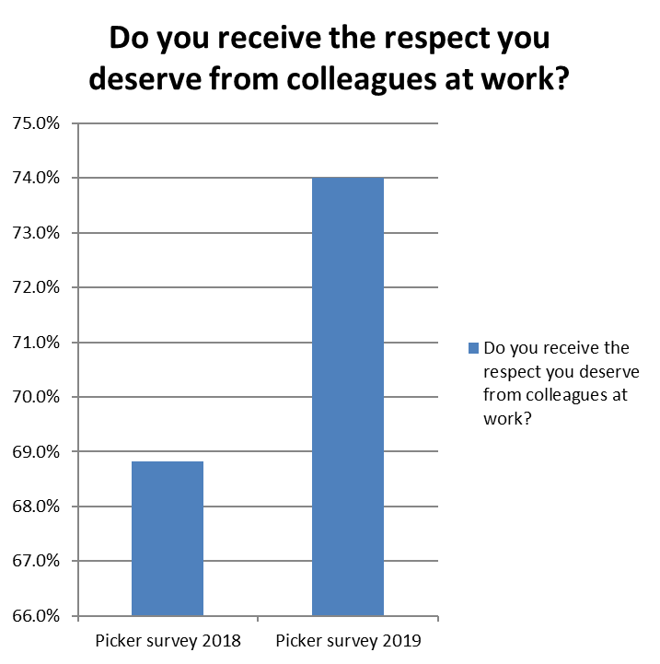
The impact

Slide 37
The IMPACT

Slide 38
Kindness change package
CHANGE 1. COLLECTIVE RESTORATION
CHANGE 2. CREATE GROUP NORMS
CHANGE 3. RECRUITMENT & RETENTION
CHANGE 4. TAKE TIME TO GET TO KNOW EACH OTHER
CHANGE 5. DEVELOPING REAL TEAMS
CHANGE 6. DEVELOPING AN OUTWARD MINDSET

Slide 39
questions

