Slide 1
Irritable Bowel Syndrome
Education for health care professionals
Summary information based on
Irritable bowel syndrome | Health topics A to Z | CKS | NICE
March 2024

Slide 2
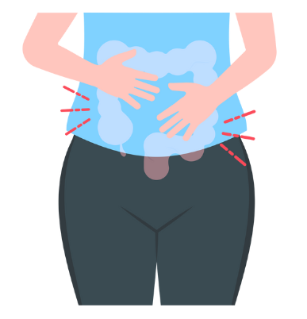
What this presentation covers
The possible causes of IBS
How to assess a patient with possible symptoms of IBS and not overlook other serious causes
Key aspects of management

Slide 3
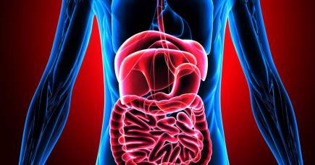
Irritable bowel syndrome (IBS)
Irritable bowel syndrome (IBS) is a chronic, relapsing, and often debilitating disorder of gut-brain interaction

Slide 4
Prevalence
The prevalence of IBS in the general population is estimated to be 5–20% but as many people with symptoms do not seek medical advice this may be an underestimate
IBS most commonly affects young people aged 20–39 years, and prevalence decreases with increasing age, so use caution re diagnosing IBS for the first time in older people, exclude other causes first
Several studies have reported a higher prevalence of IBS in females compared to males

Slide 5
What causes IBS?
Likely to be multifactorial involving the interplay of biological, psychological, and social factors.
Biological
Psychological
Social

Slide 6
Possible mechanisms
Visceral hypersensitivity
Abnormal gastrointestinal immune function
Changes in gut microbiome
Abnormal autonomic activity
Abnormal central pain processing of afferent gut signals (altered 'brain-gut interactions’)
Abnormal gastrointestinal motility

Slide 7
Possible causes or risk factors include
Enteric infection
Post infectious IBS is observed in about 10% of people following acute enteric infection (bacterial, viral, or protozoal)
Genetic
Twin studies and family studies confirm familial aggregation of IBS, and a US case-control study found a person with a first-degree relative with IBS had an odds ratio of 2.75 of developing the condition themselves [Saito, 2010]
Shared childhood experiences and/or environmental exposures within families may confound findings
Gastrointestinal inflammation (for example, secondary to inflammatory bowel disease)
Dietary factors (such as alcohol, caffeine, spicy, and fatty foods)
Up to 90% of people report that food triggers symptoms.
Drugs, such as antibiotics
Psychological comorbidity (such as stress, anxiety and/or depression)
Psychosocial factors influence the physiological functioning of the gastrointestinal tract via the brain-gut axis, and may affect the person's pain experience, symptom behaviour, expectations of treatment, and clinical outcome

Slide 8
Suspect irritable bowel syndrome (IBS)
Suspect irritable bowel syndrome (IBS) if the person reports having had any of the following symptoms for at least 6 months WITHOUT alarm symptoms:
A
bdominal pain or discomfort
B
loating
C
hange in bowel habit

Slide 9
Diagnosis
Make a diagnosis of IBS in primary care if abdominal pain or discomfort has been present for at least 6 months and:
Is either
relieved by defaecation or associated with altered bowel frequency or stool form.
And
this should be accompanied by at least 2 of the following 4 symptoms:
altered stool passage (straining, urgency, incomplete evacuation)
abdominal bloating (more common in women than men), distension, tension or hardness
symptoms made worse by eating
passage of mucus

Slide 10
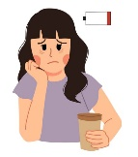
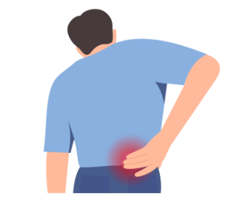
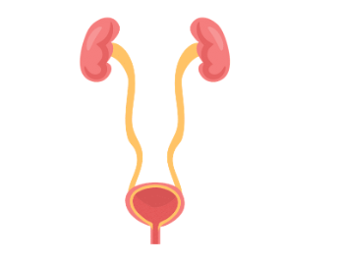
Extra-intestinal features
Be aware that extra-intestinal features are common in people with IBS including:
Lethargy
Nausea
Back Pain
Headache
Gynaecological symptoms
Bladder Symptoms

Slide 11
Other causes
Don’t overlook other serious causes of IBS like symptoms ie IBD, Ovarian Cancer, Coeliac Disease and Colorectal Cancers
Look out for Alarm symptoms and signs:
Unintentional and unexplained weight loss
Rectal bleeding
Positive faecal immunochemical test (FIT)
Change in bowel habit over the age of 60 years
Raised faecal calprotectin
Iron deficiency anaemia
Persistent or frequent bloating in females (especially if aged over 50 years – ovarian cancer)
Abdominal or rectal mass
This means that taking a thorough history and examining the patient are extremely important

Slide 12
Assessing the patient – specifics in the history
Symptoms
Onset and duration
Type and severity — showing people the Bristol Stool Form Scale may help with description of stool form.
*Clinical features suggestive of an alternative diagnosis, including a serious or life-threatening condition — arrange admission or referral where appropriate*
Dietary assessment
Including fibre intake, nutrition, and any known food triggers (such as alcohol, caffeine, spicy and fatty foods).
Consider the use of a food diary to determine an association between specific foods and symptoms.
Other triggers
Including enteric infection, recurrent antibiotic use, recent stress, anxiety, or depression
Comorbidities
Including psychological and previous surgery and medications including opioids
The impact of symptoms
on daily functioning such as home, work, school, and leisure activities
Activity
The person's exercise and physical activity levels

Slide 13
Assessing the patient – specifics in examination and diagnostics
Examine the person:
Check weight, calculate the body mass index (BMI), and assess for unintended or unexplained weight loss
Palpate the abdomen for signs of tenderness or masses
Perform a rectal examination, with the person's consent, to exclude perianal or rectal pathology
Consider arranging the following investigations to exclude other diagnoses:
Full blood count (FBC) — to assess for anaemia, and/or a raised platelet count
Inflammatory markers such as erythrocyte sedimentation rate (ESR) and C-reactive protein (CRP) — may be raised if there is active inflammation or infection
Coeliac serology — to exclude coeliac disease, particularly if there is diarrhoea-predominant IBS or mixed symptoms
Faecal calprotectin — in particular if the person has diarrhoea and is aged 45 years or younger to exclude inflammatory bowel disease
Local and national referral guidelines for suspected colorectal or ovarian cancer should be followed, where indicated

Slide 14
Alternative conditions
Alternative conditions which may present similarly to irritable bowel syndrome include:
Malignancy (such as colorectal cancer, small bowel cancer, ovarian cancer and lymphoma)
Other causes of constipation, such as:
Functional or drug-induced constipation
Hypothyroidism
Other causes of diarrhoea, such as:
Inflammatory bowel disease
Coeliac disease
Gastrointestinal infection and secondary lactose intolerance
Antibiotic-associated diarrhoea (for example Clostridium difficile colitis)
Microscopic colitis — more common in females over the age of 45 years. Often presents with coexisting autoimmune disease, nocturnal or severe watery diarrhoea and weight loss and may be precipitated by some medications such as NSAIDs, SSRIs, or proton pump inhibitors.
Bile acid malabsorption — a past medical history including cholecystectomy or right hemicolectomy may be suggestive of bile acid diarrhoea.
Hyperthyroidism
Laxative misuse
Other causes of abdominal pain or discomfort, such as:
Diverticular disease
Chronic pancreatitis
Gallstones
Peptic ulcer disease
Gastro-oesophageal reflux disease
Other causes of symptoms :Premenstrual syndrome and endometriosis
Anxiety and/or depression

Slide 15
When to refer to a specialist
If atypical presentations such as nocturnal diarrhoea or abdominal pain
Features of a defecatory disorder (such as a sensation of incomplete, or blocked evacuation and use of digital manoeuvres to facilitate defaecation)
Faecal incontinence

Slide 16
Initial Management
Focus should be individualized to the person's symptoms and psychosocial situation, and should initially include clear explanation of the condition, and diet and lifestyle advice
Discuss diagnosis of IBS in the context of the ’gut-brain axis’ and explain that IBS is a chronic condition with recurrent fluctuating symptoms which can be triggered by stress, intercurrent illnesses, medications and eating.
Reassure the person that IBS is not associated with an increased risk of cancer or mortality
Explain that the aim of management is to improve symptoms (it may not relieve them completely) and quality of life — treatments are likely to be needed long term

Slide 17
General Advice and IBS support
Direct the person to sources of information and support, such as:
The NHS patient information leaflet Irritable bowel syndrome
The IBS Network is a national charity supporting people living with irritable bowel syndrome (telephone 0114 2723253) which has multiple self-help information pages and runs local support groups.
For all people with IBS give advice on diet, lifestyle and mental wellbeing:
Advise the person to eat regular meals with a healthy, balanced diet, and to adjust their fibre intake according to symptoms The Eatwell Guide
Recommend drinking an adequate fluid intake. Fluid (water and drinks)
For people who choose to take an over-the-counter probiotic supplement, advise that they do so for at least twelve weeks and discontinue if there is no improvement in symptoms
Advise on the benefits of regular physical activity and discuss weight management if the person is overweight or obese.
Adults should aim to do 30 minutes of moderate intensity physical activity on at least 5 days of the week
Encourage the person to identify any associated stress, anxiety, and/or depression, and manage appropriately

Slide 18
Managing loose motions and constipation
If there are predominant symptoms of diarrhoea and/or bloating, advise the person to:
Reduce their intake of insoluble fibre, such as wholemeal or high-fibre flour and breads, cereals high in bran, and whole grains such as brown rice
Consider reducing foods that may exacerbate symptoms, such as caffeine, alcohol, carbonated drinks, and gas-producing foods
If there are predominant symptoms of constipation, advise the person to:
Try soluble fibre supplements (for example ispaghula) or foods high in soluble fibre (for example oats and linseed).
Gradually increase fibre intake to minimize flatulence and bloating — it may be several weeks before beneficial effects are seen.
The Association of UK Dietitians has a food fact sheet on Irritable bowel syndrome (IBS) and diet.
Arrange to review the person with the next two months, depending on clinical judgement, and if there are ongoing or refractory symptoms, consider further management options

Slide 19
Ongoing symptoms
If first line dietary advice is ineffective:
Consider referral to a specialist dietician for dietetic assessment to reinforce general dietary advice, and for specialist advice on single food avoidance and exclusion diets, especially if food is a trigger for symptoms
Exclusion diets may include a trial of a low FODMAP (fermentable oligosaccharides, disaccharides, monosaccharides, and polyols) diet. High FODMAP-containing foods include some fruits (apples, cherries, peaches, and nectarines); artificial sweeteners; most lactose-containing foods; legumes; some green vegetables (broccoli, Brussels sprouts, cabbage, and peas)
The IBS Network has a FODMAP diet sheet that may be useful.
Be aware that long-term dietary restriction may lead to inadequate nutrient intake and alterations in the microbiome. A low FODMAP diet should be supervised by a trained dietitian and FODMAPS reintroduced according to tolerance after a limited period of restriction

Slide 20
Ongoing constipation
Consider prescribing a bulk-forming laxative initially
Efficacy of treatment should be reviewed after 3 months — discontinue if no response
Laxatives from any class can be considered but AVOID lactulose which is not recommended as it may increase gas production and therefore exacerbate symptoms
If symptoms of severe constipation persist for at least 12 months, and optimal or maximum tolerated doses of previous laxatives from different classes have not helped, consider a trial of the secretory drug linaclotide
Linaclotide [3] 290microgram ONCE daily taken 30mins before meals. 2 Constipation with irritable bowel syndrome – review after 4 weeks if no response
constipation.pdf (panmerseyapc.nhs.uk)

Slide 21
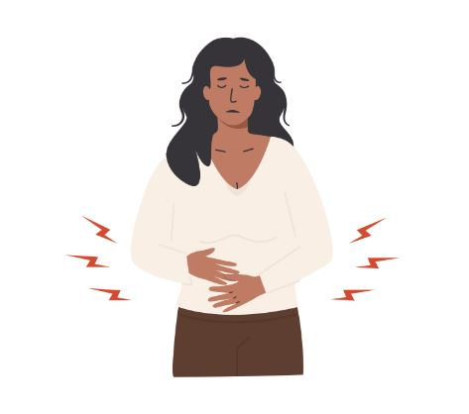
Ongoing diarrhoea
Consider prescribing an antimotility drug, such as loperamide.
Initially 4 mg, followed by 2 mg for up to five days, dose to be taken after each loose stool; usual dose 6–8 mg daily; maximum 16 mg per day
Review efficacy at 3 months, discontinue if no response

Slide 22
Ongoing abdominal symptoms
Consider prescribing an antispasmodic drug such as mebeverine hydrochloride, alverine citrate, or peppermint oil to be taken when needed and review efficacy at 3 months
If an antispasmodic is ineffective, consider a trial of a low-dose tricyclic antidepressant (TCA) second-line, such as amitriptyline (off-label indication)
*The National Institute for Health and Care Excellence (NICE) recommends starting treatment at a low dose, for example, amitriptyline 5–10 mg at night, and titrating the dose up in steps of 10 mg at least every 2 weeks if needed, to a maximum of 30 mg at night [NICE, 2017].
If a TCA is ineffective, is contraindicated, or not tolerated, consider prescribing a selective serotonin reuptake inhibitor (SSRI), such as sertraline, citalopram or fluoxetine are second-line drug options (off-label indication).
*NICE recommend that SSRIs are only considered in people who do not respond to a tricyclic antidepressant [NICE, 2017].NICE and British Society of Gastroenterology (BSG) guidelines do not specify an SSRI of choice.
*The BSG [Vasant, 2021] recommend advising patients that TCAs or SSRIs are being used at low doses for their pain modulatory properties and peripheral effects on gastrointestinal function, rather than at a dose used to treat common mental disorders.

Slide 23
Still getting stuck with management
If there are persistent or refractory symptoms following trial(s) of drug treatment is the diagnosis of IBS incorrect – reassess, ensure no features of malignancy etc
Refer to a gastroenterologist if:
Atypical presentations such as nocturnal diarrhoea or abdominal pain emerging
Features of a defecatory disorder (such as a sensation of incomplete, or blocked evacuation and use of digital manoeuvres to facilitate defaecation) evolving
Faecal incontinence
There is uncertainty about the underlying diagnosis
Symptoms are severe or are refractory to optimal management in primary care
The person requests a specialist opinion
Refer to mental health services for psychological support and intervention if there are ongoing symptoms for at least 12 months and/or psychological comorbidities, depending on clinical judgement.
Psychological therapies can be considered at an earlier stage (depending on local availability and patient preference) but are strongly recommended if symptoms remain refractory to drug treatment for 12 months

Slide 24
In summary
In summary, Irritable bowel syndrome (IBS) is a chronic, relapsing, and often debilitating disorder of gut-brain interaction
The initial symptoms require a detailed assessment to avoid missing other more serious diagnoses such as malignancy, with an individualised approach to the management of symptoms

Slide 25
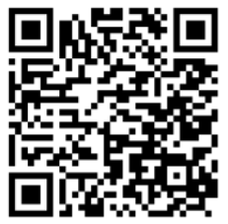
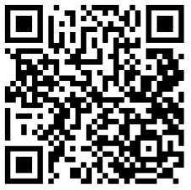
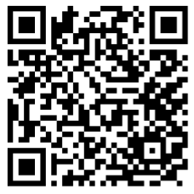
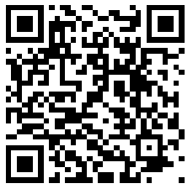
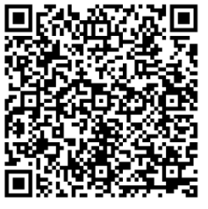
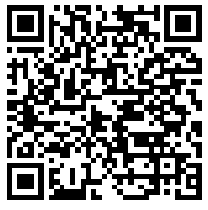
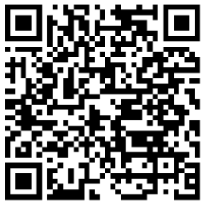
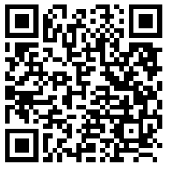
Appendix - Links
Cover Slide:
Slide 20 – Ongoing constipation
Irritable bowel syndrome | Health topics A to Z | CKS | NICE
Constipation, chronic, management of adult patients in primary care
Slide 17 - General Advice and IBS support
Irritable bowel syndrome (IBS) - NHS
The IBS Network
The Self Care Programme | The IBS Network
The Eatwell Guide
The importance of hydration - British Dietetic Association (BDA)
Slide 18 - Managing loose motions and constipation
Irritable bowel syndrome (IBS) and diet - British Dietetic Association (BDA)
Slide 19 – Ongoing symptoms
Scenario: Management | Management | Irritable bowel syndrome | CKS | NICE
FODMAPS | The IBS Network

