Slide 1



Quality Improvement Building Blocks Framework

Slide 2
Aims of this session
Introduce you to the ‘Building Blocks Framework’
Help you understand how multiple key concepts interact to enable the development of an effective ‘learning system’
Explain the process and provide examples of the full organisational ‘diagnostic’

Slide 3
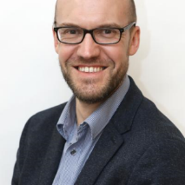
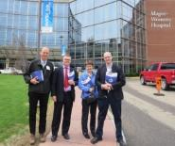







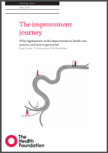

History of the Building Blocks Framework
20+ organisations
Lots of experts
The building blocks framework!
Dr Pete Chamberlain
Preliminary testing:
High Performing
Average
Failing
Cohort 1
x4 orgs
Cohorts 2-4:
x17 organisations
Recognition
Notes:
This slide describes how the Building Blocks came about and how they have been used

Slide 4
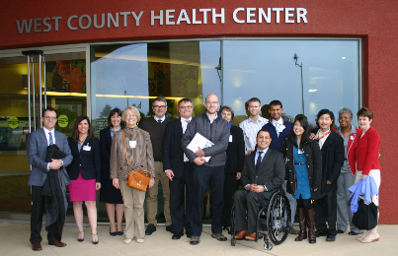

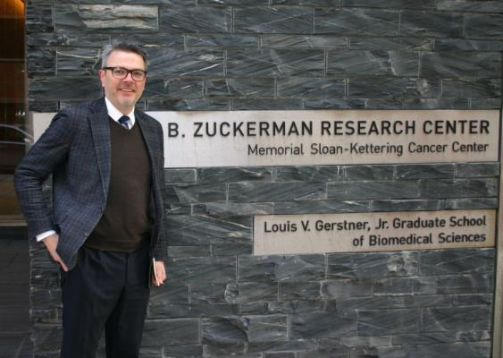
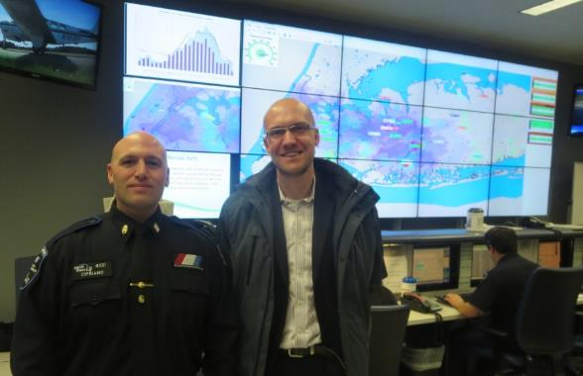
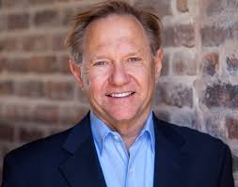
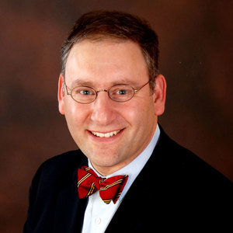
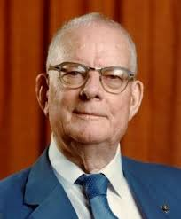
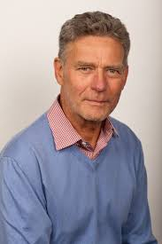
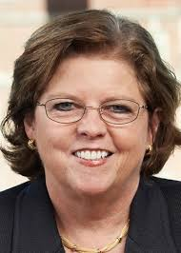
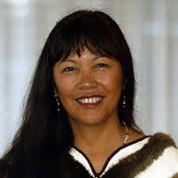
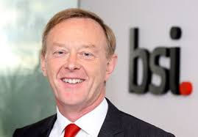
Influencers…

Slide 5


The Trajectory
Outcome
Steve Spear
Time
http://www.thehighvelocityedge.com/
Notes:
THE HIGH VELOCITY EDGE
The Building Blocks is developed from understanding the principles and high performing organisations
Prof Steve Spear is an expert in this field and his input was the catalyst to develop the framework

Slide 6
The Trajectory
Outcome
Steve Spear
Time
http://www.thehighvelocityedge.com/
Notes:
THE HIGH VELOCITY EDGE

Slide 7
The Trajectory
Outcome
Steve Spear
Time
“Sustainable competitive advantage has to be won by creating the internal capacity to improve and innovate – fast and without let up. Simply put, today’s leading organizations outrace their competition by outlearning them.”
Notes:
What we have to do is bend the trajectory over time using
*Read the quote*
The framework has been designed to complement as opposed to replace other key aspects to organisational success and can’t negate the need for adequate funding, staffing, clinical training and due diligence procedures.
…we are now going to give a brief overview

Slide 8

Motivation – (why)
Mechanism – (what)
(seed)
Outcome
Context - (where)
(soil)
Process – (how)
(Gardener: Light, water)
Mo + Me + C + P = O
Notes:
+ Bate
+ Rycroft-Malone
Kanter/ Shortell (Garderner)

Slide 9

Three
key
layers

Slide 10
Learning System Essentials
The mechanisms to sustain continuous improvement
Cultural & Infrastructure Essentials
The foundations to support continuous improvement
Person & Family Centered Care
The principles to direct continuous improvement

Slide 11
Learning System Essentials
Cultural & Infrastructure Essentials
Person & Family Centered Care
Notes:
Within each layer are 4 blocks which represent key quality improvement and organisational development concepts
Every organisation will have some blocks in place, but most will have gaps and opportunity for development

Slide 12
Learning System Essentials
Cultural & Infrastructure Essentials
Person & Family Centered Care
Notes:
The aim is to complete the building blocks

Slide 13


Learning System Essentials
Comprehensive ‘capture’ process:
Issues, events & feedback
System diagnostics across the continuum
Model for Improvement
active at the frontline
Real time transparent measurement & understanding of variability
Cultural & InfrastructureEssentials
Valued workforce & psychological safety
Compassionate leadership with relentless focus who connect with the ‘front line’
Functional ‘Team’ ethos incl. clinical & informatics integration
Increasing staff capacity
& capability in QI & innovation
Person & Family Centered Care
From “what’s the matter?” to
“what matters to me”
System co-design
Representation
Collective Voice
Family as a unit of care
Partnership in personalized
care
Without this we won’t have the right values to continually improve
$$© Dr Peter Chamberlain$$
Notes:
At the end of the program staff have a better understanding about how all the blocks fit together and how what are often etheral concepts can be operationalised into powerful tools

Slide 14
S
Deming’s “System of Profound Knowledge”
K
P
V
Learning System Essentials
Comprehensive ‘capture’ process:
Issues, events & feedback
System diagnostics across the continuum
Model for Improvement
active at the frontline
Real time transparent measurement & understanding of variability
Cultural & InfrastructureEssentials
Valued workforce & psychological safety
Compassionate leadership with relentless focus who connect with the ‘front line’
Functional ‘Team’ ethos incl. clinical & informatics integration
Increasing staff capacity
& capability in QI & innovation
Person & Family Centered Care
From “what’s the matter?” to
“what matters to me”
System co-design
Representation
Collective Voice
Family as a unit of care
Partnership in personalized
care
Without this we won’t have the right values to continually improve
$$© Dr Peter Chamberlain$$

Slide 15

Comments and Questions

Slide 16
Person and Family Centered Care
Learning System Essentials
Cultural & Infrastructure Essentials
Person & Family Centered Care
Without this we won’t have the right values to continually improve

Slide 17
Person and Family Centered Care
Learning System Essentials
Cultural & Infrastructure Essentials
Person & Family Centered Care
Partnership in Personalized
Care
“What’s the matter?” to “what matters to me”
System Co-design
Representation
Stories & Voices
Family as a unit of care
Without this we won’t have the right values to continually improve
Notes:
Core Concepts of Patient- and Family-Centered Care
Dignity and Respect. Health care practitioners listen to and honor patient and family perspectives and choices. Patient and family knowledge, values, beliefs and cultural backgrounds are incorporated into the planning and delivery of care.
Information Sharing. Health care practitioners communicate and share complete and unbiased information with patients and families in ways that are affirming and useful. Patients and families receive timely, complete and accurate information in order to effectively participate in care and decision-making.
Participation. Patients and families are encouraged and supported in participating in care and decision-making at the level they choose.
Collaboration. Patients, families, health care practitioners, and health care leaders collaborate in policy and program development, implementation and evaluation; in research; in facility design; and in professional education, as well as in the delivery of care.
Adapted from: Johnson, B. H. & Abraham, M. R. (2012).
Partnering with Patients, Residents, and Families: A Resource for Leaders of Hospitals, Ambulatory Care Settings, and Long-Term Care Communities. Bethesda, MD: Institute for Patient- and Family-Centered Care.

Slide 18
Co-design, representation,
Stories & Voices
Family as a unit of care
Partnership in Personalized Care
What matters to me
Notes:
What matters to me
DIGNITY / RESPECT / COMPASSION
https://www.cbsnews.com/news/11-year-old-girl-granting-wishes-to-nursing-home-residents/
STICKERS!
“Seeing the same doctor” – evidence for continuity of care – mortality
Continuity of care is measureable – statistically sig changes in OOH/ admission/ mortality are ‘dose’ dependent
https://bjgp.org/content/72/715/e84

Slide 19
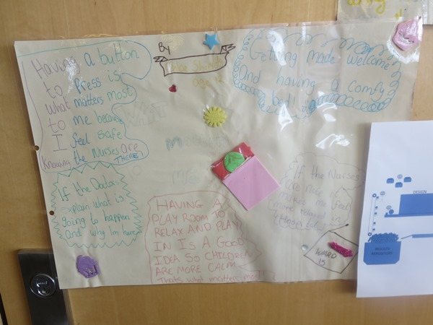
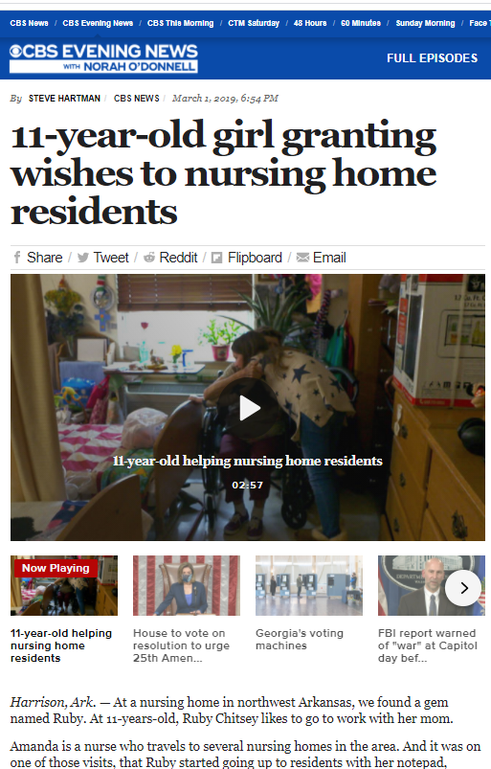
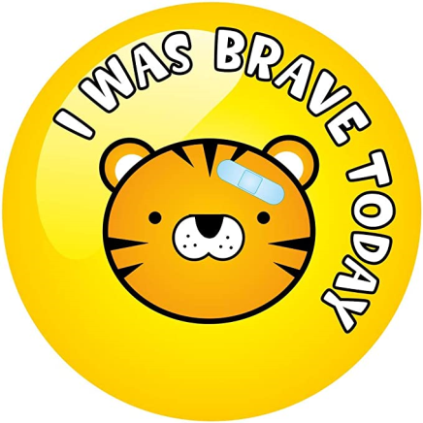
Co-design, representation,
Stories & Voices
Family as a unit of care
Partnership in Personalized Care
What matters to me
https://www.cbsnews.com/news/11-year-old-girl-granting-wishes-to-nursing-home-residents/
Notes:
What matters to me
DIGNITY / RESPECT / COMPASSION
https://www.cbsnews.com/news/11-year-old-girl-granting-wishes-to-nursing-home-residents/
STICKERS!
“Seeing the same doctor” – evidence for continuity of care – mortality
Continuity of care is measureable – statistically sig changes in OOH/ admission/ mortality are ‘dose’ dependent
https://bjgp.org/content/72/715/e84

Slide 20

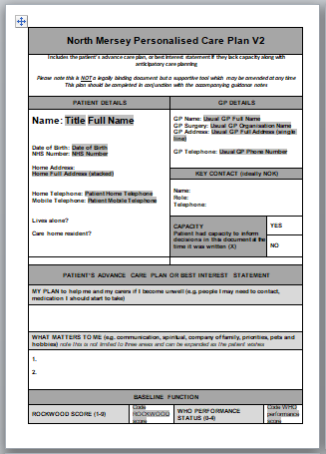

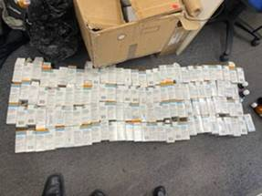
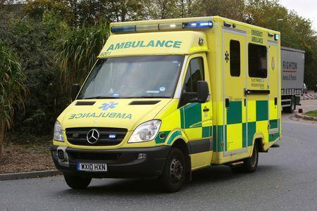
Co-design, representation,
Stories & Voices
Family as a unit of care
Partnership in Personalized Care
What matters to me
www.opennotes.org
Notes:
Shared Decision Making is a process which simultaneously combines the expert medical knowledge of the clinician with the expertise of the patient
Not hitting a target with a rock – trying to land a Pidgeon on a platform
Ensuring clinicians who have intimate knowledge of the patient are put at the center of decision making
BETH ISRAEL: HUMAN FIRST
At the heart of everything we do is a fervent belief that before patients are patients, they are people…
CONTINUITY OF CARE: Efficiency, access, partnership
IDEAS/ CONCERNS / EXPECTATIONS
Present choices >
Mutual respect/ patient activation/ adherence plan
Video call elderly: “Shut up alexa”

Slide 21
Cultural & Infrastructure Essentials
Learning System Essentials
Cultural & Infrastructure Essentials
Person & Family Centered Care
Without this we won’t have the right values to continually improve
Notes:
Mid Staffs Francis inquiry (125 exec summary)
The Trust’s culture was one of self promotion rather than critical analysis and openness. This can be seen from the way the Trust approached its FT application, its approach to high Hospital Standardised Mortality Ratios (HSMRs) and its inaccurate self declaration of its own performance. It took false assurance from good news, and yet tolerated or sought to explain away bad news.
Liverpool Community Health (Kirkup report)
Staff were overstretched, demoralised and, in some instances, bullied
…incidents, some serious, should also have been reported and investigated, but we heard repeated accounts that reporting was discouraged
…the reaction of the Trust Board to this gathering crisis in services was based on denial. The management team was still focused predominantly on becoming a FT, and reports of service problems were not only seen as a distraction
Ockenden review Shrewsbury & Telford
1:4 out of nearly 500 stillbirths were found to have significant major concerns in maternity care
Combination of delays in escalation and failure to work collaboratively across disciplines, resulted in the many poor outcomes experienced by mothers or their babies, such as sepsis, HIE and, unfortunately, death.
The review team heard directly from staff that there was a culture of ‘them and us’ between the midwifery and obstetric staff, which engendered fear among midwives to escalate concerns to consultants. This demonstrates a lack of psychological safety in the workplace and limited the ability of the service to make positive changes.

Slide 22
Cultural & Infrastructure Essentials
Learning System Essentials
Cultural & Infrastructure Essentials
Valued Workforce & Psychological Safety
Compassionate leadership with relentless focus who connect with the ‘front line’
‘Team’ ethos: Clinical & Informatics Integration
Increasing staff capacity
& capability in QI & innovation
Person & Family Centered Care
Without this we won’t have the right values to continually improve
Notes:
Mid Staffs Francis inquiry (125 exec summary)
The Trust’s culture was one of self promotion rather than critical analysis and openness. This can be seen from the way the Trust approached its FT application, its approach to high Hospital Standardised Mortality Ratios (HSMRs) and its inaccurate self declaration of its own performance. It took false assurance from good news, and yet tolerated or sought to explain away bad news.
Liverpool Community Health (Kirkup report)
Staff were overstretched, demoralised and, in some instances, bullied
…incidents, some serious, should also have been reported and investigated, but we heard repeated accounts that reporting was discouraged
…the reaction of the Trust Board to this gathering crisis in services was based on denial. The management team was still focused predominantly on becoming a FT, and reports of service problems were not only seen as a distraction
Ockenden review Shrewsbury & Telford
1:4 out of nearly 500 stillbirths were found to have significant major concerns in maternity care
Combination of delays in escalation and failure to work collaboratively across disciplines, resulted in the many poor outcomes experienced by mothers or their babies, such as sepsis, HIE and, unfortunately, death.
The review team heard directly from staff that there was a culture of ‘them and us’ between the midwifery and obstetric staff, which engendered fear among midwives to escalate concerns to consultants. This demonstrates a lack of psychological safety in the workplace and limited the ability of the service to make positive changes.

Slide 23

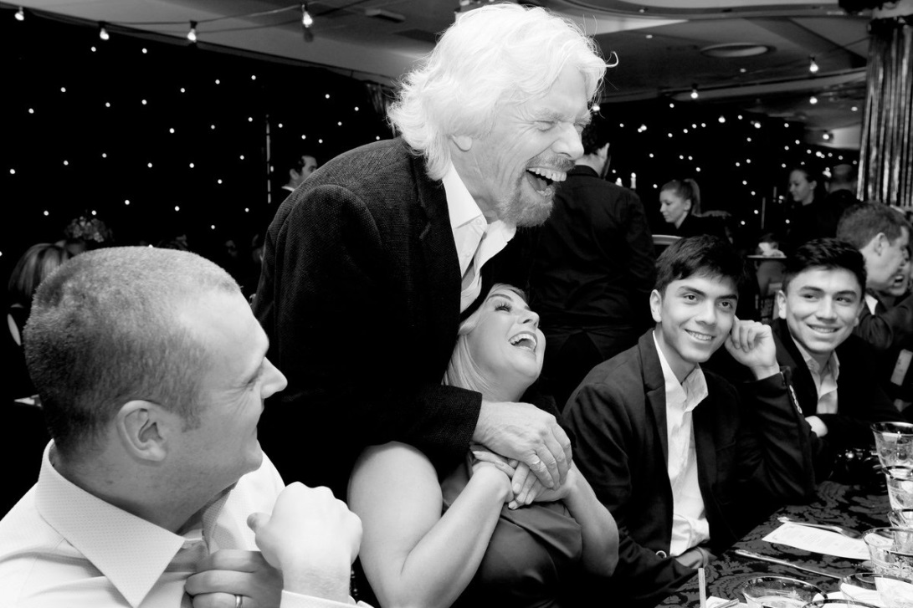

Valued Workforce & Psychological Safety
‘Team’ ethos: Clinical & Informatics Integration
Leadership with relentless focus who
connect with the ‘front line’
Increasing staff capacity
& capability in QI & innovation
We believe that the time has come for business to stop looking at people as resources and to start looking at them as human beings..
..Put your staff first, your customers second & your shareholders third – you will benefit all three.

Slide 24
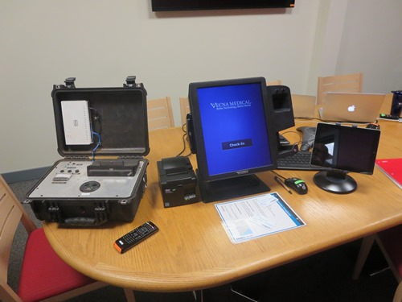
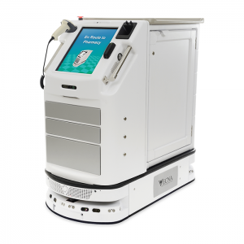

Valued Workforce & Psychological Safety
‘Team’ ethos: Clinical & Informatics Integration
Leadership with relentless focus who
connect with the ‘front line’
Increasing staff capacity
& capability in QI & innovation
“Vecna® was founded on the idea that people matter….
Notes:
“Vecna® was founded on the idea that people matter….

Slide 25
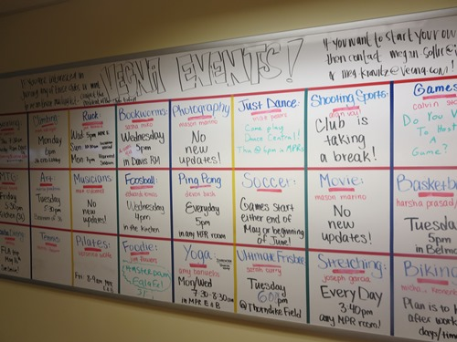

Valued Workforce & Psychological Safety
‘Team’ ethos: Clinical & Informatics Integration
Leadership with relentless focus who
connect with the ‘front line’
Increasing staff capacity
& capability in QI & innovation
Notes:
Foster meaningful relationships. Who you work with matters. According to Harvard Business Review, "close work friendships boost employee satisfaction by 50%."
Moreover, "people with a best friend at work are seven times more likely to engage fully in their work."
Build teams that foster friendships and use your current team members to tap new talent. If a member of your team has a strong working relationship with a former colleague and friend, don't hesitate to bring that individual on board. Good people surround themselves with good people.
Happiness at work proportional productivity – reproducible in psychological laboratory experiments
https://businessperspectives.org/images/pdf/applications/publishing/templates/article/assets/8193/PPM_2017_01_Mamun.pdf
Glass door study > 5000 people variety work backgrounds
Company staff turnover correlated most strongly with…company culture culture
Relationship immediate line manager

Slide 26

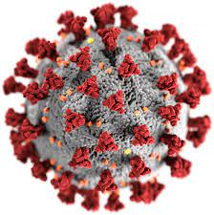


Valued Workforce & Psychological Safety
‘Team’ ethos: Clinical & Informatics Integration
Leadership with relentless focus who
connect with the ‘front line’
Increasing staff capacity
& capability in QI & innovation
Who have you noticed this week?
6th April 2020
1000’s welfare calls
‘CorONA Voice’
Anne Laverty
https://www.health.org.uk/news-and-comment/blogs/supporting-staff-wellbeing-during-covid-19-a-northumbrian-experience
Notes:
Corona Voice
10,000 responses first 3months
Staff felt they were heard and concerns responded to
Identified those working from home most vulnerable, isolated, guilty > 1000s welfare calls were made
Anne Laverty – Chief experience officer
No surprise top staff survey results in the country
Gary Chapman – 5 love languages
Acts of service
Gifts
Quality time
Words of Affirmation
Physical Touch

Slide 27

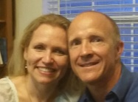
Valued Workforce & Psychological Safety
‘Team’ ethos: Clinical & Informatics Integration
Leadership with relentless focus who
connect with the ‘front line’
Increasing staff capacity
& capability in QI & innovation
Notes:
NATS Prestwick
Strategic approach to safety
Just Culture protocol
Safety Culture program
Culture surveys
Leadership
Mentoring, coaching..
Max and Caroline
Loss of psychological safety – major warning sign see Mid Staffs

Slide 28
Valued Workforce & Psychological Safety
‘Team’ ethos: Clinical & Informatics Integration
Leadership with relentless focus who
connect with the ‘front line’
Increasing staff capacity
& capability in QI & innovation
CAPACITY
CAPABILITY
“Dosing Formula” | WTE dedicated Improvement
0.05% | > 50% WTE
0.5% | 10-50% WTE
5% | 5-10% WTE
50% | 1-5% WTE
Level | Training
Strategic/ Expert | +1 year
Advanced | Months - Year
Intermediate | Weeks - Month
Basic | Hours -Days
QI
Leaders
Improvement Advisors
“Coaches”
All Staff
Institute/ QIS
Front line
Notes:
Deeper Explanation on ‘dosing formula”
‘Two jobs’

Slide 29

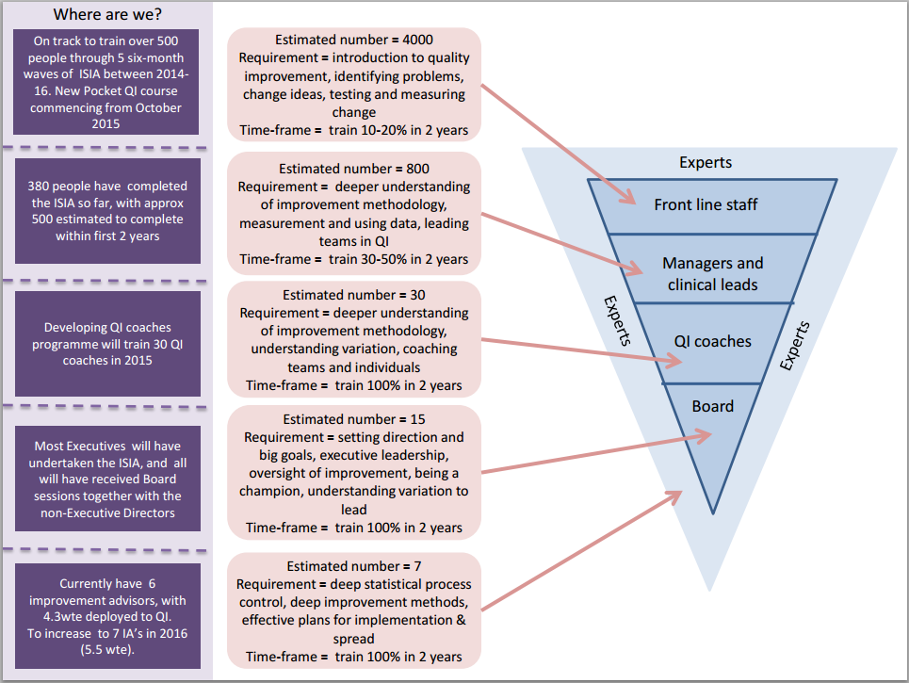
Increasing staff capacity
& capability in QI & innovation
https://qi.elft.nhs.uk/

Slide 30
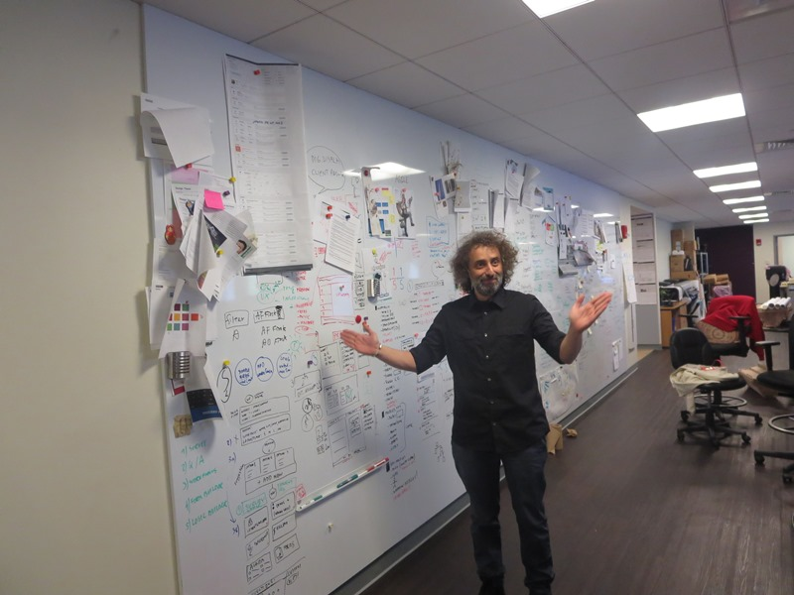
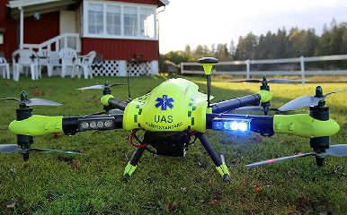
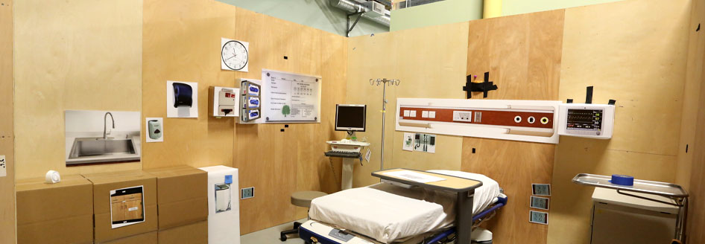

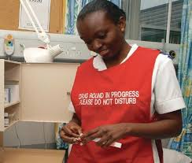

Increasing staff capacity
& capability in QI & innovation
“Stop THINKING outside the box, start GOING outside the box…”
“Integrate two or more different functions/ components”
Notes:
TOYOTA > VIRGINIA MASON
US NAVY > CINCINNATTI CHILDRENS
IDEO > KP
PREDICTIVE MODELLING / METEROLOGY > CAMDEN HEALTH
All time greats
Pele, Messi
Jerry Rice – Top San Fran 49y
Wayne Gretzky – Top Canadian Ice Hockey
Creativity…
Failure isn’t failing – move from “trial and error” to “trial and learn”

Slide 31
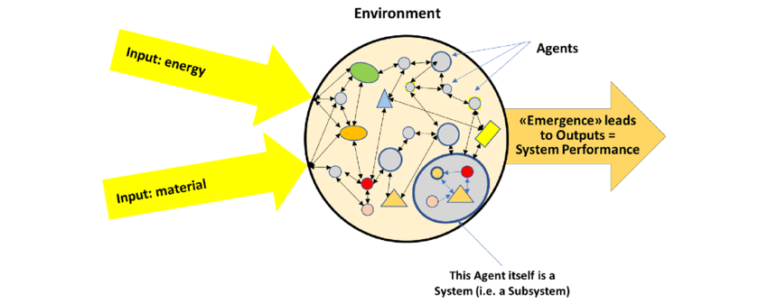
Comprehensive ‘capture’ process:
Issues, events & feedback
Model for Improvement
active at the frontline
Real time transparent measurement & understanding of variability
System diagnostics across the continuum
Why?
Healthcare is a dynamic complex & adaptive system
The power of incremental gain/loss
Sturmberg et al 2019 DOI:10.12688/f1000research.19414.1
https://www.health.org.uk/publications/complex-adaptive-systems
https://www.mq.edu.au/__data/assets/pdf_file/0012/683895/Braithwaite-2017-Complexity-Science-in-Healthcare-A-White-Paper-1.pdf
Notes:
Sir Dave Brailsford
“Marginal gains – as an approach is about having the INTELLECTUAL HONESTY to see where you are going wrong and delivering improvements as a result”
Bicycle redesign
Painting inside of vans white
Teaching cyclists how to wash hands to avoid viruses
Using thigh warmers to ensure muscles stay at optimum temperature
GB cycling
100 years won one gold medal Olympics
Never won Tour de France
Top European bike manufacturers refused to sell to the team for fear it would hurt sales
Over 10y stretch 60% Gold medals at 2008 Olympics
178 World Championships/ 66 Olympic Golds including 60% Golds 2008
5/6 Tour De France wins
COMPLEX ADAPTIVE SYSTEMS
a large number of elements which interact dynamically
any element in the system is affected by and affects several other systems
non linear interactions, so small changes can have large effects
openness, so it may be difficult to define system boundaries
a constant flow of energy to maintain the organisation of the system
a history whereby the past helps to shape present behaviour
elements in the system are not aware of the behaviour of the system as a whole and respond only to what is available or known locally.

Slide 32

Comprehensive ‘capture’ process:
Issues, events & feedback
Model for Improvement
active at the frontline
Real time transparent measurement & understanding of variability
System diagnostics across the continuum
Why?
Healthcare is a dynamic complex & adaptive system
The power of incremental gain/loss
 |  | Year 1 | Year 2
A | Plus 0.1% a week | 1.05 | 1.11
B | Minus 0.1% a week | 0.95 | 0.90
 | Relative advantage | 10% | 21%
C&M ICB has a financial deficit of 8%
Notes:
Sir Dave Brailsford
“Marginal gains – as an approach is about having the INTELLECTUAL HONESTY to see where you are going wrong and delivering improvements as a result”
Bicycle redesign
Painting inside of vans white
Teaching cyclists how to wash hands to avoid viruses
Using thigh warmers to ensure muscles stay at optimum temperature
GB cycling
100 years won one gold medal Olympics
Never won Tour de France
Top European bike manufacturers refused to sell to the team for fear it would hurt sales
Over 10y stretch 60% Gold medals at 2008 Olympics
178 World Championships/ 66 Olympic Golds including 60% Golds 2008
5/6 Tour De France wins
COMPLEX ADAPTIVE SYSTEMS
a large number of elements which interact dynamically
any element in the system is affected by and affects several other systems
non linear interactions, so small changes can have large effects
openness, so it may be difficult to define system boundaries
a constant flow of energy to maintain the organisation of the system
a history whereby the past helps to shape present behaviour
elements in the system are not aware of the behaviour of the system as a whole and respond only to what is available or known locally.

Slide 33
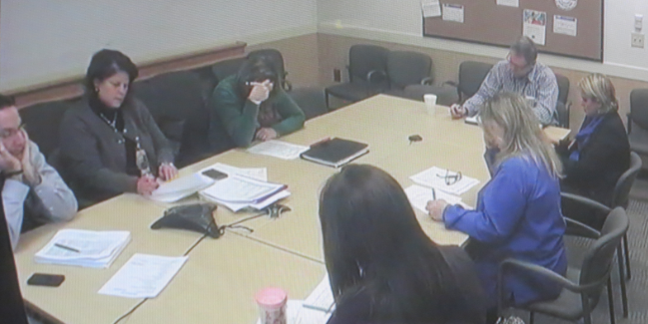
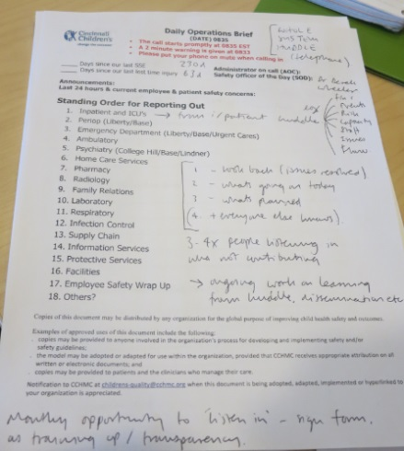

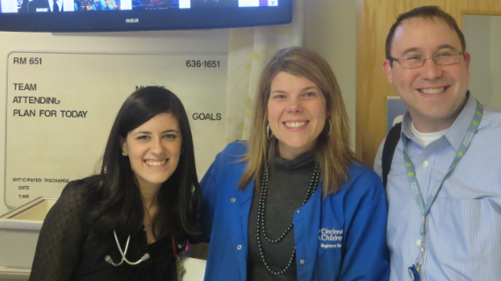

Comprehensive ‘capture’ process:
Issues, events & feedback
Model for Improvement
active at the frontline
Real time transparent measurement & understanding of variability
System diagnostics across the continuum
Organisation
“Watcher”
Parental concern
Communication issue
High risk
Staff issue
Division
Daily
Ward
Notes:
Intermountain:
+ addressing underperfromers “worth a free lunch”
Intermountain:
-+ Surgeons > blind data, all had something to teach, all something to learn
“Just culture”
Role of leaders it to create culture and enablers for front line staff to do a great job – basically remove the barriers then get out of the way.
CINCINATTI CHILDRENS
Stephen Muething > $10B Aircraft Carrier = SITUATIONAL AWARENESS
https://www.cincinnatichildrens.org/bio/m/stephen-muething#contentmaster_1_pagemaincontent_0_pnlPublications
Reduction in Significant Safety Incidents reduction 80% over 5year program, sustain – zero over 200+ days,
Going for ‘best in class’
Going for high reliability
Pre-occupation with failure

Slide 34
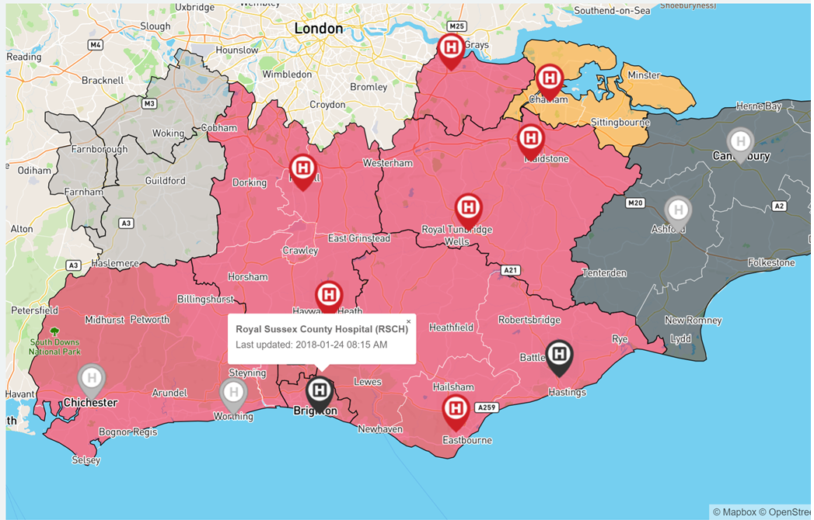
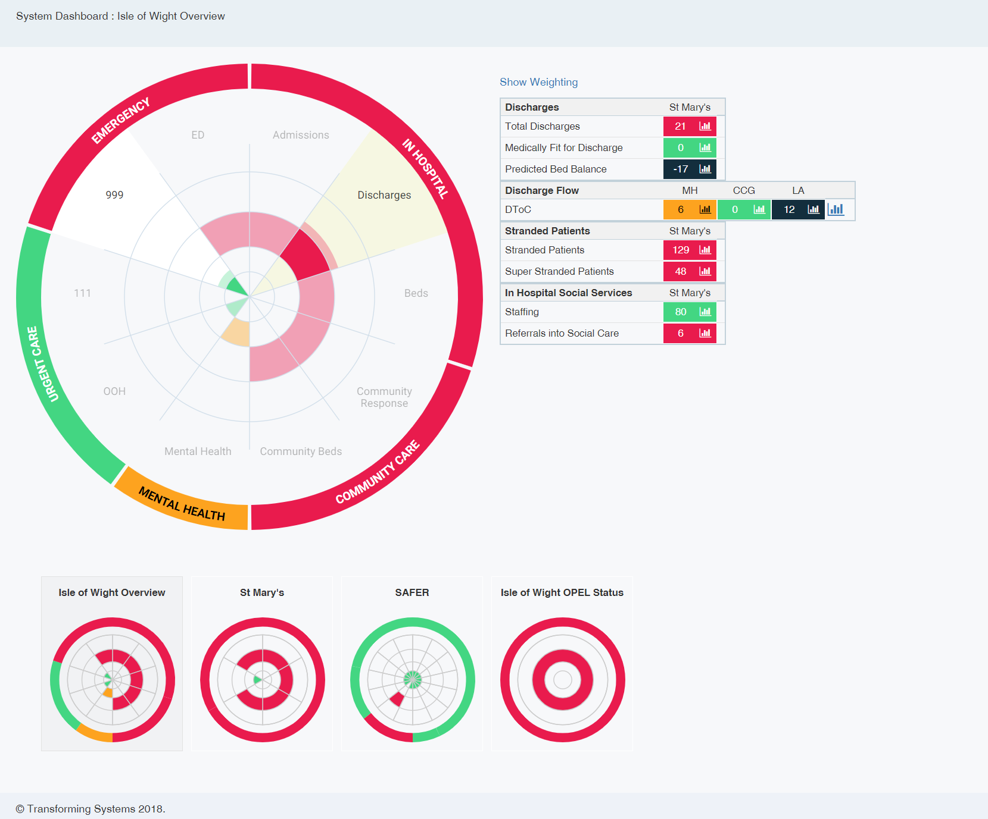
SHREWD:
A real-time Operational tool for Urgent Care
Comprehensive ‘capture’ process:
Issues, events & feedback
Model for Improvement
active at the frontline
Real time transparent measurement & understanding of variability
System diagnostics across the continuum
Notes:
DATIX
EMS – Emergency Management System
OPEL – Operational Performance Escalation Levels

Slide 35

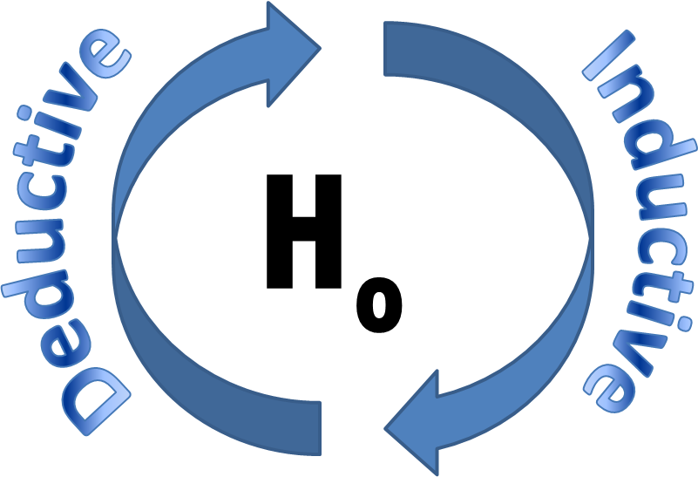
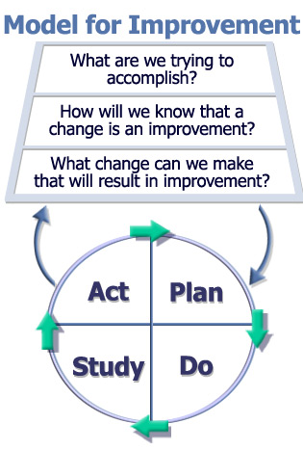
Model for Improvement
active at the frontline
Real time transparent measurement & understanding of variability
Comprehensive ‘capture’ process:
Issues, events & feedback
System diagnostics across the continuum
Aim
Measures
Change Concepts
Walter Shewhart
THEORY
PREDICTION
‘EXPERIMENT’
MEASUREMENT
APPLICATION
Notes:
MECHANISM + CONTEXT + QI = OUTCOME

Slide 36
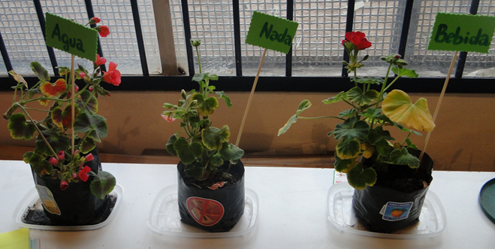
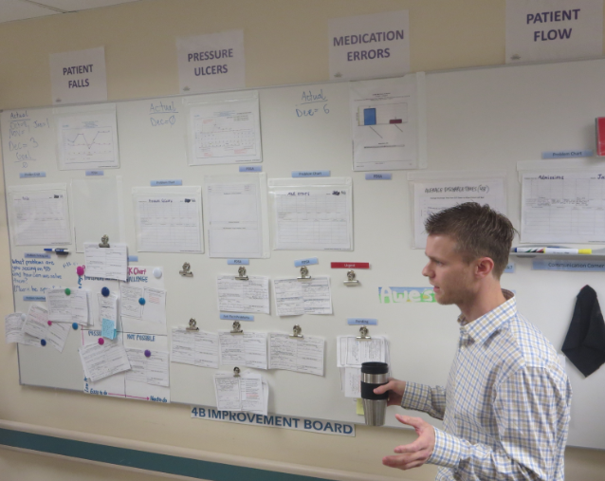
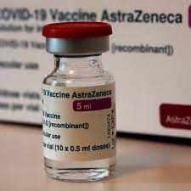
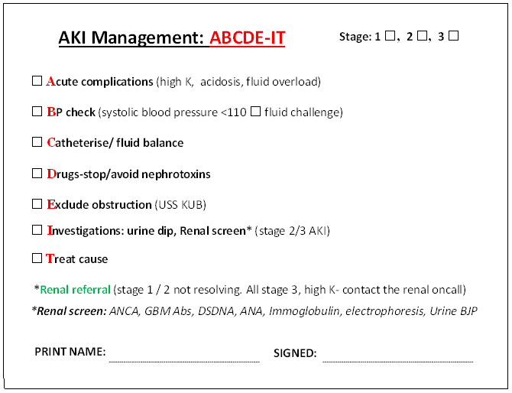
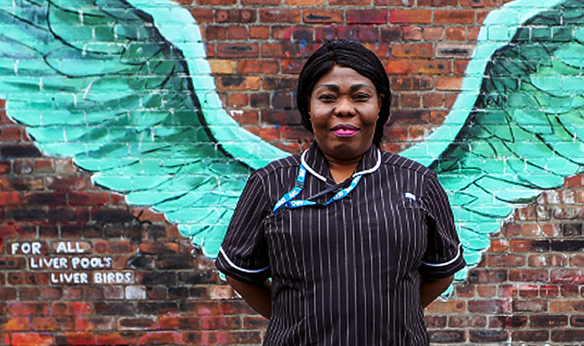
Model for Improvement
active at the frontline
Real time transparent measurement & understanding of variability
Comprehensive ‘capture’ process:
Issues, events & feedback
System diagnostics across the continuum
Notes:
Patient Falls
Pressure Ulcers
Medication Errors
Patient Flow
School seeking to improve water intake and reduce soft drinks – test what happens feed plant > developed impactful tool primary school children
Susan: Matrons MCT Liverpool Paul Curtis Angel Wings: Testing 1week access Direct matron/ through GP/ through SPC
Covid-19 Vaccination: Incremental testing, tweaking > Increase flow and vaccine delivery by 20% > 100000 vaccines
PDSA: Parachuted volunteers practices calling patients scripted answers:

Slide 37
Model for Improvement
active at the frontline
Real time transparent measurement & understanding of variability
Comprehensive ‘capture’ process:
Issues, events & feedback
System diagnostics across the continuum
SMALL & RAPID
BE THERE: learn from the experience
THINK couple of cycles AHEAD
DO NOT require BUY-IN
Test with VOLUNTEERS
Use TEMPORARY SUPPORT
QUANTITATIVE & QUALITATIVE
VARIETY OF CONDITIONS
LOG/ WRITE up the PDSA
Don’t turn TASKS into TESTS
Improve
Integrate
Innovate
Exnovate
Notes:
MECHANISM + CONTEXT + QI = OUTCOME
Innovate: A new process
Integrate: Bringing two or more processes together
Exnovate: Stopping processes that do not add benefit
Improve: Making current process better

Slide 38
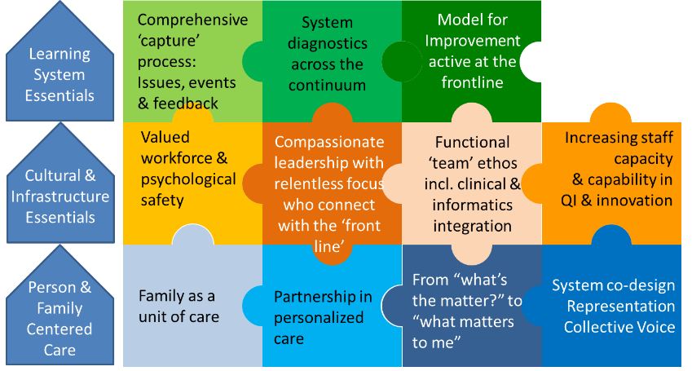
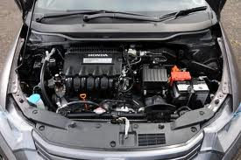

Where do we go from here?
Real time transparent measurement & understanding of variability
“Going under the bonnet”
Notes:
Lets have a look under one block as an example

Slide 39
QI Building blocks Framework
Real time transparent measurement & understanding of variability
Max block score = 15
High >10
Average 5-10
Low <5
1 | 2 | 3 | 4 | 5
Is coded data collected and collated automatically in real time ie. within one time unit of specified analysis (shorter time unit the better, maximum time unit 1 month) | Does data on projects/ work streams consistently cover a family of meaningful measures including outcome, process and balancing measures? | Is there a suite of system measures actively in place aligned to strategic objectives? Are these measures reported on time on a monthly basis? Is there evidence of the identification of improvement gaps and QI projects as a result? | Are projects and system measures data consistently presented in time series and routinely analysed using ratified statistical process control? | Are data summaries of live and current improvement work are made available throughout the organisation within publically facing areas either physically or electronically?
0-3 | 0-3 | 0-3 | 0-3 | 0-3
Notes:
The framework provides specific and pragmatic questions which allow staff to grade their experience against in line with the examples of common themes seen within high performing organisations and best evidence from experts in the field

Slide 40
QI Building blocks Framework
Real time transparent measurement & understanding of variability
/60
/60
/60
-----
180
0 Organisation has not started/ no progress / ‘don’t know’
1 Organisation has started / early progress
2 Organisation has embedded / steady progress
3 Organisation has fully met criteria across whole organisation
Notes:
Go through the grading system
A failing organisation may score 30/180
An exemplary on 150/180
HONESTY is key – if you don’t know what it is you likely are not experiencing it, so it would be a 0
If you are proud that this is your experience as part of routine and you believe it is the norm in your organisation – score a 3

Slide 41





Running the diagnostic
Person & Family Centered Care
Cultural & InfrastructureEssentials
Learning System Essentials
Notes:
At the end of the program staff have a better understanding about how all the blocks fit together and how what are often ethereal concepts can be operationalised into powerful tools

Slide 42

Running the diagnostic
Engage corporate & select your judgement sample
Engage staff: Briefing & resource back up
Survey Hero (1 layer = 20 questions)
View your results
Virtual coaching
X3
Executive sign-up mandatory
Pre-requisites to effective diagnostic
Full Diagnostic
Notes:
Lets have a look under one block as an example

Slide 43
Selecting your judgement sample
Explanation and opportunity to engage essential
Aim to provide a 15min briefing as provided
Respondents should be:
  Minimum band 7
  Substantive staff who have worked 2+ years in the trust
Type of staff | ~ %
Clinicians & front line staff - Seek to spread across services | 50%
Executives & Managers | 16%
QI personnel | 16%
Support services | 16%
Organisational size | Surveys
30 | 25
100 | 50
1000 | 100
10000 | 200
70000000! | 1000
Notes:
Lets have a look under one block as an example

Slide 44
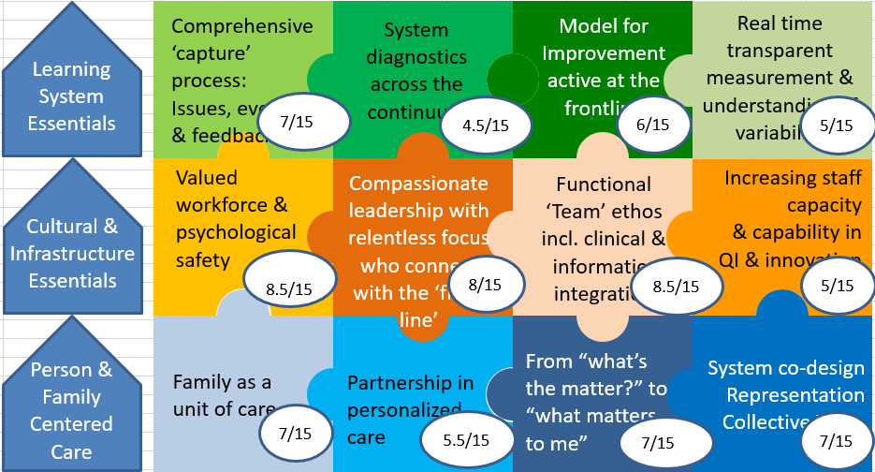
####### NHSFT
22.5 60
30 60
26.5 60
79 180

Slide 45

System diagnostic
Can the QIBBF be used at a system level to help:
  Develop a common understanding of core improvement concepts?
  Develop a common approach to continuous improvement?
  Identify strengths and opportunities across sectors?
  Foster a collective learning community with similar aims?

Slide 46
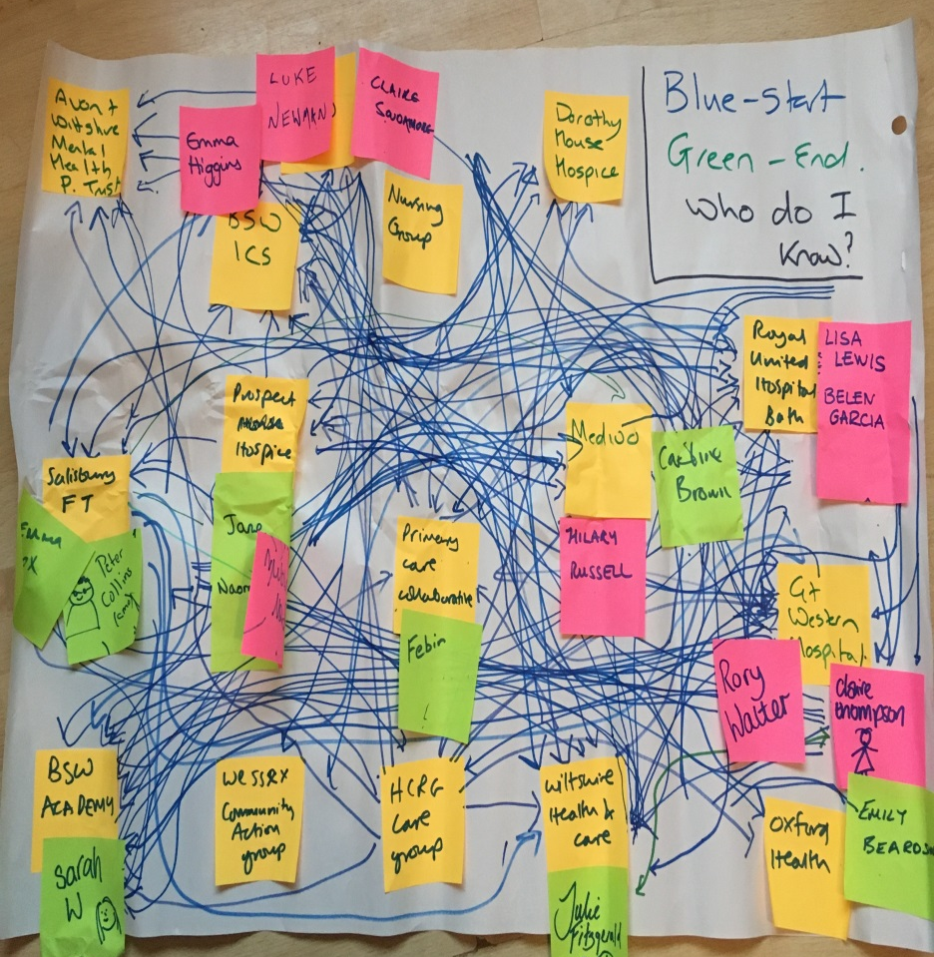
System diagnostic
Nine healthcare organisations
X2 Acute Trusts
X2 Community Trusts
X2 Mental Health Trusts
X2 Hospices
X1 ICB
Notes:
At the end of the program staff have a better understanding about how all the blocks fit together and how what are often ethereal concepts can be operationalised into powerful tools

Slide 47
Program Timeline
Layer 1 delivered launch event
Survey 1 undertaken
Review results survey 2
Layer 3 delivered
Survey 3 undertaken
Sharing and learning – celebration event
Face-to-face Launch
Virtual Workshop 2
Sharing and learning
5 May 2023
27 July 2023
15 Dec 2023
C o a c h i n g t h r o u g h o u t
10 March 2023
16 June 2023
15 Sept 2023
Review results survey 1
Layer 2 delivered
Survey 2 undertaken
Review results survey 3
Review final results and insight/learning
90-day plans agreed
Final report written
90 day progress check-in
Virtual Workshop 1
Virtual Workshop 3
Progress Check-in

Slide 48
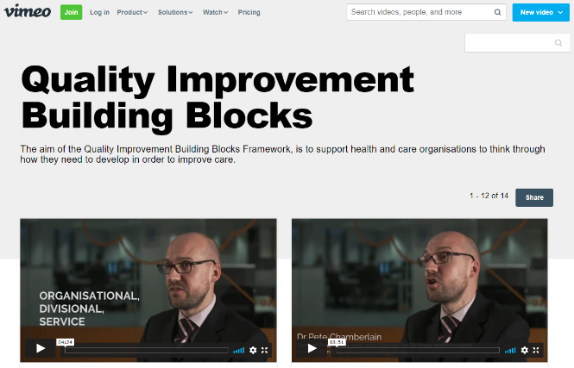
Resources for support
On site facilitation & training
Presentation packs
3 minute videos explain each block
Glossary of terms
Survey-Hero collates responses
Diagnostic report
https://vimeo.com/showcase/7222193

Slide 49
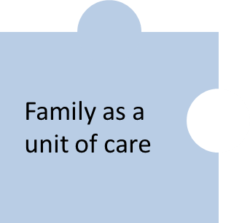
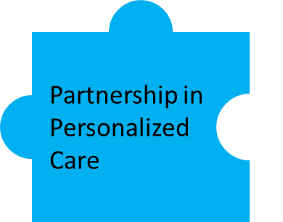



Layer 1

Slide 50
Average System diagnostic
Learning System Essentials
Comprehensive ‘capture’ process:
Issues, events & feedback
System diagnostics across the continuum
Improvement methods active at the point of care
Real time transparent measurement & understanding of variability
7.7
5.5
5.1
5.5
Cultural & InfrastructureEssentials
Valued workforce & psychological safety
Compassionate leadership with relentless focus who connect with the ‘front line’
Functional ‘Team’ ethos incl. clinical & informatics integration
Increasing staff capacity
& capability in QI & innovation
✓
8.5
6.3
6.8
5.6
Person & Family Centered Care
Family as a unit of care
Partnership in personalized
care
From “what’s the matter?” to
“what matters to me”
System co-design
Representation
Collective Voice
Without this we won’t have the right values to continually improve
6.3
6.3
6.3
4.8
Notes:
At the end of the program staff have a better understanding about how all the blocks fit together and how what are often ethereal concepts can be operationalised into powerful tools

Slide 51
QIBBF Diagnostic Report
Background & theory
Process & methods of the diagnostic
Your trust diagnostic with qualitative analysis
Comparison to other delegates
Pragmatic suggestions in relation to OD tailored for your trust

Slide 52
Survey completion
Use the specific SurveyHero link
Distribute links to resources with the survey
Criteria are specific and pragmatic
Aim maximum 1 minute per question
Grading in in relation to personal experience and modus operandi
Criteria that is not understood should be scored low (0/1)
Encourage scoring of high or low, avoid median score across all blocks
Notes:
Lets have a look under one block as an example

Slide 53

90 Day Challenge
Can you increase your Trust’s score by 2?
Which blocks are achievable?
Present your diagnostic and 90 day challenge to execs

Slide 54



Slide 55


Slide 56
Any Questions?

