Slide 1

The National HOPE(S) NHSE Collaborative – to reduce long term segregation
Dr Jennifer Kilcoyne | Clinical Director & Director for the National HOPE(S) NHSE Collaborative
Danny Angus | Associate Director for the National HOPE(S) NHSE Collaborative

Slide 2

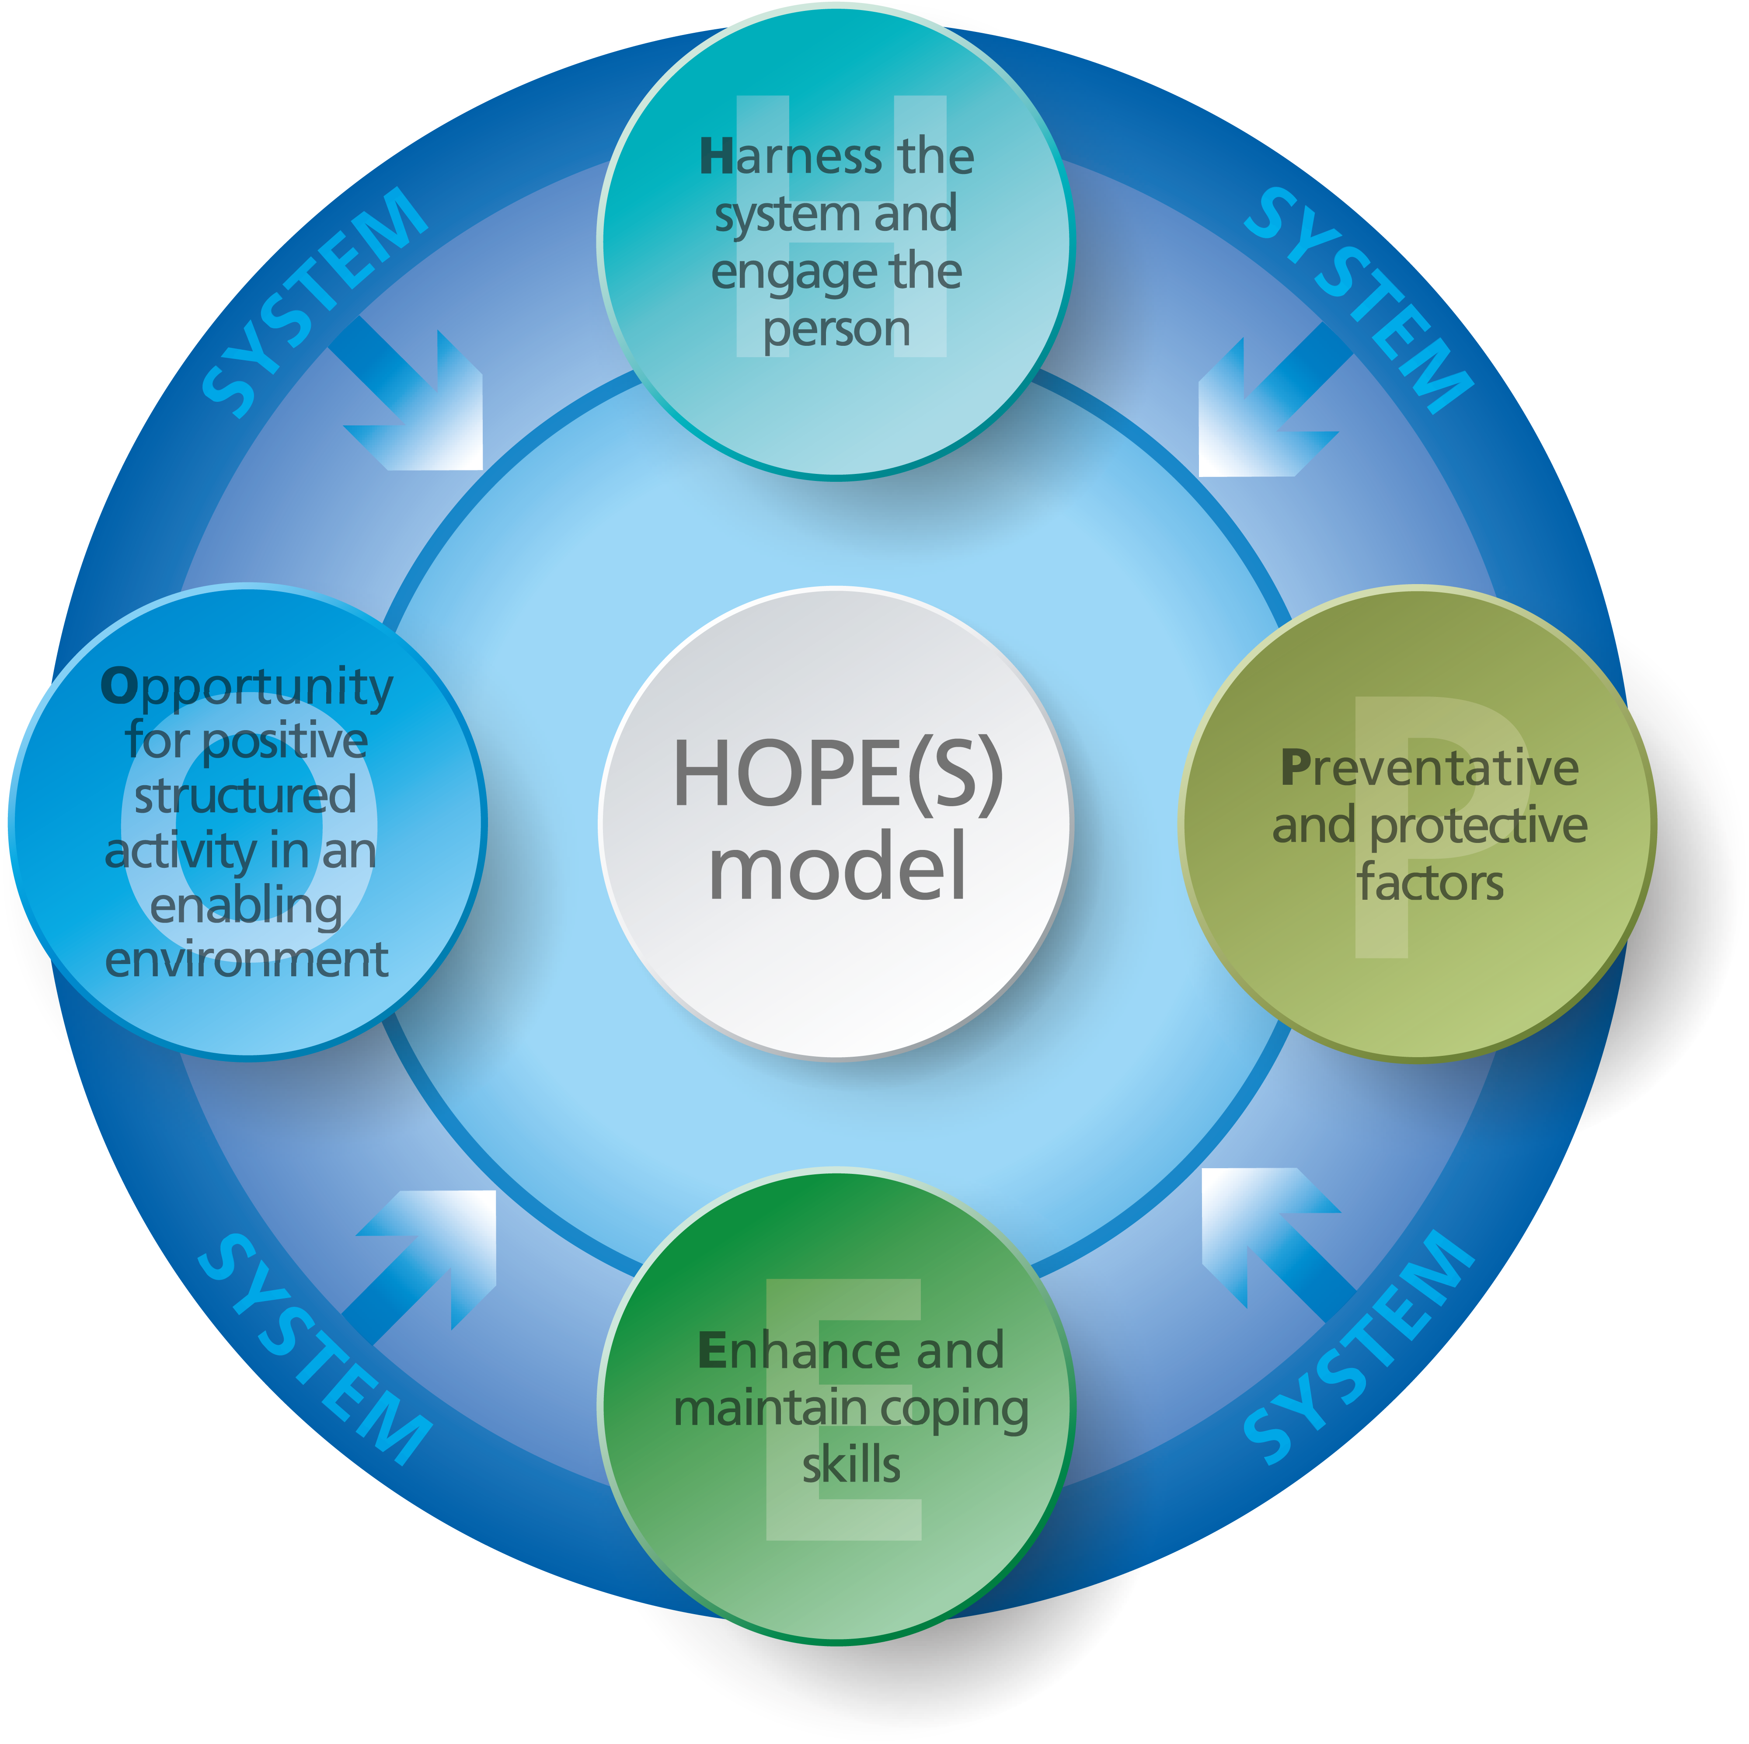
The HOPE(S) model of care

Slide 3




Key priorities
Organisational & Systems Impact
Workforce Capability & Development
Culture & Practice Change
Individual & Family Quality of Life

Slide 4
National outcomes to date
89 people in LTS have been identified for support from the programme to date
73 adults / 16 CYP
Supported 31 NHS Commissioned providers nationally across 56 hospital sites
63 people progressed out of LTS
Supported 4 community providers to ensure safe transition
HOPE(S) training – 2694 staff
HOPE(S) practice leadership qualification with BILD and RRN
Rigorous academic oversight from Manchester Metropolitan University

Slide 5
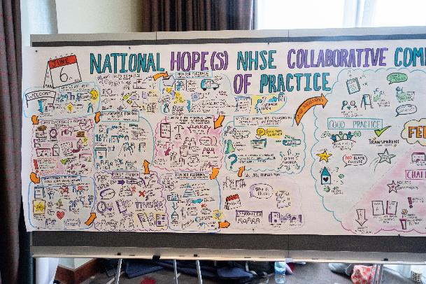
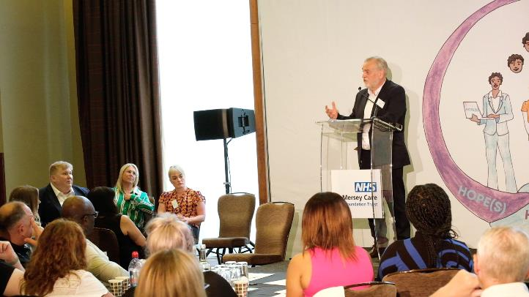
Sharing best practice
Last summer more than 240 people, including experts by experience, national leaders and stakeholders, came together in Liverpool for a unique event
Mersey Care’s CEO Prof Joe Rafferty CBE opened the day and former health minister and co-chair of the national HOPE(S) oversight group Sir Norman Lamb closed it.
We shared powerful stories and expertise which brought together a new community of practice

Slide 6
Dr Jennifer Kilcoyne
Clinical Director & Director for the National HOPE(S)
NHSE Collaborative
Mersey Care NHS Foundation Trust
Jennifer.Kilcoyne@merseycare.nhs.uk
Danny Angus
Associate Director for the National HOPE(S)
NHSE Collaborative
Mersey Care NHS Foundation Trust danny.angus@merseycare.nhs.uk
Further Information

