Slide 1
Transfer of Care Hub:
Discharge Story
2023/24

Slide 2
Introduction
WUTH are committed to a journey of flow continuous improvement. The Hospital Wide Flow programme launched in April 2023, is aimed to support in treating the right patient, in the right place, at the right time. This programme of work focusses upon improving internal processes and working with system partners to ensure a joined-up approach to safe, timely patient discharge.
Significant sustained reduction in the number of non-criteria to reside (NCTR) patients residing in acute hospital beds at WUTH has been multifactorial and will be discussed during this session.

Slide 3
Overview of Contents
Hospital Wide Flow Programme
Transfer of Care Hub
Outcomes
System Partner Feedback
Summary and Benefits

Slide 4
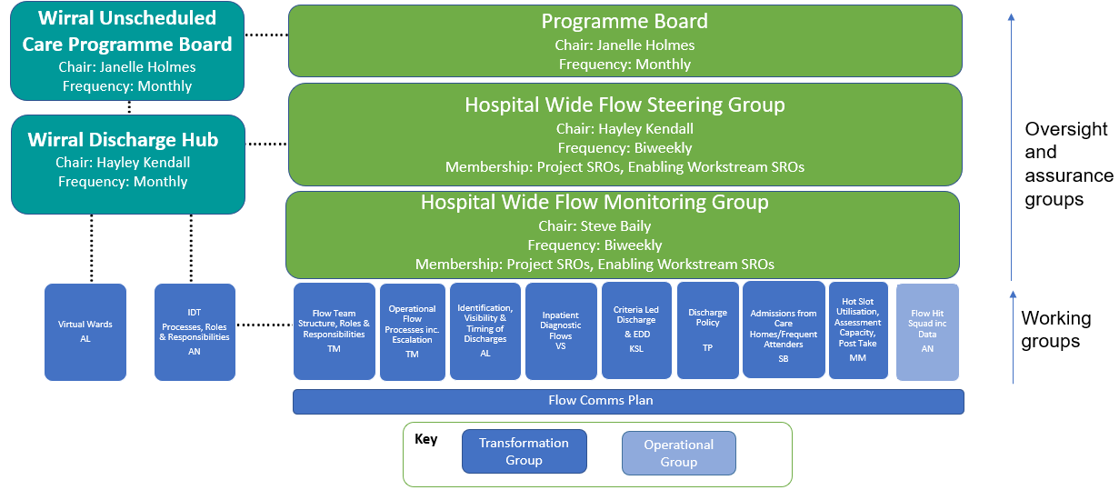
Background
Hospital Wide Flow Programme Scope and Governance Structure
Launched April 2023

Slide 5
Transfer of
Care Hub

Slide 6
Transfer of Care Hub
Timeline Overview of Improvement, 2023/24
NCTR 240
April
Established Transfer of Care Hub (ToCH) in shadow form with Discharge Director
May
Governance processes, including Discharge Hub Operational Group establishment
Enablers
Leadership
within ToCH
June
Top 30 patient tracking list and Safe Transfer of Care Workshops with Care Home partners
September
Daily validation of patient pathways and Care Home Placement Officer commenced
August
Daily tracking, monitoring and oversight of complex discharges
Enhanced system oversight and collaboration
NCTR 160
July
ToCH established, Social Care TUPE to WBC and Trusted Assessor TUPE to WIUTH
October
Demand exercise by ward for P1-3 discharge support with subsequent ToCH team restructure
Robust processes for patient tracking
December
System partner feedback
November
Commenced twice weekly team 2 & 3 huddles (focus 0-7 days NCTR patients)
Key: Q1 Q2 Q3
NCTR 110
Q4
Embedded daily workflow and ongoing monitoring

Slide 7
Transfer of Care Hub
Deep Dive into Timeline of Improvement, Q1 2023/24
Shadow Hub took ownership of the Top 30 progress chasing and discharge tracking
Escalation process for Domiciliary Care circulating > 24 hours agreed
Established Hub transition 9-week plan
Apr
Shadow Hub took ownership of the Top 30 reporting
Commenced development of weekly no C2R & Discharge data pack
Hub Team Leads meetings established
Scope key daily workflow processes to enable timely discharge
Discharge Hub Operational Group established (Chair Deputy COO)
Discharge Trackers attend afternoon ward huddles
Weekly whole Hub Team catch ups commenced
Introduced SToC document concept (remove N2A/Ds)
Commenced Professionals meetings for very complex discharges
Commenced point prevalence meetings to expedite P1/2 discharges
Social work team commenced using 3 conversation model (reduced reliance on assessment paperwork)
Commenced twice weekly Hub ‘Top 30’ review meetings (Tuesday/Thursday)
Teams Top 30 tracking list
Inaugural WUTH/ Care Homes Safe Transfer of Care workshops commenced
Commenced dialogue with Wirral Housing Options on homeless pathway
Discharge Cell meeting discussion now consider the top delays in WUTH; Home First & CICC
Standard Operating Procedure for Wirral Discharge (ToCH) being drafted with key partners
Ensured access to Teams; NHS Mail; Cerner for those TUPE who require it (supported by DPIA)
Hub Director joined Care Market oversight group meeting
May
Jun

Slide 8
Transfer of Care Hub
Deep Dive into Timeline of Improvement, Q2, 2023/24
ToCH established
Social Care Team TUPE to WBC
Trusted Assessor TUPE to WUTH
Jul
Engaged Organisational Development team to support Team Leads development
Business Support Manager commenced in role
Discharge list: to track daily complex discharges, delay and cancellations, wait list for D2A, HomeFirst, Age UK activity, out of area patients and community readmissions
Tracker for weekly discharge outcomes, so monitor actual discharges by pathway & by service
Hub Daily workflow tracker to support command meetings
Established weekly ToCH team leads meetings
Commenced daily validation of the new (0 days) no C2R patients and sign posting to pathways
Hub leads modelled daily discharge flow by pathway required (reducing the backlog)
Care Home Placement Officer commenced
Complex discharge Checklist initiated: sent to Wards, Flow Team, DHC four times a day/ 7 days a week
Collaborated with intermediate care wards at CBH to improve model of transfer
Aug
Sept

Slide 9
Transfer of Care Hub
Deep Dive into Timeline of Improvement, Q3, 2023/24
Oct
Hub Team Leads Development Day
Undertook demand exercise by ward for P1-3 discharge support to understand Hub structure required
Established Hub Teams 1, 2, 3 supporting agreed wards
Major Hub ‘dump the junk’ exercise over four weeks
Created space to store incontinence products to use when discharging patients to Care Homes
First Domiciliary Care WUTH event
Hub monthly Quality Board established and first meeting
Daily Team 1-3 no C2R list circulated within Hub
Project group established to focus on complex discharge pathways including Delirium, Non-weight-bearing, Bariatric and Homelessness
ToCH teams moved to co-locate as ‘Teams’
WBC Hub service manager appointed on secondment basis
Commenced twice weekly team 2&3 huddles (focus 0-7 days no C2R patients)
Nov
Scoped hub refurbishment (co-locate Nurse & professional leads, Trusted Assessors & Care Home Placement Officer)
Team huddles commenced Tuesdays and Thursdays to review and validate no C2R patients 0-7 days
TTH tracker visibility within ToCH
TV screens located for Team ‘command’ working, computers, keyboards/mouse ordered
Age UK SPA ‘go live’ 4/12 to give enhanced support for people going home and link wider VCSEF organisations
Embedded daily workflow and ongoing monitoring
Sent Questionnaire to Care Homes to ascertain feedback on improvements
National Pilot site for adopting the new NCTR coding model with DHSC.
Dec

Slide 10
Transfer of Care Hub
Deep Dive into Timeline of Improvement, Q4, 2023/24
Jan
NCTR and status capture (via Cerner)
Safe Transfer of Care document – agreed at CDDA 18/1/24 as priority
Therapists joining twice weekly Team 2 and 3 huddles. Team 1 huddles to commence 22/1/24
B6 Discharge Coordinators/Social Work Development Programme
Commenced workflow admin development (embed workflow and reporting responsibilities)
Age UK target wards 21, 22 and 31
Establish Care Home discharge ‘wellness’ calls
Maximise Age UK going home service for HomeFirst discharges
MCA training for Discharge Coordinators
SNOPSs to collocate with Hub Team - complete
Feb
Delirium pathway workshop – recovery in community
Bariatric pathway through acute and rehabilitation
Second Trusted Assessor and WCB Professional Lead due to commence in March 2024
Department of Health and Social Care visit March 2024
Mar

Slide 11
Transfer of Care Hub
Summary
WUTH have proactively undertaken a significant amount of work during 2023/24 to ensure the right patient, is treated in the right place, at the right time.
This has included: the establishment of the ToCH, embedded leadership, refinement of processes to ensure robust patient oversight and tracking, commitment to collaborative and partnership working.
Outcomes are reflected in Section 3.
WUTH ambition is to continue this work to further drive down the number of NCTR patients residing in acute hospital beds and reduce the length of stay for this patient group further.

Slide 12
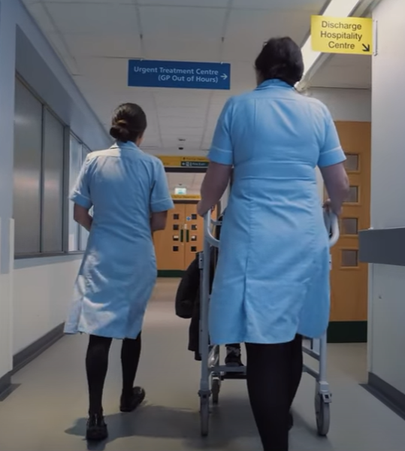
Outcomes

Slide 13
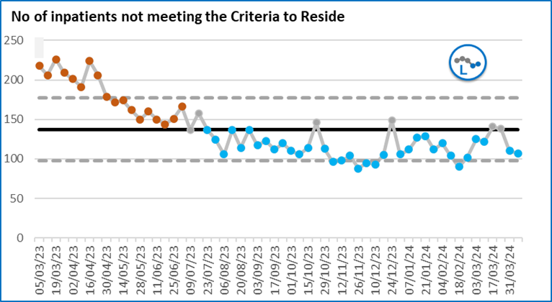
NCTR Position
WUTH established Transfer of Care Hub in shadow form with Discharge Director.
Executive Discharge Cell commenced.
Focus on improved pathways and processes and escalations.
Visibility of data and where delays were occurring.
Formal establishment of the Transfer of Care Hub at WUTH.
Social workers transfer back to LA and come under single WUTH leadership structure in collaboration with LA.
New reporting arrangements introduced.
Reduced transactional hand offs between organisations.
100 no-criteria to reside patients achieved from 260 at its highest point

Slide 14
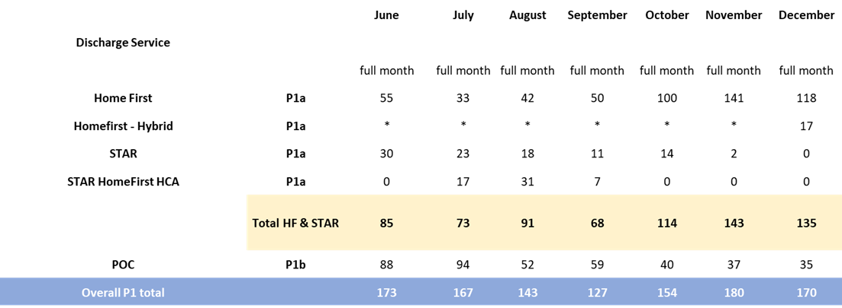
Pathway 1 Discharges
Home First has had a significant impact on capacity to reduce the non-criteria to reside position.
This has been offset by the reduced numbers of packages of care, so the net pathway 1 discharge volumes have not changed

Slide 15
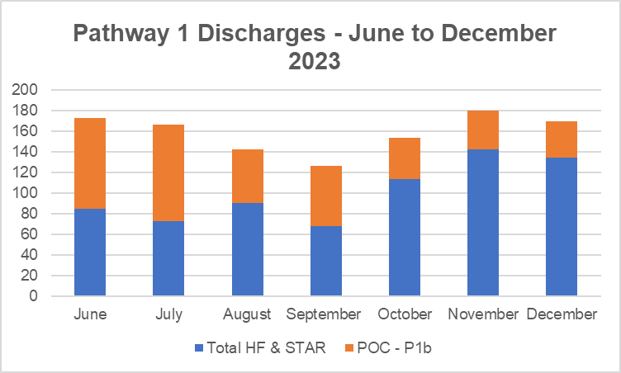
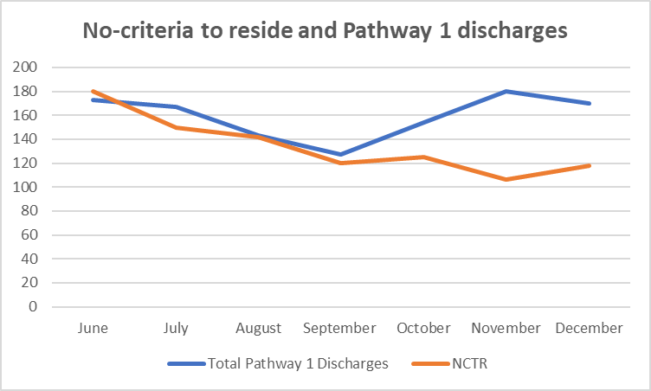
Pathway 1 Discharges
In summary the number of pathway 1 discharges from WUTH have not changed over the period.
There has been a shift from packages of care to Home First.
Utilising the data it seems that the streamlining of processes has had the largest impact in reducing the number of beds occupied by patients that do not have a criteria to reside, in addition to reducing the length of stay for patients with no criteria to reside.

Slide 16
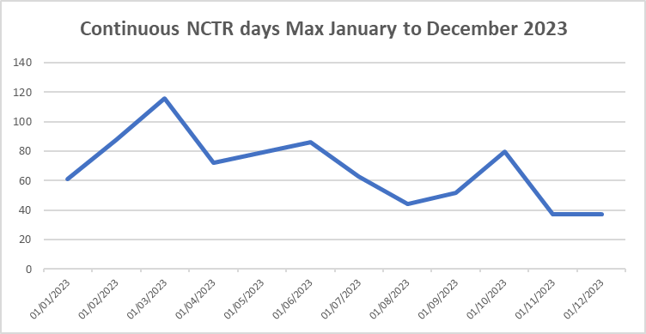
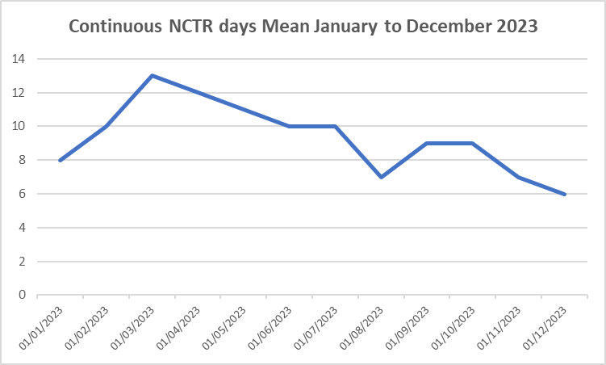
NCTR - Length of time to discharge
Maximum continuous NCTR –
Reduced from 116 to 37 days
Continuous NCTR mean –
Reduced from 13 days to 6 days
Demonstrated a reduction in length of stay for patients from the point of meeting NCTR.

Slide 17
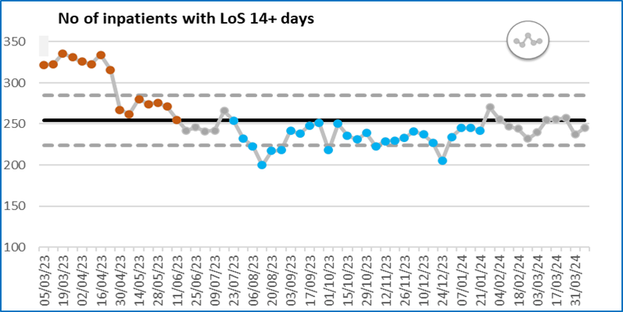
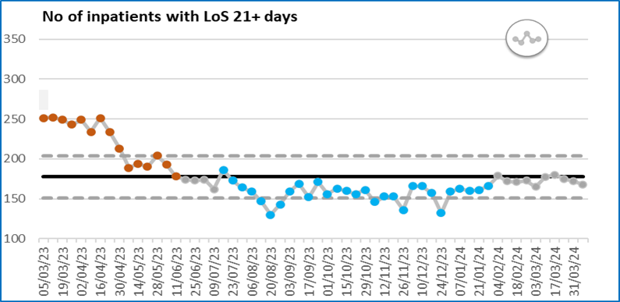
Long LoS Hospital Wide
14+ & 21+ day LOS charts illustrate the sustained nature of the reduction over the last 12 months

Slide 18
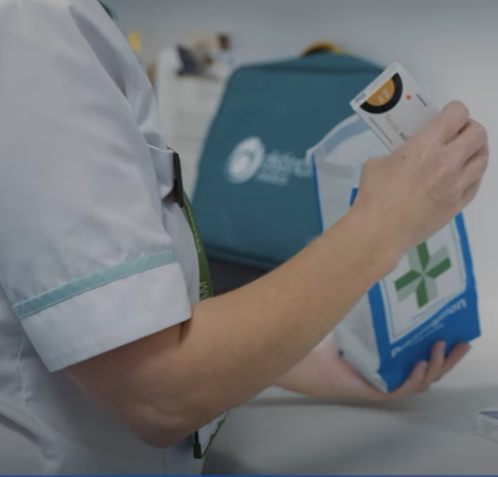
System Partner
Feedback

Slide 19
System Partner Feedback
ToCH Quality Board
The ToCH launched monthly Quality Board in October 2023 to ensure patient stories, system partner feedback and incidents are monitored and actioned to ensure the highest standard of care and safe transfer for patients.
Safe Transfer of Care Feedback Questionnaire
A series of Safe Transfer of Care workshops have been undertaken hosted by the Local Authority and attended by WUTH, Care Home partners, Domiciliary Care and Community Pharmacy. The purpose of the workshops was to build working relationships between the providers, understand each other's requirements and identify areas for improvement.
Following a number of actions being undertaken to enhance the transfer of patients out of hospital, WUTH actively sought system partner feedback via questionnaire circulated by the Local Authority. Feedback will be used to highlight further areas of improvement.
The questionnaire was circulated in December 2023 for initially a two weeks period and then extended for a further two weeks in January 2024 to maximise the number of responses.
6 Care Home and Domiciliary providers returned completed questionnaires.
Overview of Questionnaire Results
66.7% reported improved communication between WUTH and their service (remaining 2 selected neither agree or disagree).
100% of respondents value the role of the Trusted Assessor.
66.7% reported the quality of information about patients being discharged from hospital has improved.
66.7% confirmed that they know how and who to contact at the hospital if they have any queries (remaining 2 selected neither agree or disagree).
Additional comments provided include:
“The communication has improved and the quality of discharges”
“Discharge information has improved and the quality of the service”
“The Trusted Assessor is very valued by Elderholme and makes Transfers quicker and communicates well”
“I am aware that the Care Home Placement Officer is ensuring the right referrals are being placed”
Safe Transfer of Care Feedback Questions

Slide 20
Summary and Benefits

Slide 21
Summary and Benefits
Significant progress has been made in reducing the NCTR position at WUTH.
There has been no change in the volume of Pathway 1 discharges from WUTH.
The Transfer of Care Hub has been instrumental in achieving these statistical improvements.
The length of time patients are waiting from discharge ready to actual discharge has significantly reduced and maps with the transactional improvements in the Transfer of Care Hub and other improvement programmes from our Wirral partners.
The Home First service has been considerable in supporting the improved NCTR position and has been a great success as well as significant improvements in the care market sufficiency project.
The above has been offset by a reduction in the number of Pathway 1 discharges to a package of care.
To improve the performance further we need to maximise the package of care discharges to achieve the next stretch target for NCTR.
Quality Benefits
Patient | Significant and sustained reduction in the number of NCTR patients residing in acute hospital beds and for reduced bed days, resulting in patients being cared for in the most appropriate setting. Acutely unwell patients being treated in the most appropriate setting due to increased access to hospital beds. Safe transfer of care.
System | M3 escalation ward sustained closure. Appropriate allocation of resource to care for patients. Collaboration and partnership working.

