Slide 1
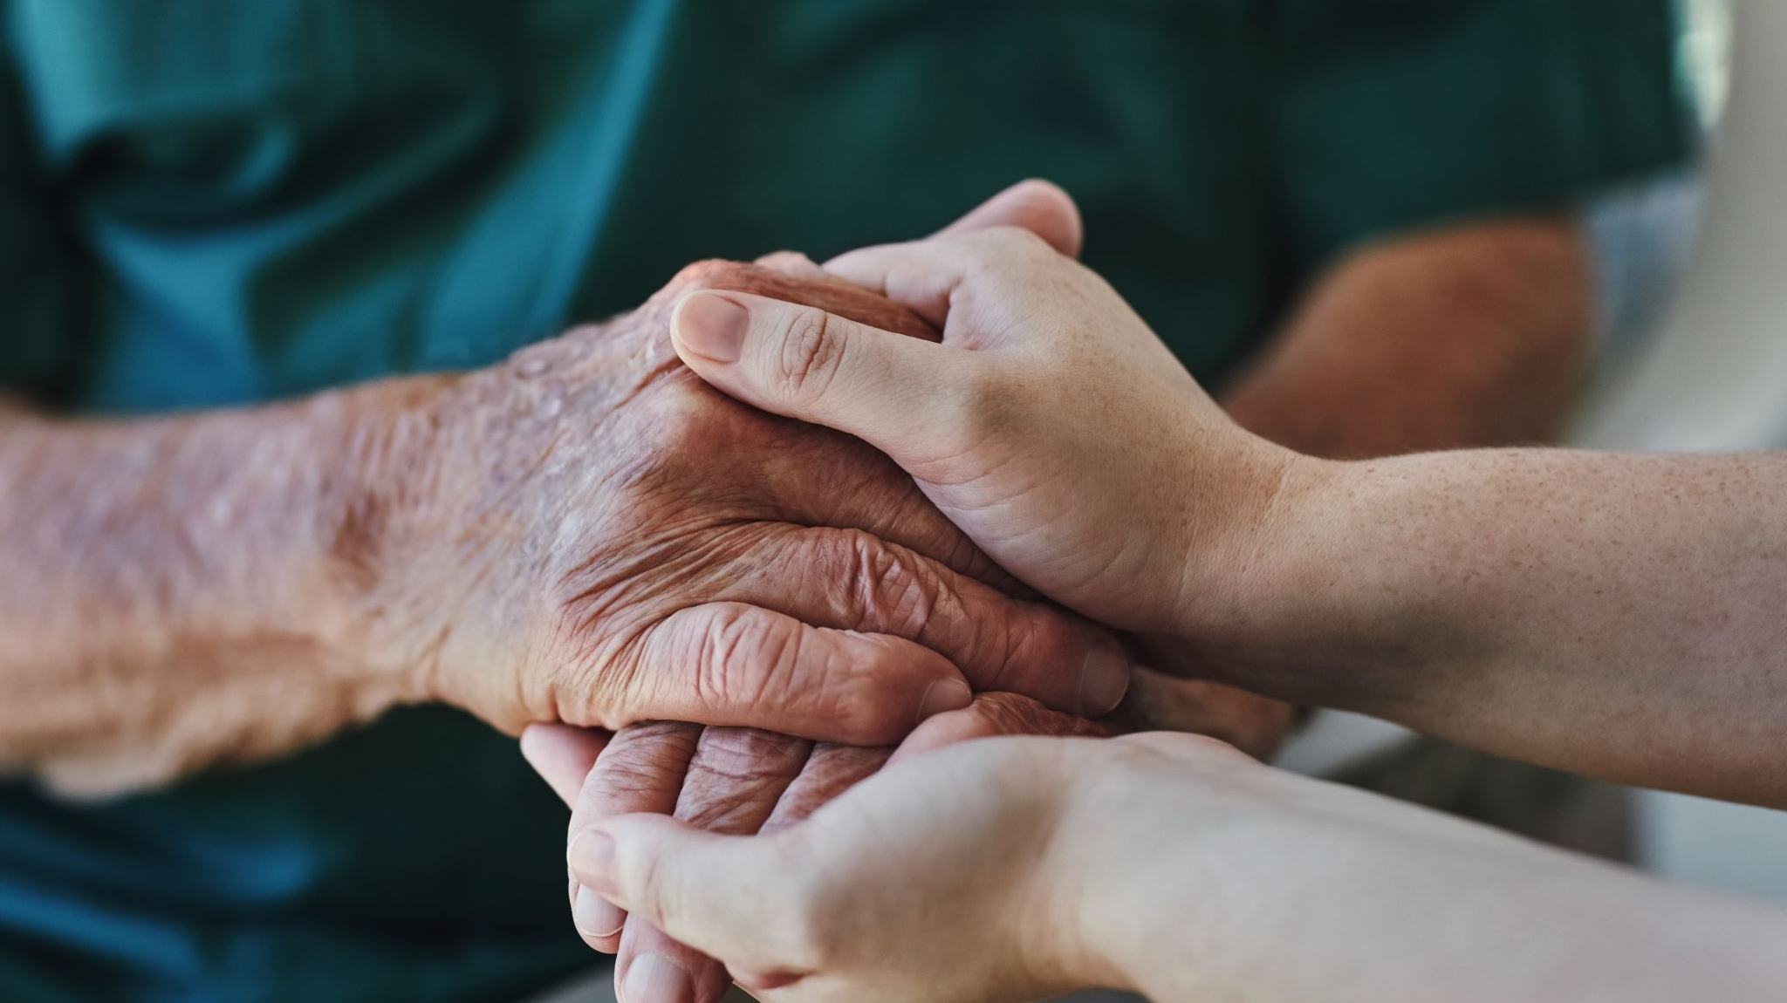
Clinical and Care Leadership: Opportunities for IMPACT
Jen Kohan, Health Innovation North West Coast
Suzy Ning, Clinical Leaders Network

Slide 2


In this session we will develop shared understanding of Clinical and Care Professional Leadership within the context of IMPACT.
In the next 30 minutes we will:
Explore your identity and role as a clinical and care leader
Generate ideas and inspiration for meaningfully leading IMPACT at scale
Create collaborative commitments for supporting integration of CCPL and IMPACT

Slide 3
Clinical and Care Leadership
Framework
(CCLF)
Integrate clinical and care professionals in decision making at every level of the ICS
1
Create a culture of shared learning, collaboration and innovation, working alongside patients and local communities
Our Clinical and Care Constitution will work alongside the Clinical and Care Leadership Framework.
The constitution will be the set of principles that clinical and care leaders are asked to reference when involved in service and system design and decision making.
Approving this constitution gives them the ICB-level support they need to guide them in their leadership roles.
2
Ensure clinical and care professional leaders have appropriate resources to carry out their system roles
3
Provide dedicated leadership development for all clinical and care professional leaders
4
Identify, recruit and create a pipeline of clinical and care professional leaders
5

Slide 4
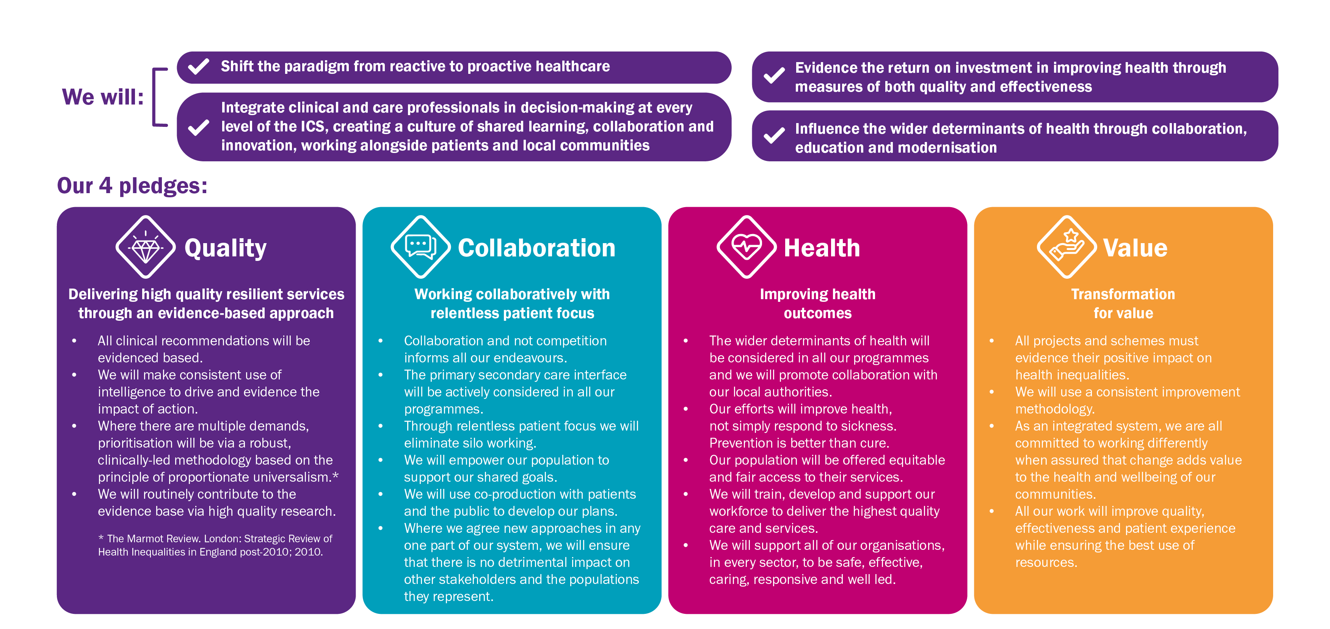
Our Clinical and Care Constitution
Our Clinical and Care Constitution is a set of principles that underpin all we do. It has been written by clinicians with input from clinical and care colleagues to support the Cheshire and Merseyside Integrated Care System (ICS) to develop with our partners an overarching population health approach, driven by the needs of our communities, with a clear focus on addressing health inequalities.
Enablers:
  Wide engagement across health, social care and the voluntary, community, faith and social enterprise sector
  Clinical strategy informed by the richest intelligence and supported by QI methodology
  World-class research and innovation in partnership with our academic institutions
  Clinical and care professional leadership framework with a focus on workforce development

Slide 5
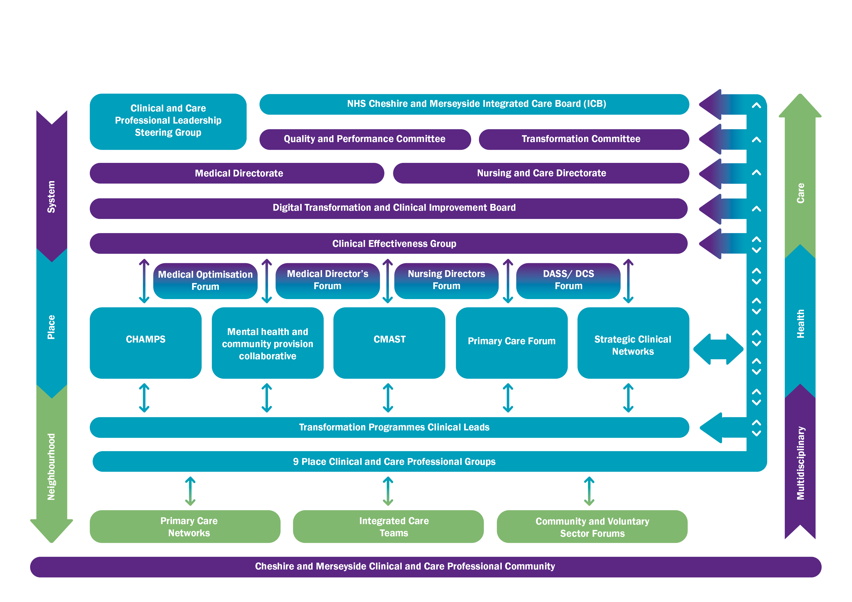
Our Leadership Structure
Clinical and care leaders are represented in all groups and committees
Our clinical and care system is complex.
It has multiple nodes of leadership and strategies for its development.
Our constitution aims to establish and use commonly agreed and understood principles in all nodes of the system for how we will design and deliver our services in the future to best support the populations we serve.

Slide 6
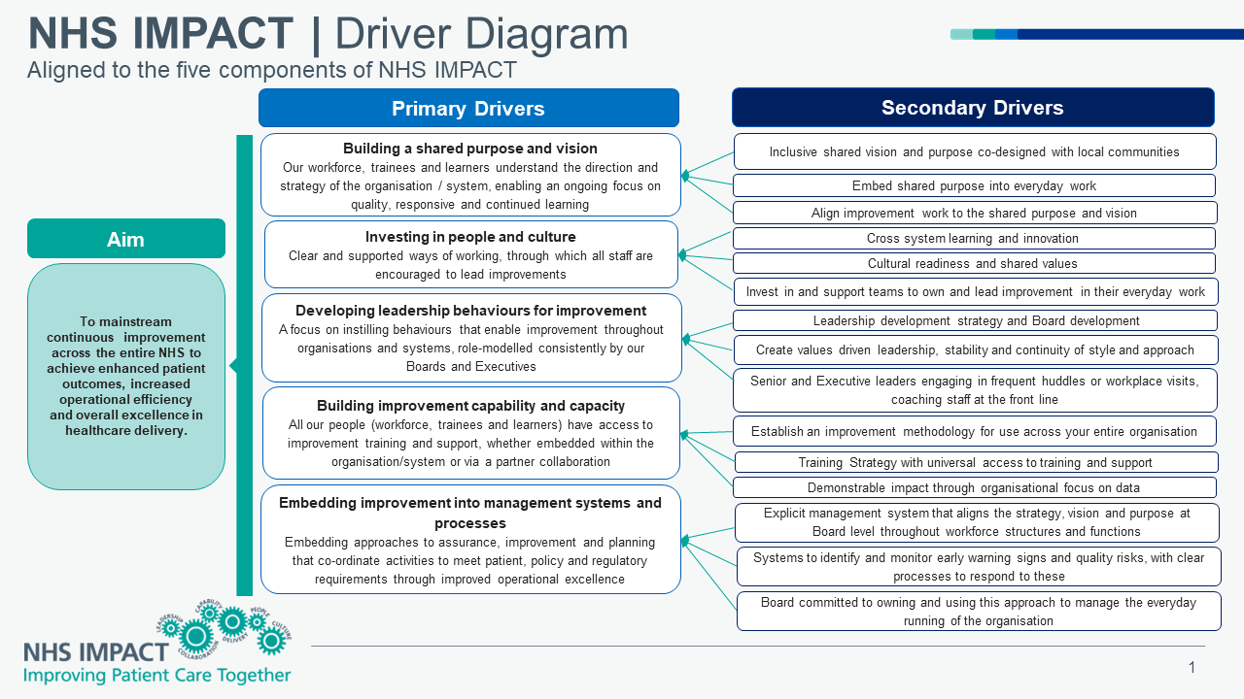

Slide 7

We are going to use Slido to gather some input…
Please take out your phones…

Slide 8

The infinity diagram: our plan for continuous improvement
Our design team and wider health and care community values continuous improvement and reflective practice to help us improve health and care outcomes and eliminate inequalities for the people in Cheshire and Merseyside.
This infinity model demonstrates the planning and implementation process guiding our shared work. Insights and outcomes from cycle activity and reflections will inform future aims and goals, to support ongoing, system-wide improvement across all health and care professions.
The following slides outline our plans to bring the interwoven guiding principles within our framework to life.
Stage 1: Setting aims and goals
Stage 3: Refining the work
(Resource and invest)
(Reflect and refresh)
Stage 2: Launching the work
Stage 4: Evidence-based reflection

Slide 9

Clinical and Care Professional Leadership:
Inclusive Decision Making
Stage 1: Setting aims and goals
Stage 3: Refining the work
Align CCPL ideas with emerging, related ICS strategies, particularly the quality strategy, and other related functions
Engage in a robust system mapping exercise to uncover communications channels and identify inclusive CCPL needs from all communities
Monitor implementation of framework to ensure coordination with relevant ICS structures and workstreams
Check system mapping outputs for accuracy and share
(Resource and invest here)
(Reflect and refresh here)
Stage 2: Launching the work
Stage 4: Evidence-based reflection
Connect with system leaders to strategically integrate goals and planned activity across ICS workstreams
Continue system mapping exercise to align communications channels and identify CCPL needs
Align CCPL ideas with emerging, related ICS strategies, particularly the quality strategy, and other related functions
Regular reviews of the system mapping – continue and update as system develops

Slide 10
Clinical and Care Professional Leadership:
Inclusive Decision Making
To make it work:
We will undertake a whole system mapping exercise:
Mapping existing leaders and opportunities for the development of future Clinical and Care Professional Leadership at neighbourhood, place, and system levels
Map structures to identify current leaders and identify where we have leadership gaps to ensure representation
Continue to develop our structures to maximise the potential for clinical and care professional leaders to influence ICS decision making
Through the leadership structure, our senior clinical and care professional leaders will ensure there is active engagement and communication through neighbourhood and place so that members of our workforce are informed, can contribute to, and influence decision making.

Slide 11

Clinical and Care Professional Leadership:
Culture, Shared Learning, and Inclusion
Stage 1: Setting aims and goals
Stage 3: Refining the work
Articulate need for relationship and trust building between health and care professional communities within and across all sectors
Map out learning opportunities and communities of practice
Gather data and input to define priorities for care quality, population health, and health inequalities in collaboration with other relevant professional groups
Continue relationship and trust building between health and care professional communities within and across all sectors
Convene clinical and care leaders in a system-wide conference to share learning and address challenges together
Utilise innovative data and change methodology to collaborate at scale
(Resource and invest here)
(Reflect and refresh here)
Stage 2: Launching the work
Stage 4: Evidence-based reflection
Plan for relationship and trust building activity between health and care professional communities - all sectors
Collaborate with learning and culture stakeholders and experts
Plan for innovation and improvement work to address care quality, population health, and health inequalities challenges
Reflect on relationship and trust building between health and care professional communities within and across all sectors
Gather and reflect on learning from collaboration to scale-up successful work, address new challenges, and shift outdated mindsets toward an improved, more inclusive culture of care

Slide 12
Clinical and Care Professional Leadership:
Culture, Shared Learning, and Inclusion
To make it work we will:
Launch our framework at an inaugural system wide CCPL conference
Develop an engagement plan that is inclusive and universally accessible
Develop communities of practice for shared learning that supports the roll out of innovation
Adopt a restorative practice approach
Engage with staff representative groups across professions and at every level
Provide reverse mentoring opportunities
Collaborate with learning and culture stakeholders to align and coordinate learning opportunities
Plan for innovation and improvement work to address care quality, population health, and health inequalities challenges
Build an inclusive and committed CCPL Advisory Council
Support multidisciplinary place-based CCPL groups
Capture outputs from action learning across the system to inform future goals and translate outputs into population outcomes

Slide 13
Clinical and Care Professional Leadership:
Leadership and Pipeline Development
Stage 1: Setting aims and goals
Stage 3: Refining the work
Health and care staff across each place will connect with experienced mentors and coaches to support ongoing development
Workforce leaders from all sectors will collaborate with representatives from CCPLs to establish desired system-wide outcomes from shared leadership development and recruitment aims
Health and care staff members deepen their development activity to align professional practice with place-based goals
Role model distributed leadership across the system
ICS health and care system representatives collaborate to support and ensure capacity for sustaining ongoing leadership and pipeline development work
(Resource and invest here)
(Reflect and refresh here)
Stage 2: Launching the work
Stage 4: Evidence-based reflection
Health and care staff members enact learning and development plans, with support of shared system resources
Leaders from health and care at place activate plans to ensure that leadership development and recruitment goals are realised for members of the workforce at all levels and across all neighbourhoods and care settings
Health and care staff members integrate information and insights from learning cycle for improvement work and development
ICS health and care representatives collaborate ensuring insights and outcomes from leadership and pipeline development cycle inform shared decision-making

Slide 14
Clinical and Care Professional Leadership:
Leadership and Pipeline Development
To make it work we will:
Establish our CCPL Steering Group to put a plan in place for a system-wide leadership development offer
Assess development needs of the CCPL community
Work with our Universities to support development of future leaders
Agree resources to implement individual and team development and recruitment plans, in conjunction with relevant development organisations
Adopt a Talent Management Approach
Provide coaching and mentoring support to our health and care leaders
Utilise insights from learning cycles to continuously review and improve current practice, and drive future development aims

