Slide 1
NHS IMPACT
Improving Patient Care Together
What is NHS IMPACT and why is it important’
John Ashcroft
Director of NHS IMPACT and Pathway Transformation

Slide 2
The evidence base
Every NHS provider that has achieved a rating of “outstanding” from the CQC has a systematic approach to quality improvement.
Done well, organisation-wide or system wide quality improvement leads to sustainable improvements in:
The quality, experience and outcomes of care
Use of resources
Health equity
The wellbeing of people who work in the system
Levels of engagement
Connections and collaborations for better outcomes
Sources of evidence:
Braithwaite (2019) Health systems improvement across the globe: success stories from 60 countries
Burgess (2022) Leading change across a healthcare system: How to build improvement capability and foster a culture of continuous improvement
Fulop and Ramsay (2019) How organisations contribute to improving the quality of healthcare
Institute for Healthcare Improvement (2021) Whole system quality: a unified approach to building responsive, resilient health care systems.
Shah and Course (2018) Building the business case for quality improvement: a framework for evaluating return on investment
The Health Foundation (2021) Quality Improvement made simple
The Strategy Unit (2022) What matters when waiting? – involving the public in NHS waiting list prioritisation
Notes:
Evidence shows that those organisations which have embedded a single approach to improvement deliver consistent, high-quality services with improved health outcomes.
Every NHS provider that has achieved a rating of “outstanding” from the CQC has a systematic approach to quality improvement.
The best healthcare organisations across the world, including in the NHS, invest time and effort to build an improvement culture. It is at the heart of how they operate and means that every member of staff is encouraged and supported to improve the work they do every single day.

Slide 3
NHS IMPACT (Improving Patient Care Together)
Five components form the ‘DNA’ of all evidence-based improvement methods, which underpin a systematic approach to continuous improvement:
Building a shared purpose and vision
Investing in people and culture
Developing leadership behaviours
Building improvement capability and capacity
Embedding improvement into management systems and processes
When these five components are consistently used, systems and organisations create the right conditions for continuous improvement and high performance, responding to today's challenges, and delivering better care for patients and better outcomes for communities.
Notes:
NHS IMPACT (Improving Patient Care Together) was launched in April 2023, it identifies the 5 core components of an improvement approach to support organisations, systems and providers to shape their development strategy, and to share best practice and learn from one another.
It encourages partnership working between providers, integrated care systems, regions and national NHS England to embed an improvement method and culture aligned with NHS IMPACT.
NHS IMPACT strives to enable an improvement approach across the NHS, where continuous improvement is the 'go to' method for tackling clinical, operational and financial challenges.
The five components are:
Build a shared purpose and vision so that everyone understands what they are trying to achieve, how they are going to achieve it and how quality improvement will support them to achieve their objectives
Invest in people and culture by skilling people up and change processes for improvement to become a routine part of everyday work
Developing leadership behaviours so that leaders are present, listening about ways to improve services, encouraging and enabling collaboration and helping to move forwards and removing blockers on the way
Building improvement capability and capacity - by providing training in improvement methodology for everyone at all levels
And embedding improvement into management systems – into every process including procurement, operational planning and human resources (HR).
The NHS IMPACT team are developing tools and resources to support the implementation of these components into NHS England Programmes.

Slide 4
“No country in the world has done what NHS England are trying to do…no country in the world has attempted improvement at the scale of a population of 50million plus……”
Sir Chris Ham, November 2023

Slide 5
2024/25 Priorities and Operational Planning Guidance
NHS IMPACT will support delivery of clinical and operational excellence, helping to develop the leadership and organisational capacity, capability and infrastructure to create the conditions for improvement.
It will also deliver a small number of centrally led national programmes to drive adoption and local adaptation of operational processes and clinical pathways that are proven to improve quality and productivity. The focus for 2024/25 will be interventions that improve patient flow.
2024/25 priorities and operational planning guidance (page 6)
Notes:
NHS IMPACT (Improving Patient Care Together) was launched in April 2023, it identifies the 5 core components of an improvement approach to support organisations, systems and providers to shape their development strategy, and to share best practice and learn from one another.
It encourages partnership working between providers, integrated care systems, regions and national NHS England to embed an improvement method and culture aligned with NHS IMPACT.
NHS IMPACT strives to enable an improvement approach across the NHS, where continuous improvement is the 'go to' method for tackling clinical, operational and financial challenges.
The five components are:
Build a shared purpose and vision so that everyone understands what they are trying to achieve, how they are going to achieve it and how quality improvement will support them to achieve their objectives
Invest in people and culture by skilling people up and change processes for improvement to become a routine part of everyday work
Developing leadership behaviours so that leaders are present, listening about ways to improve services, encouraging and enabling collaboration and helping to move forwards and removing blockers on the way
Building improvement capability and capacity - by providing training in improvement methodology for everyone at all levels
And embedding improvement into management systems – into every process including procurement, operational planning and human resources (HR).
The NHS IMPACT team are developing tools and resources to support the implementation of these components into NHS England Programmes.

Slide 6
What CEOs asked for in April 2023
Lead by example, move from performance management to performance improvement.
Change leadership behaviours and make sure to use quality improvement methodologies
Have a smaller but high-quality resources that support improvement
Align our regulatory framework, the system oversight, the well-led framework and work jointly with the CQC.
Develop a simple, jargon-free self-assessment for improvement
Find ways in which organisations can leverage their assets and support those who are the most challenged.
Notes:
At Amanda Pritchard's leadership summit in April 2023, we sat down with the 200-plus chief execs from systems and from providers and asked them, what needs to be true at NHS England in order to create the context and the conditions for change?
They said that there were six things we could do:
Lead by example, move from performance management as our main tool to performance improvement.
Change leadership behaviours and make sure to use quality improvement methodologies to ensure we all get the benefits from them.
For policy teams, it means having a smaller but high-quality resources, that support improvement for those people who are working with patients and with populations in systems.
Align our regulatory framework, the system oversight, the well-led framework and work jointly with the CQC.
Develop a simple, jargon-free self-assessment (for improvement) so that we can understand and they can understand where their organisation's systems are on the journey. Support systems and provider collaboratives to enable them to leverage the quality improvement skills that already exist in their organisations
Find ways in which organisations can leverage their assets, coach, develop and help organisations that are at a different point in their journey is a key part of our approach. And support those who are the most challenged.

Slide 7
Where we are now
Launch of NHS IMPACT and awareness and engagement activity including NHS IMPACT series of events, FutureNHS and bulletin
NHS IMPACT Self-Assessment and Baseline for Improvement launched
Established the National Improvement Board
Leadership for Improvement development in collaboration with NHS England’s Workforce Training and Education
NHS England Executive workshop on own improvement journey
Implementation Framework in development
Procurement Framework in development
Notes:
We have launched NHS IMPACT and carried out extensive awareness and engagement activity including a series of NHS IMPACT virtual events, a FutureNHS workspace and an NHS IMPACT bulletin that I will come to later in the presentation and show you how to get involved.
We have published the NHS IMPACT Self-Assessment that is available on the NHS IMPACT website and carried out a stocktake of NHS improvement capability and capacity to give us a baseline for improvement.
The national improvement board has been established and meets monthly
We are working with the Workforce, training and education directorate here at NHS England on ‘leadership for development’. This includes an introduction to improvement e-learning course for all NHSE staff, a new chair and non-exec director induction and the development of regional workshops
NHS England has held an exec workshop to start to look at it’s own improvement journey
And we are co-developing an implementation framework and a procurement framework for NHS IMPACT.

Slide 8
Notes:
Established in September 2023, the National Improvement Board is chaired by David Fillingham CBE and Professor Andy Hardy is Deputy Chair. Ailsa Brotherton is the new Improvement Director. We are recruiting a National Clinical Director of Improvement. Dr Amar Shah is the first National Clinical Director for NHS Improvement.​
​
The Board is made up of CEOs from Trusts and ICBs, clinicians, improvement experts, and NHS England leaders.​
​

Slide 9
National Improvement Board Priorities FY23/24
The ambition of the NIB is to build local systems and culture so that in 5 years’ time every place and system will have its own management system, culture and all staff are focussed on improving their work – with a robust methodology behind it.
Five priorities:
Promote NHS IMPACT vision aims and framework
Inspire and encourage trusts, places, systems on improvement journeys
Strengthen delivery of key priorities (including safety) using an improvement led focus
Mobilise network of support partners
Engage, support and encourage NHS England’s improvement journey

Slide 12
NHS IMPACT Events
www.england.nhs.uk/nhsimpact/events
NHS IMPACT sharing events
Find out more and register: www.england.nhs.uk/nhsimpact/events
Embedding improvement: 16th May
Evaluating success: 10th September
Sustaining, scaling and spreading improvement: 3rd December
These virtual events are for anyone who’s curious about improvement. Hosted by Ailsa Brotherton, Improvement Director on the National Improvement Board and Director of Continuous Improvement at Lancashire Teaching Hospitals NHS Foundation Trust. Guest speakers include members of the National Improvement Board and wider NHS, visit the event page to find out more.
Notes:
Sign up for our NHS IMPACT events and join in the discussions

Slide 13
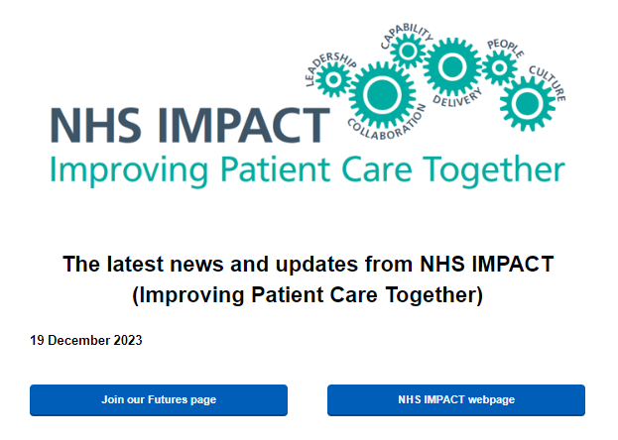
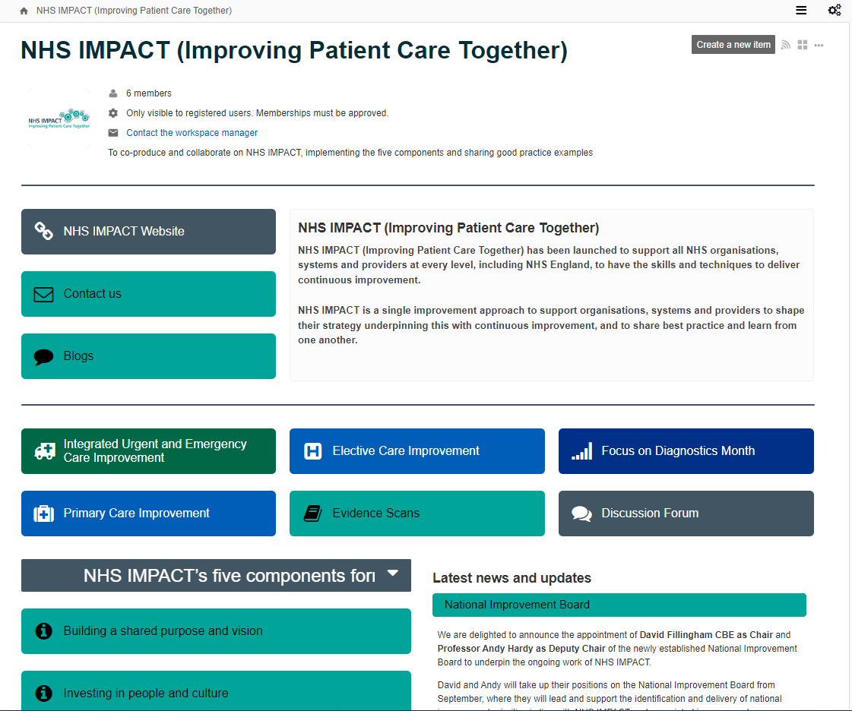
Find out more
https://www.england.nhs.uk/nhsimpact/
https://future.nhs.uk/NHSIMPACT/groupHome
https://www.england.nhs.uk/email-bulletins/nhs-impact/
Notes:
New resources and support tools are being added to the NHS IMPACT website as the programme develops. I’d like to encourage you to have a look at what’s available.
Become a member of the NHS IMPACT Future NHS Workspace, join in the discussions and connect with your peers
Sign up to the bulletin and be the first to hear the latest news and updates from NHS IMPACT

