Slide 1
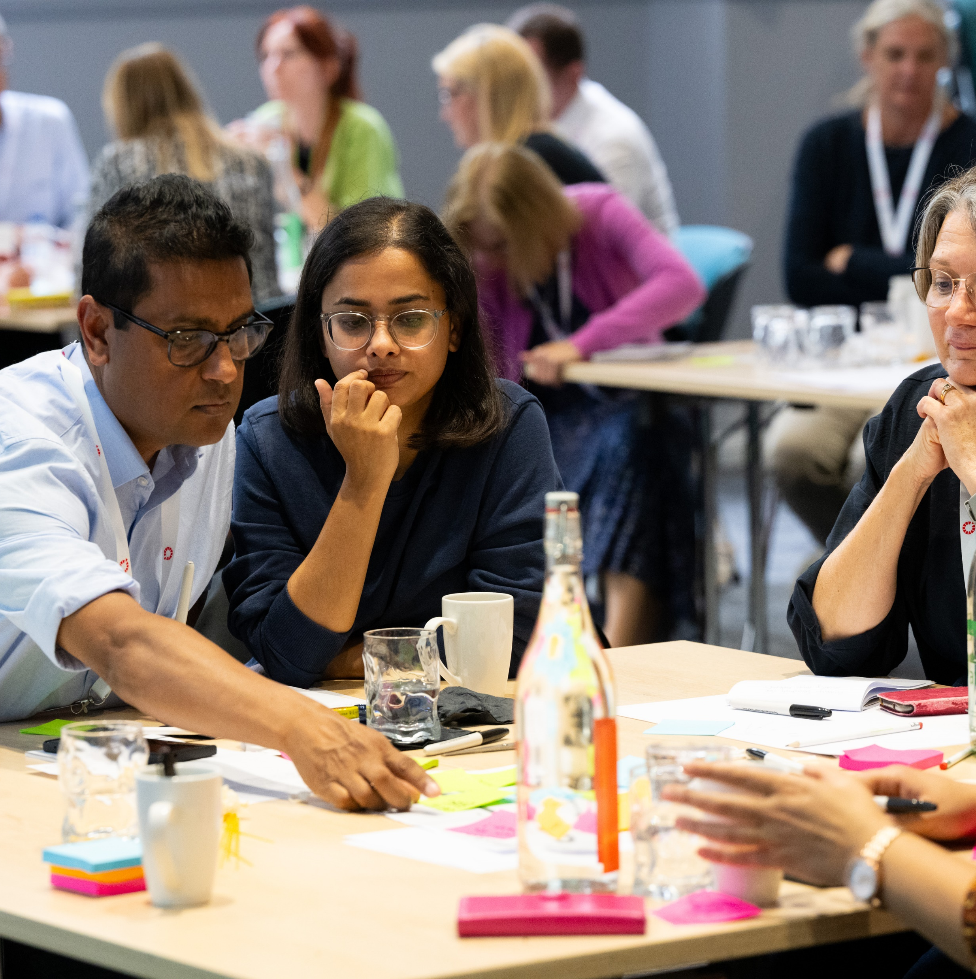

Learning and Improving Across Systems
April 2024

Slide 2

A complex living system

Slide 3

Improving Health and Care at Scale – The Experience of Systems
Scale of ambition: No country has ever put in place a learning and continuous learning and improving like NHS IMPACT; realism and constancy of purpose
Role of systems: Enabler and a convenor; ‘club and country’
Goal: ‘Self-organising systems’ - improvement and learning fundamental to this shift
Navigating tensions: short/ long term; changing patterns of embedded culture
Lots to be hopeful about: great examples of change exist; how can we amplify and learn from each other?

Slide 4
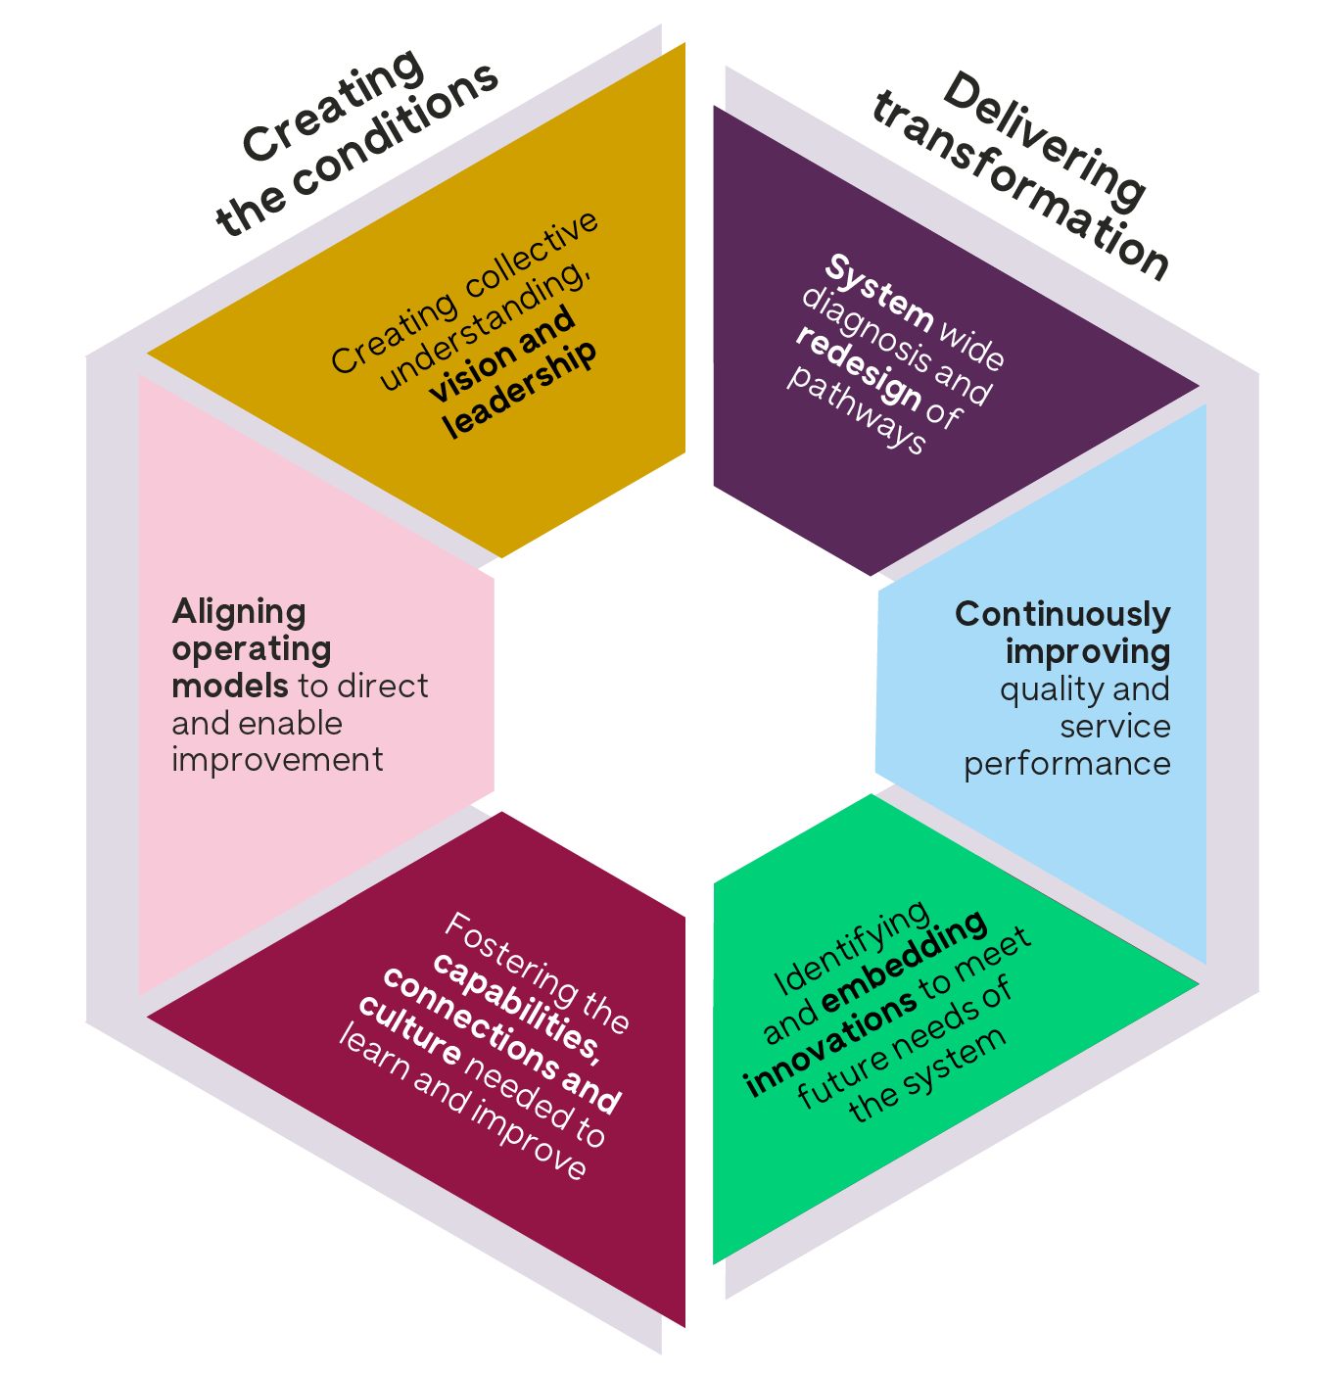

Notes:
We’re going to come back to the framework now. I’m going to walk you through the structure and highlights of the content, but first a bit more on why.
Why are we encouraging us to think about the work of improving across systems in this way and how can this help support the work we’ll do together through this programme?
Two aspects to this:
This framework sets out six domains of activity.
while there’s work been happening in all these areas for many years, we believe the next frontier to unlock progress is to be better at weaving together these different elements. I’ll say a bit about why.
And then we need to recognise that there’s lots we can draw on from work in these fields, but the majority of evidence is at team and org level. So this frameworks help us recognise what needs particular attention when working across multiple orgs.
This is based on work over the last 18 months with national partners for Q across UK and Ireland and the experience of people working in large scale change and our work with systems designing this programme. I’m really excited to think about how it will develop through the experience coming together in this group. So, I hope this provides a shared structure for our learning together, but also expect it won’t constrain us and will evolve.

Slide 5
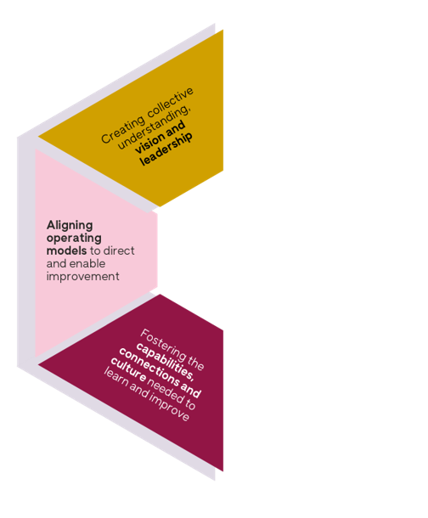
Creating the conditions
Notes:
So, let’s come onto why we need to weave together these different domains. I’m going to start with the domains on the left, focused on creating the conditions for improvement. This is the main focus for NHS IMPACT, relevant to those working in England.
However good the specific changes you want to make, we have learnt the organisational conditions are pretty critical to your chances of success.

Slide 6
We need to create the enabling conditions for sustainable change
Collective vision and leadership | An aligned operating model | Capabilities, connections and culture | You might expect to get…
Yes | X | X | An inspiring vision without the ability and skills to deliver: loss of momentum. Cynicism and low morale.
X | Yes | X | Processes that tick the boxes but lack buy in. Bureaucracy and disengagement.
X | X | Yes | People with energy and skills, frustrated by lack of support and scope for change. Small scale or short lived projects.
Notes:
This framework can help us reflect on why currently our improvement efforts can often fall short of expectations.
We think that’s partly because we neglect one or more of these domains.
This table is obviously simplifying. Collective vision and leadership isn’t something you have or don’t, but we hope this provides a way in to understanding what’s needed.
I’d love to hear your experience. What the evidence suggests is that if you just have strong vision for a particular service change, say changing the model of care to be less hospital centric, if you don’t back that up with an operational model for actually delivering the change and the supporting skills and relationships, then you might inspire people only to leave them feeling cynical and lacking momentum when you struggle to move to action.
If you were strong say on your delivery plan and structures but that shift in the model of care is weaker in the leadership support and skills from all who need to be behind it, you might see processes without buy in.
And often in improvement we see lots of energised pockets of change, but again and again struggling to sustain and scale.
We know the factors that make a difference if you want your change efforts to succeed. This framework and table brings home that it’s not enough to just do some of them – we need enough attention to all of these elements.

Slide 7
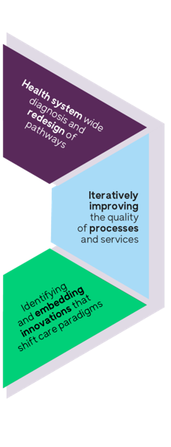
Delivering transformation
Notes:
Improvement approaches allow you to build the conditions for improvement at the same time as implementing changes, hence a framework that shows all domains together in a circle.
When it comes to the delivery of change, we talk a lot about transformation, but if that’s change that really shifts how the system delivers for populations, then we think we need to get much better at integrating the macro work of redesign, with the iterative improvement of processes and services and then pulls in innovations to support that service vision.

Slide 8
We need all strands for sustainable change
System and pathway redesign | Continuous quality improvement | Targeted innovation | You might expect to get…
Yes | X | X | Ambitious plans for shifting models of care that fail to work in practice. Limited benefits realised.
X | Yes | X | Incremental improvements that help maintain the current model of care. Limited scaling or bigger benefits.
X | X | Yes | Individual tech or other solutions that may not embed well or meet the priorities for the health system. Increased inequity. Wasted resource and potential.
Notes:
So, say you’re trying to change end of life care in a system, sometimes we have programmes that are focused on the macro design of a new pathway. If we have that without every service along the new pathway, within and beyond the boundaries of the NHS, able to understand, shape and implement the changes, often the strategy struggles to get into practice and we see limited benefits.
If we’re just doing continuous improvement projects without a clear enough overall vision for how the service overall should shift, we might make small changes, but may ultimately just hold the current care paradigm in place and see limited scaling.
And too often we’re introducing lots of tech or social innovations in a way that’s not tied in to the priorities for shifting end of life care for populations, we may waste resource and potential or exacerbate inequities.
Anyway, there’s lots we can get into over the course of this programme on all of this, but I want to turn now to the second way this framework seeks to support our learning together.

Slide 9
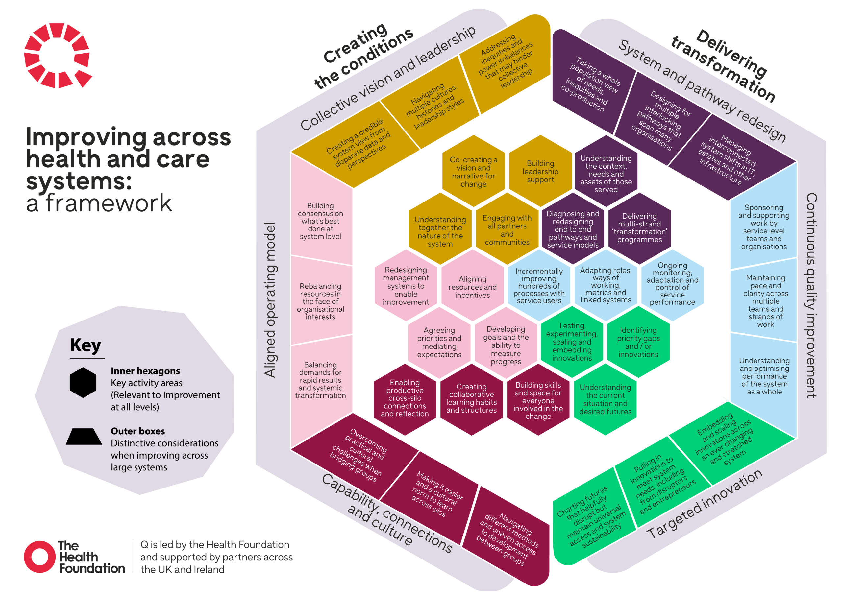
Notes:
This framework recognises working across systems brings some distinct additional considerations and that means the strategies that you use will sometimes be different.
We want to move beyond vague references to relational strategies or perhaps an overwhelming sense of it all being complex to focusing in on specific barriers, linked to particular types of work and then learn together the strategies we’re using to address them.
So, based on our work to date, the outer ring of the framework names 18 things that need particular attention when improving across multiple organisations in a place or system.
We’ll have time to dive into all of the ones that seem useful to you over the course of the programme and in a minute we’ll be asking you to tell us what’s most important to your work, but for now I’ll just dive into a couple of domains to help you navigate what’s there.

Slide 10
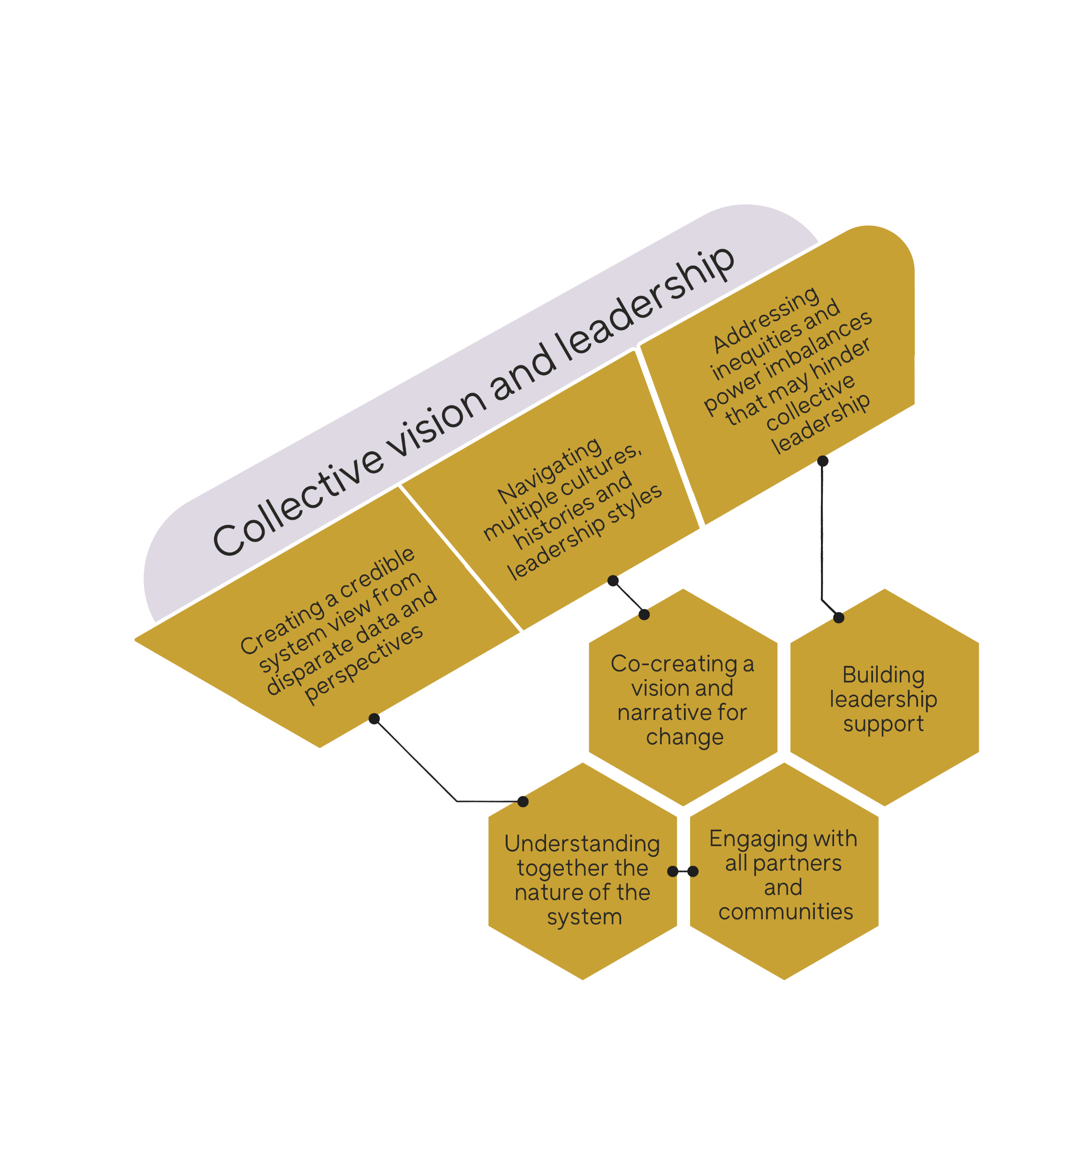
What’s distinctive when improving across systems?
Notes:
So if we zoom in on establishing collective vision and leadership.
The hexagons: summarise the work needed. We can signpost to resources and examples, recognising a lot is at the level of teams and organisations.
Then we’ve distilled three things that need particular attention when working across places or systems.
So, say you’re wanting to move to having integrated teams caring for populations in a neighbourhood or place, relative to doing improvement work within a single GP practice, there will be
the additional complexities of getting a clear view and data set
There will be many stakeholders involved who will bring different cultures and styles,
And that’s not just logistically challenging, it’s accompanied by power dynamics between different professional groups and between the NHS and VCS for example, that can get in the way of shared leadership.

Slide 11
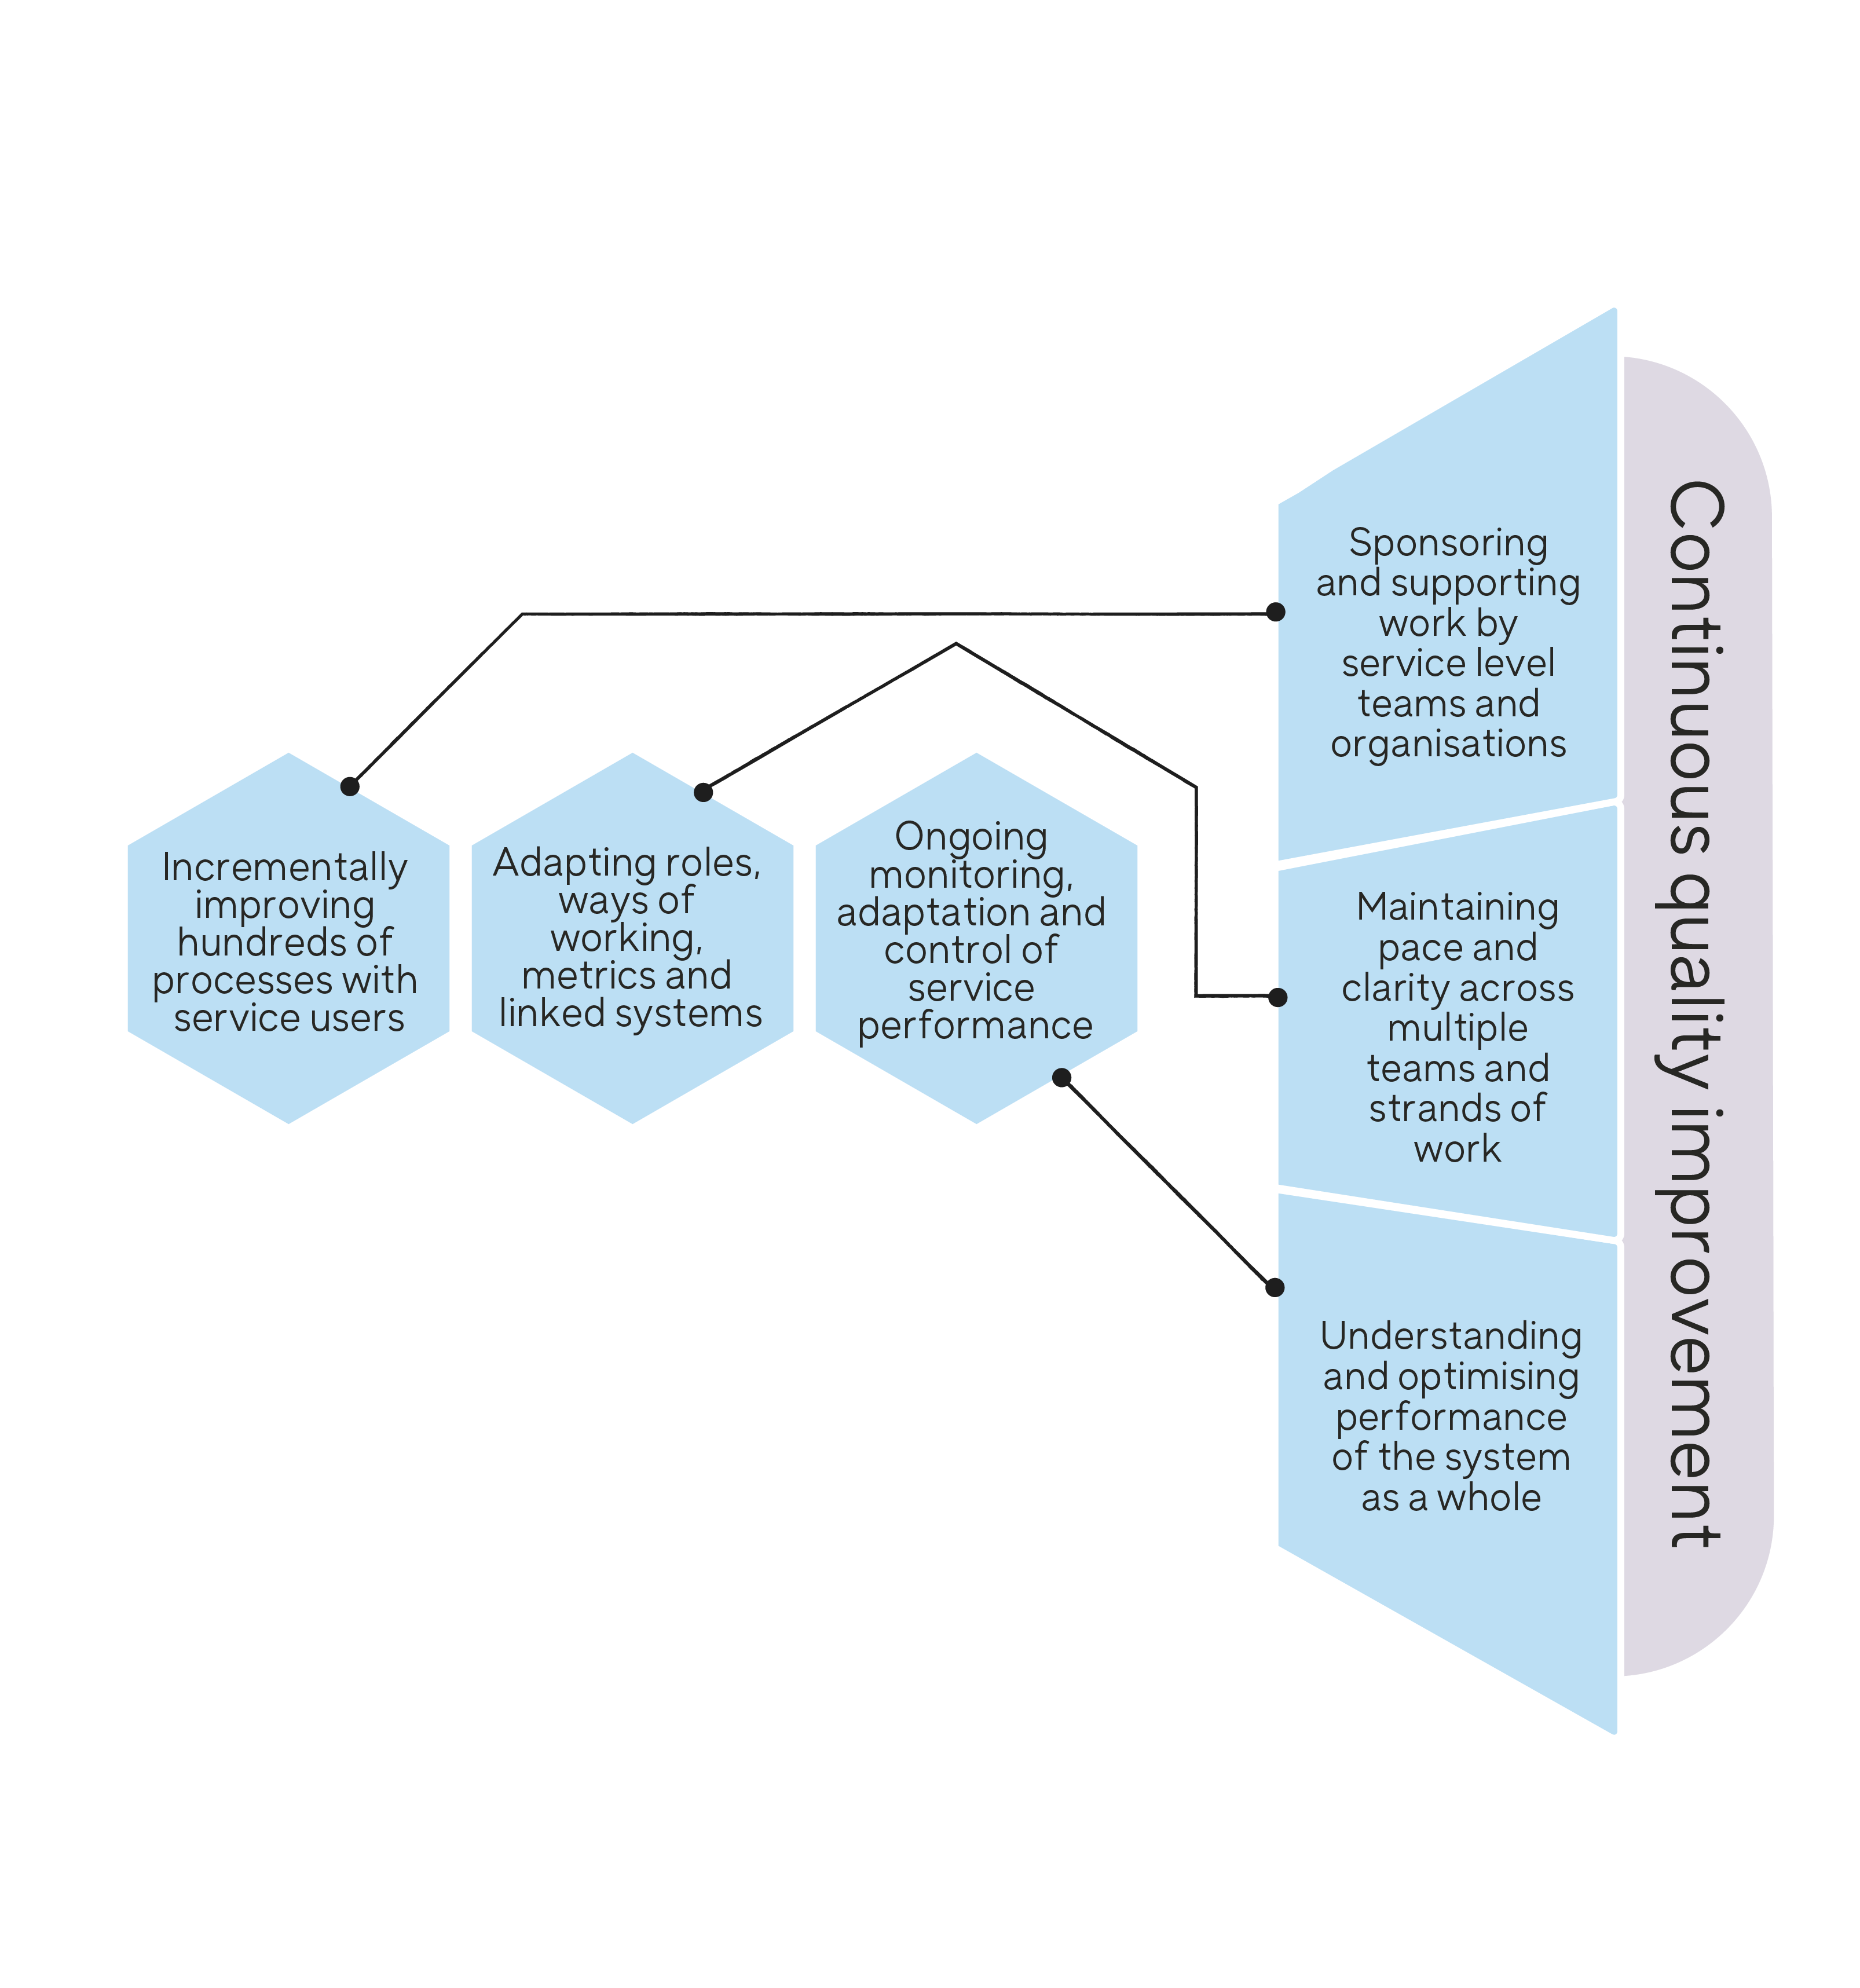
What’s distinctive when improving across systems?
Notes:
If we take one example from the right hand side, say you’re seeking to improve the way your place and system provides emergency care over winter, if you’re leading work at a system level, you’re more likely to want to be sponsoring and supporting process improvement happening within individual teams rather than doing that work directly.
There will be working happening across very many organisations and so co-ordinating that so there’s a clear purpose and appropriate pace brings a further layer of challenge than you would face in an individual ambulance service say. And when it comes to monitoring performance, understanding and doing the things that will optimise performance as a whole for an interconnected challenge like emergency care needs different data and strategies.
If we can really understand what’s different when improving at system level, we can both reinforce the critical added value of your work leading across systems and support you in taking action that’s most likely to succeed.

Slide 12
Notes:
There’s so much we could focus on here. I’m going to hand to Anindita now to get into group work so we can understand together where to focus.
We are now going to take a pause for you to reflect on what you’ve heard individually to understand where you are in relation to the content we’ve shared.
I’m going to give you a couple of minutes to think about where you are concentrating your efforts and energy now?
Are you thinking about one side – might be the left hand side as you’re embedding NHS Impact, is there a specific domain, or is it more specific and are you tackling one or two of the hexagons. I’ll also pop a link to it in the chat in case the text is too small on the slide.

Slide 13
Reflection and Discussion
How integrated are the whole and the parts of your system?
What feels most important for you right now across the domains?

