Slide 1
How the Model Health System can be used to support your improvement journey
Chloe Kastoryano, Relationship Lead
and
Dr Jim Hatton, Deputy Director of Analytics
NHS England

Slide 2
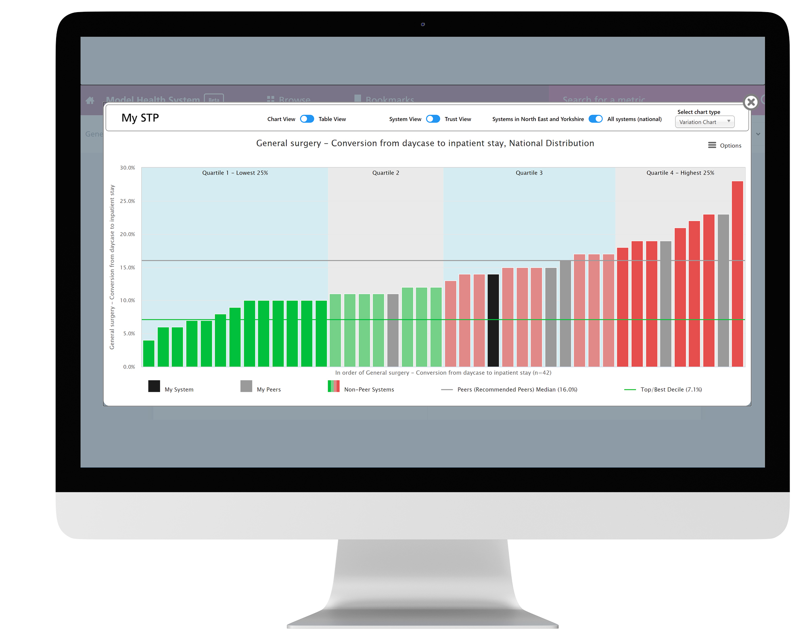
What is the Model Health System?
Established in 2016 as the Model Hospital following the Carter report – to reduce unwarranted variation
2020 evolved to the Model Health System to support system level opportunities
Provides data on healthcare activity, theatre productivity, diagnostics, quality, workforce and medicines optimisation and more to NHS Providers and ICBs/ICSs
Data covering acute, community, ambulance and mental health
Can be used by all NHS staff working within ICBs, systems and NHS providers in England
Register and log in at https://model.nhs.uk
Notes:
The MHS was established in 2016 as the Model Hospital, following the Carter report- to help trusts to identify unwarranted variation and to help drive improv using data from trusts and providers
In 2020 this was then expanded, and the data aggregated to a system level to allow trusts to now view their data at system (ICB) level. You can view your trusts data, and also the data of other trusts that are within your system
The MHS provides data on healthcare activity, theatre productivity, diagnostics, workforce and so on. We have over 20,000 sets of data on the platform.
Within that we have data covering acute, community, ambulance and mental health services
We encourage trusts or systems to put their own local perspectives on to the data to understand what’s happening locally or within their system
The MHS is all freely available to anyone and everyone who works in the NHS – from Board to ward
So please do register and login in at model.nhs.uk
Make sure you use your NHS email address when registering so we know you work in NHS and can approve your access quickly

Slide 3
Data Sources
Daily
Monthly
Quarterly
Mental Health Services Data Set. Electronic Staff Record.
NHS England monthly finance return (PFR).
Hospital Episode Statistics (HES).
Community Services Data Set (CSDS).
NHS England Cancer Waiting Times Database.
Secondary User Services (SUS+ and SEM - Standard Extract Mart).
Safe Staffing Monthly Published Data.
NHS England RTT-waiting-times.
NHS England Diagnostics Waiting Times and Activity.
Appointments in General Practice, NHS Digital.
Pharmacy Rx-info Define.
Procurement Spend Comparison Service (SCS).
England Agency Data Collection.
Electronic Staff Record.
Hospital Episode Statistics (HES).
Secondary User Services.
The National Quarterly Pulse Survey (NQPS).
NHS Digital - Quality and Outcomes Framework (QOF).
NHS Shared Business Service - Primary care prescribing.
Chemotherapy SACT Return.
Specialised services return.
Urgent Emergency Care.
Weekly
NHS England Secondary Uses Service Plus (SUS+) Inpatient and Outpatients.
COVID-19 Discharge Sitrep
Annually
Bi-weekly (every 2 weeks)
Annual Corporate Services return to NHS England.
Patient Level Information and Costing System (PLICS) Data Collections.
NHS Staff Survey.
Estates Return Information Collection (ERIC)
Waiting List Minimum Dataset.
NHSE National Theatre Data Collection.

Slide 4
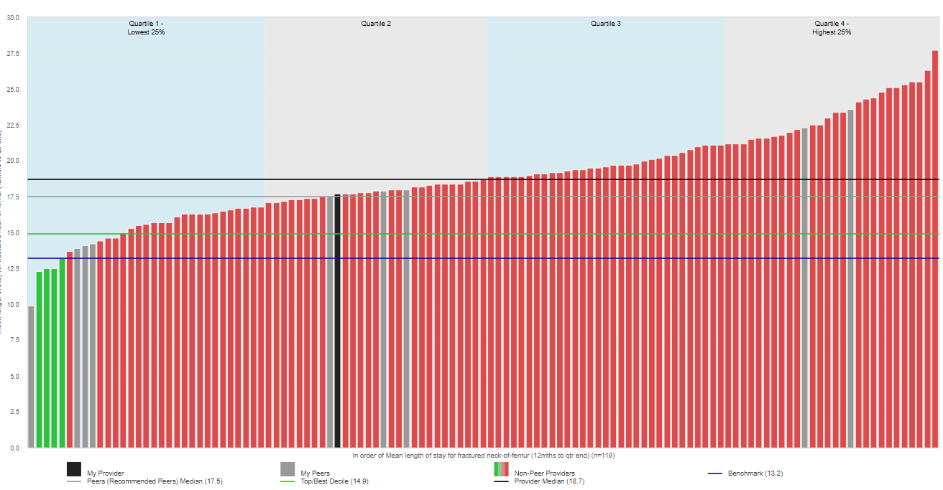
Benchmarking and peers
Allows trusts to benchmark against one another
Benchmarked against 10 recommended peers (grey)
Opportunity to change or select your own peers
Each metric provides information on data source, methodology and help interpreting
You can view as a chart or table and download the data
Notes:
One of the key function of the MHS is to be a benchmarking tool – it allows trusts to benchmark against their peers - this allows providers to compare their own performance against others to help identify ops for improv.
When you select a data set to look at a chart like the on displayed on the screen here will appear.
Your trust or system will be the black bar
You peer trusts or systems in grey
We produce a recommended peer list and this is based on the trusts most similar to yours, in terms of factors that determine your productivity (cost per WAU).
You do have the function to change your peer list so that you can compare your productivity and performance, and benchmark against other similar trusts
You might use a different peer lists for different topic areas - for example, for the different clinical service lines
Choosing peers with a similar size, case mix and other characteristics will help you identify warranted and unwarranted variation
And below each chart you will find information about the data sources, methodology, when it will be updated and support with interpreting this information
On each chart you also have the function to view it as a table or trendline when available, and you can also download the data in to an excel document.

Slide 5
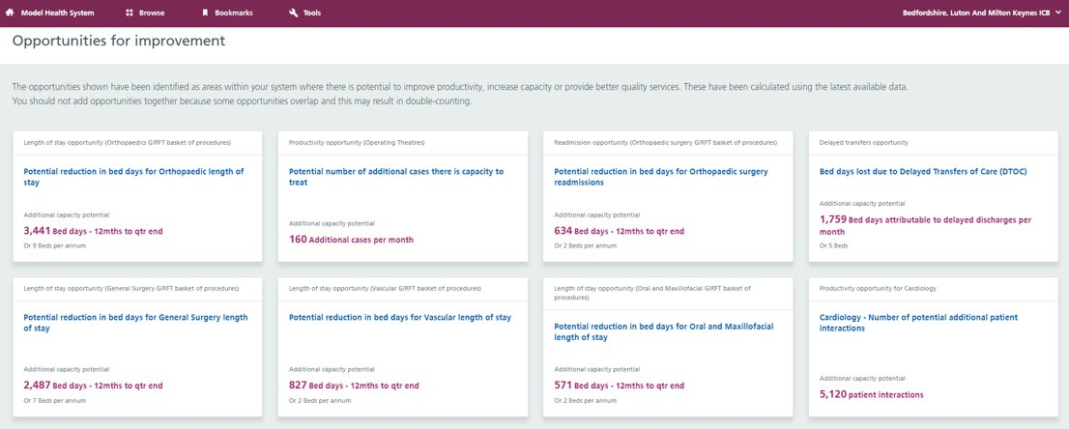
Opportunities for improvements
Helps users to identify opportunities for improvement locally
They are areas where you have the greatest potential to improve productivity, either by doing more for the same cost or reducing spend
They always use the latest available data
You should not add these opportunities together because some opportunities overlap which may result in double-counting
Notes:
Another key function of the MHS is that it identifies opportunities for improvement
Pulls together ops arising from the metrics on MHS
Gives systems or providers areas of interest they may want to look in to for where their opportunities may lie
Opps for improv are some of the areas where you have the greatest potential to improve productivity, either by doing more for the same cost or reducing spend.
you can then apply local information to these figures to understand why these areas are highlighted as an opportunity
They always use the latest available data.
To find your opportunities click on the browse button, top left of and then you’ll see the opps for improv tab just below it.

Slide 6
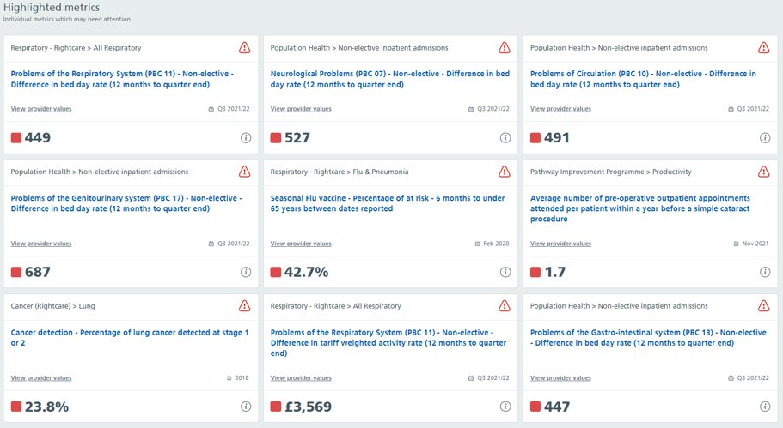
Highlighted metrics
Highlighted when a trust:
falls below a benchmark
is in the least desirable quartile
shows deterioration against previous performance
shows negative outlier performance against peer organisations
The highlighted metrics may warrant further investigation to determine whether there are any opportunities for improvement.
Notes:
You can also look at your highlighted metrics. Those with the warning triangle
MHS will go through various metrics and identify ones to alert you to
These are metrics where your system or trust is in the least desirable quartile or is not meeting a benchmark or standard.
The highlighted metrics may warrant further investigation to determine whether there are any opportunities for improvement.
To find your highlighted metrics click on the browse button, top left of and then you’ll see the tab just below it, next to the opps for improv one.

Slide 7
Supporting systems
Clinical improvement data, reflecting the GIRFT and NCIP programmes are all provided and routinely updated
Identifying opportunities to improve quality and productivity - are highlighted at system and provider level, in addition to highlighted metrics
Support collaboration across systems to help identify areas where there is potential to improve
Activity data, theatre productivity, diagnostics, workforce and medicines optimisation info are all provided
Data across acute, community, ambulance and mental health
Notes:
A I mentioned earlier, Model Hospital evolved in to the MHS in 2020 to support system wide working - the system provides clinical improvement data reflecting getting it right first time programme (GIRFT) and National Consultants information Programme (NCIP)
Opportunities for improvement and highlighted metrics are available at system levels
And we work closely with ICBS (integrated care boards) to collaborate at a system level
And all the data I mentioned before, theatre, workforce and different sector level data is available at the system level too.
You can easily switch your views between provider and system. When you’re logged in, at the top right of your screen you can switch from a provider to system view
Also when you are on a chart viewing a particular data set there is a toggle at the top which allows you to switch between system and provider views. We will show you how to do this in the live demo.

Slide 8
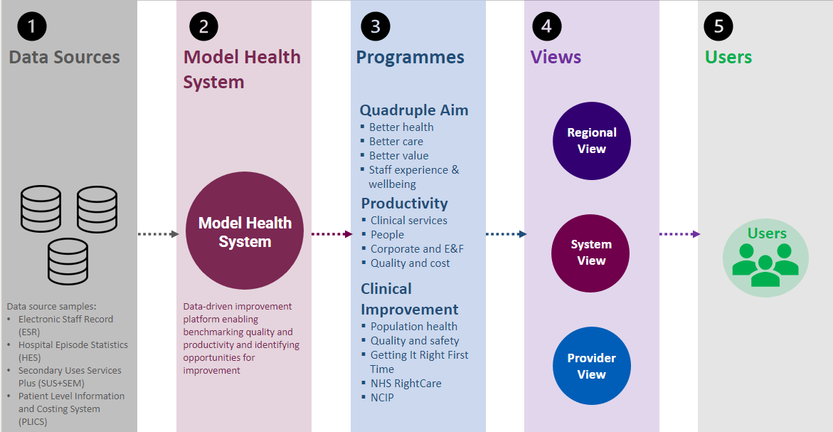
MHS data journey

Slide 9
User experiences
“We spotted we were an outlier in the Top 10 Medicines. Subsequently we developed an improvement plan to address this. We saw a real improvement in performance over the next few months. We are now one of the highest users of the Top 10 Medicines in the country and the benefits have been seen across our whole health economy.”
“The MHS showed me that I was holding more stock (medicines) than my peers. Through process changes I was able to release around £400,000 into the organisation.”
“As a trust we’ve used the MHS to set our variable cost improvement targets, based on the relative productivity of each of our departments and the known opportunities to improve this.”
“The MHS showed that our length of stay is ‘good’, though did highlight areas we could improve… we can pull the GIRFT metric, replicate it in our trust, find out which patients it’s affected…and then work out how to improve that pathway”
“The MHS showed that I was an outlier in relation to spend on IV paracetamol. Through scrutinization of the data and collaboration with clinical colleagues, I was able to seek assurance that we were using this drug clinically and therapeutically appropriately.”
“I was able to use the MHS to engage clinicians, consultant and nursing specialists. They were able to visualise the impact of a very complex change they had undertaken in relation to biosimilars. We were treating more patients more effectively in a more affordable way.”

Slide 10
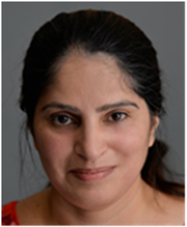
Hear from our Ambassadors
Benchmarking
Key improvement opportunities
“The Model Health System helps us to understand the power of benchmarking and helps us to see and understand what good looks like and where we sit against all relevant peers.“
“The real advantages of the Model Health System is that it provides our organisation with a clear understanding of variation, which is a guiding principle of our
waste reduction programme.”
Play
Play
Lee Lane
Head of Financial Improvement Mid Yorkshire Hospital
Bernard Pope Assistant Director Financial Improvement East Kent Hospitals University NHS Foundation Trust
High Volume Low Complexity data analysis
Benchmarking to drive improvements
“In terms of the High Volume, Low Complexity (HVLC) programme, we're starting to really get down to the kind of granular level of the data and start to analyse.”
“We can see which trusts are in the top quartile and reach out to those trusts to see what they are doing differently and how we can inform or improve our practice as well.”
Play
Adam Parsons Senior Project Manager Salisbury NHS Foundation Trust
Play
Razya Hussain Getting It Right First Time Project Manager Frimley Health NHS Foundation Trust​
https://future.nhs.uk/connect.ti/ModelHealthNetwork/view?objectId=38244144

Slide 11
Get involved
Register at model.nhs.uk
Model Ambassador network
Thriving network of expert users
Over 300 Model Ambassadors
At least two per trust
Support videos model.nhs.uk/videos
Knowledge Centre
knowledge.model.nhs.uk
Monthly webinar programme
Introductory session
Masterclasses
Bespoke sessions for your organisations
Drop-in sessions
Contact us help@model.nhs.uk
Twitter
@ModelNHS #modelhealthsystem
Engagement activities
Trust sessions/visits
Board Development days
Networking events/conferences
Regional workshops
Monthly newsletter
FutureNHS future.nhs.uk/ModelHealthNetwork

Slide 12
Demo of the Model Health System

Slide 13
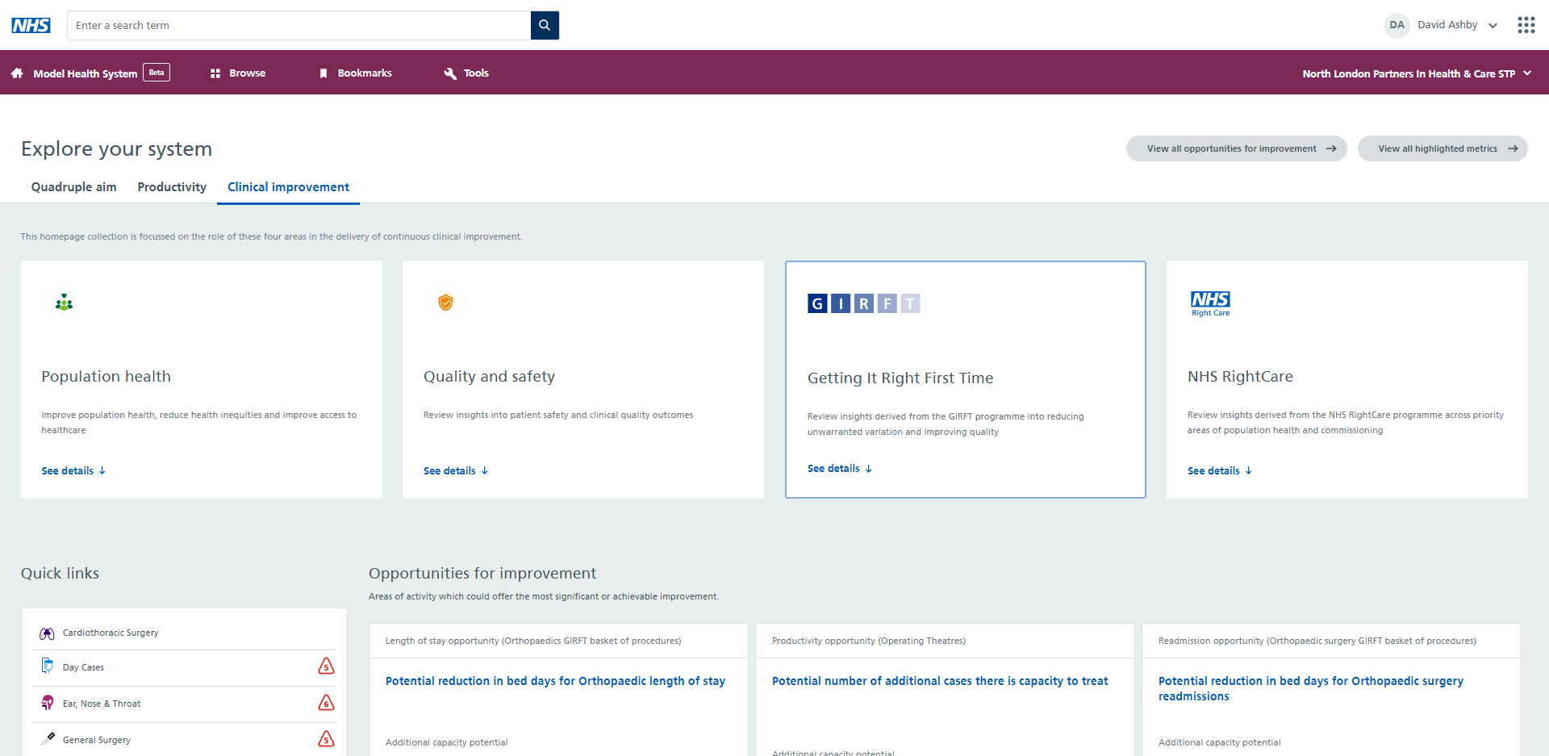
The homepage
Explore your system's:
Quadruple aims
Productivity
Clinical improvement

Slide 14
Opportunities for improvement
This gives you can overview of some of the opportunities for improvement
Taking a metric to achieve the upper quartile benchmarks in a particular area
We have used PLICS data to calculate some of the data in the Model health System.
Improvement savings include:
Bed days for BADS day case procedures
Length of stay by specialty
Emergency readmissions by specialty
Theatre productivity and utilisation
Opportunities for NHS Right Care (CCG/population based) methodology

Slide 15
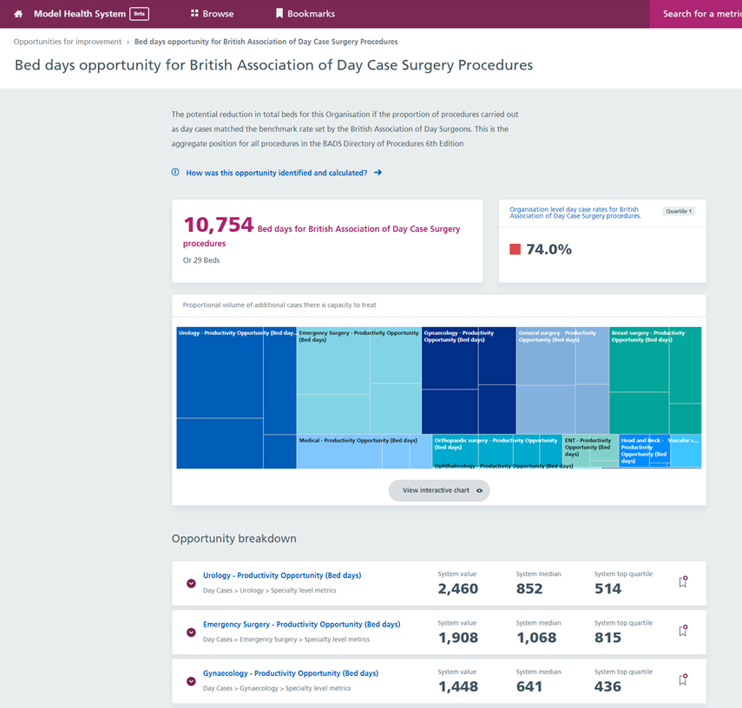
‘Opportunities for improvement’ to support your system across all specialties
Opportunities for improvement are presented at system level with a primary focus on identifying potential capacity gains rather than financial £m values

Slide 16
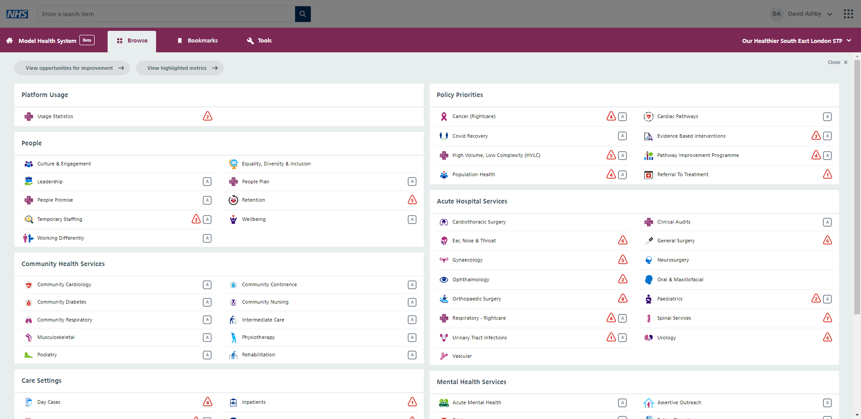
Use the Browse feature to find all your system's content
The Browse button provides an overview of everything in the system
Click into the compartments to view data (compartments are mapped depending on priorities)
Some of the compartments have a little red triangle - these show where you are a negative outlier
Symbols ‘A’ or ‘B’s are to say if this section is ‘Alpha’ or ‘Beta’ testing.

Slide 17
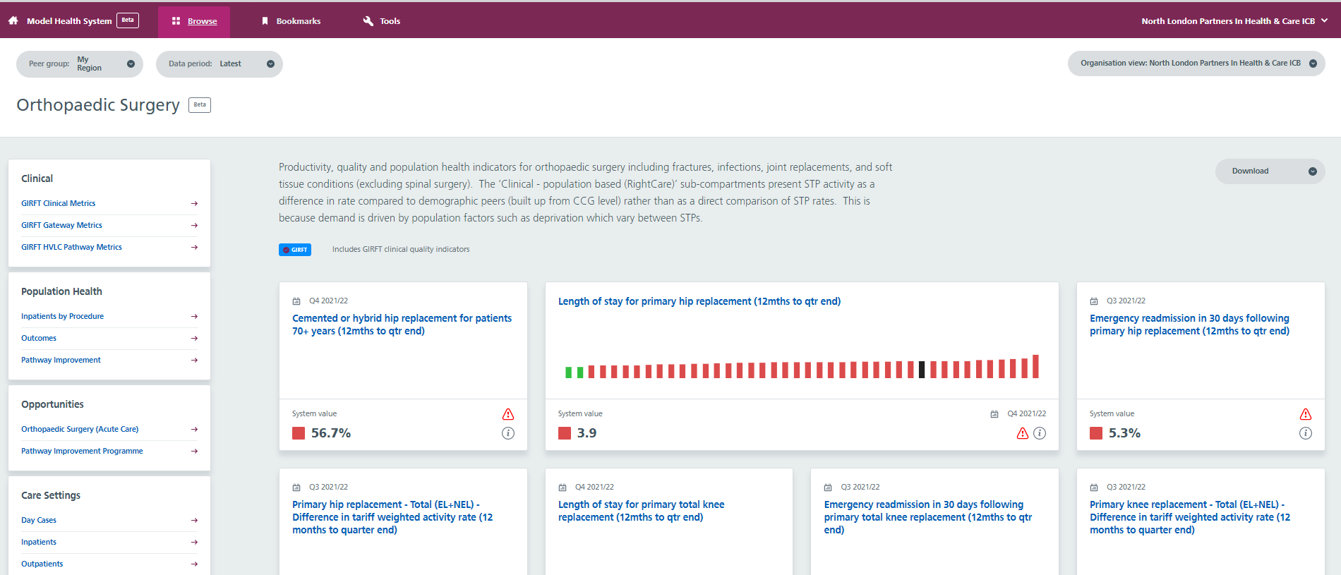
Individual compartments with a range of relevant metrics
Once you pick an area, in this case orthopaedic surgery you will see your key measures.
All the compartment pages are the same
On the left hand side there are different compartments you can click into
The middle section has tiles where SMEs or analysts have thought this data is interesting
For this example if we click on the productivity section it will take us to a sub compartment

Slide 18
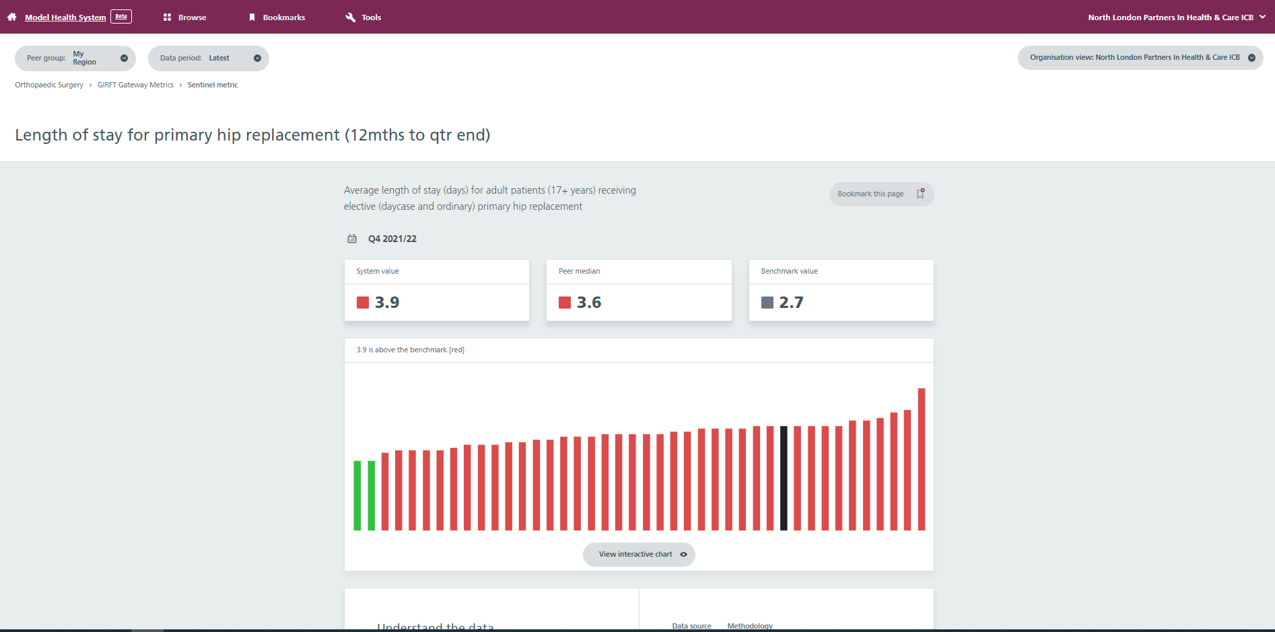
Each metric has its own page that provides benchmarking information, metadata on the data source and methodology, and help on interpreting the data

Slide 19
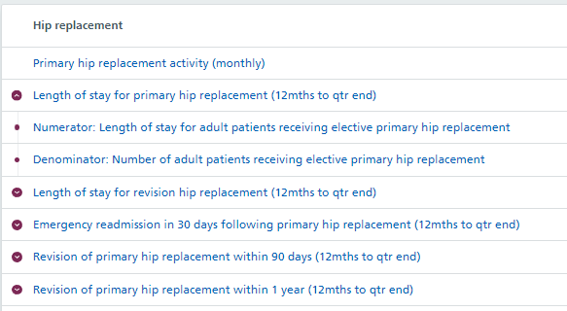
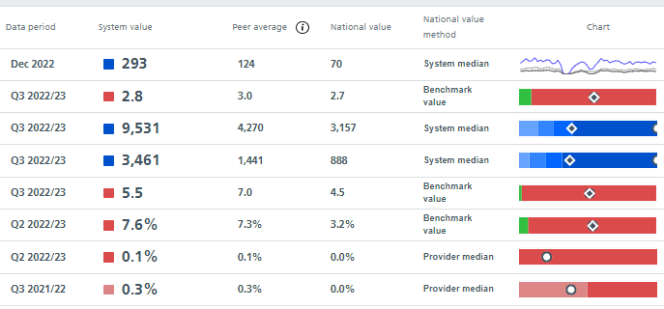
Scorecard view within each area – overview of metrics
System or provider value – RAG rated if appropriate
Metrics, organised by subsection eg outpatients. GIRFT metrics include time period eg 12mths to qtr end
Data period (ending)
Comparator values & method eg median or benchmark
Headline chart
Use arrow to see numerator and denominator values

Slide 20
Each metric also includes supporting metadata and methodology information
All the interactive charts also contain the metadata for all the different metrics
This helps you understand why the metric has been included ie it is associated to a policy
the methodology and data source let’s you know what has been included and excluded in case you want to replicate some of the data locally with more up to date information

Slide 21
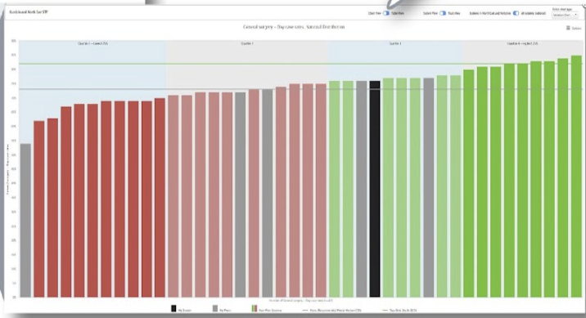
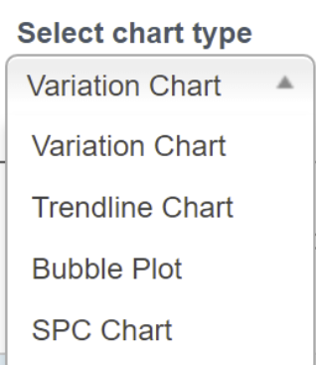
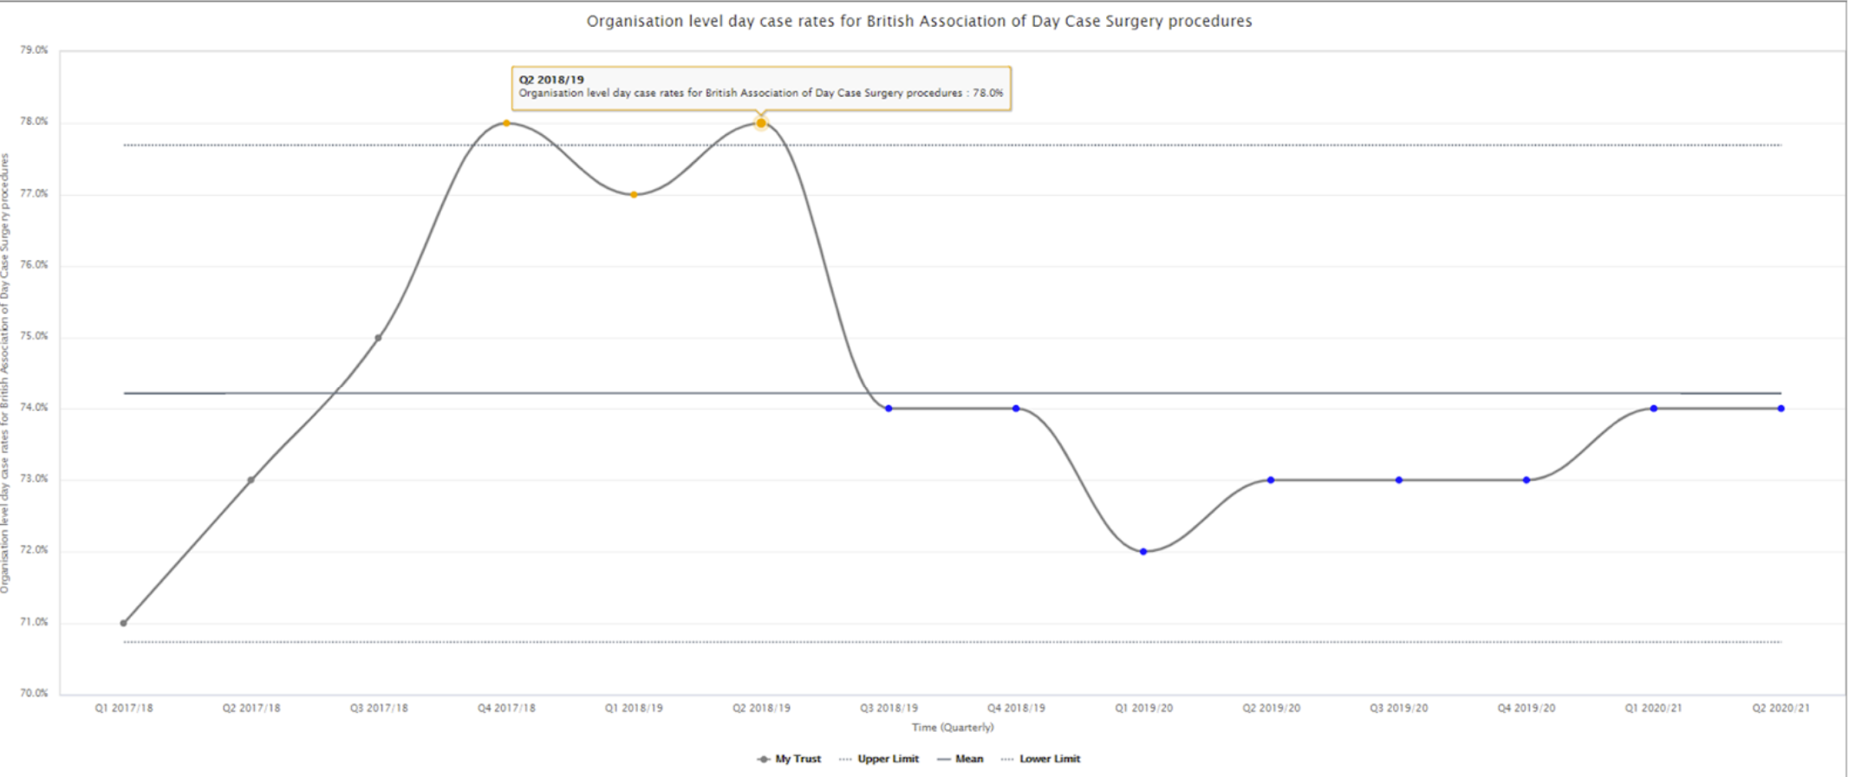
Select Charts and Export Data
When you are in the interactive chart you can select different chart types.
If there is trend data you can use a Trendline chart or SPC chart as below
Bubble or scatter chart will allow you to compare different metrics
View and export data tables

Slide 22
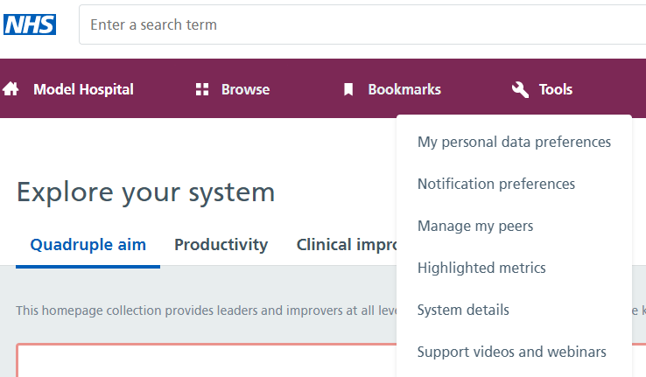
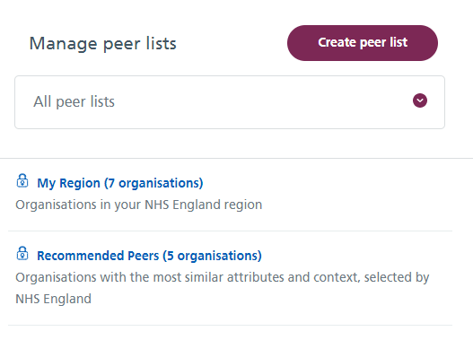
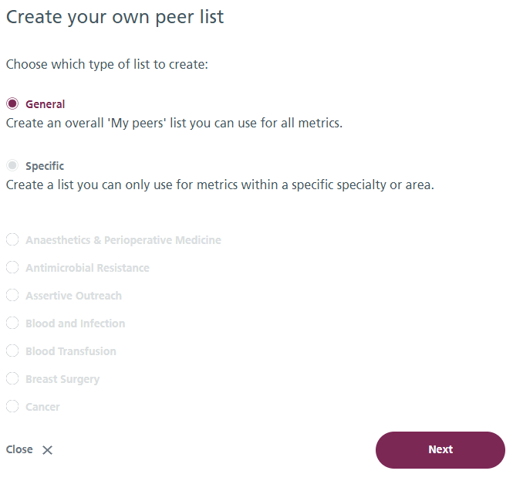
Manage your peers
The Tools button will give you an overview of your peer lists
These are recommended top 5 - 10 organisational and Regional peers
Recommend peers is a Model Health System algorithm looking at characteristics of an organisation or system such as demographics and case mix
You can also select ‘create peer list’ - a general or more specialised peer list

